Slide 1
Building Consistency
How to Create a Habit

Slide 2
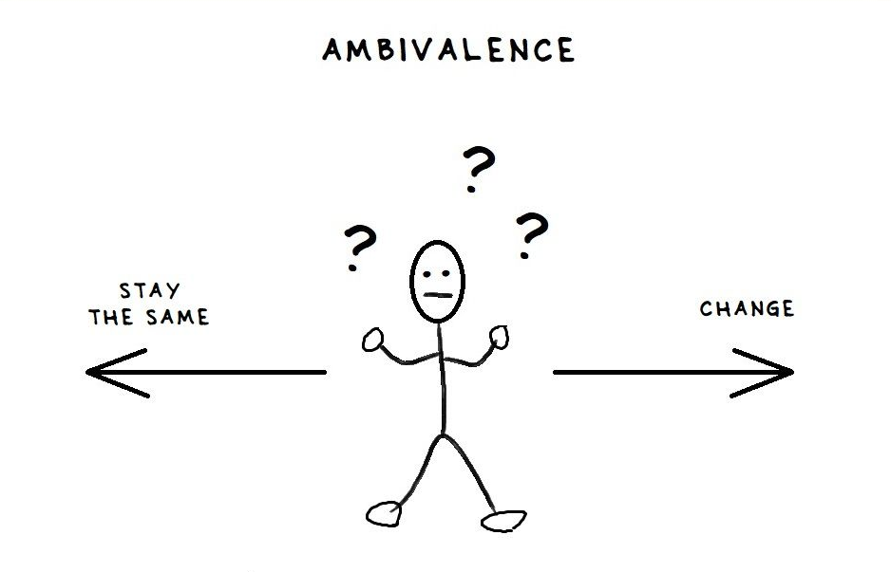

Slide 3
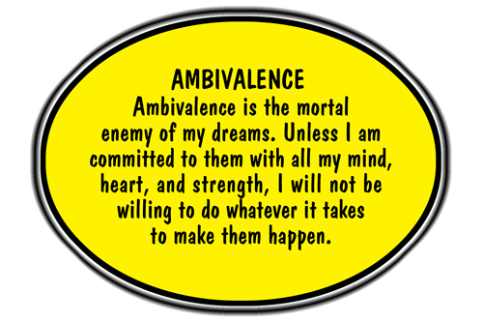

Slide 4
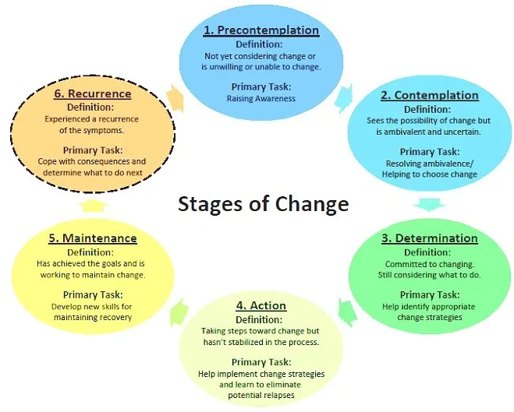
Stages of Change
Pre-contemplation
Contemplation
Preparation
Action
Maintenance
Relapse

Slide 5
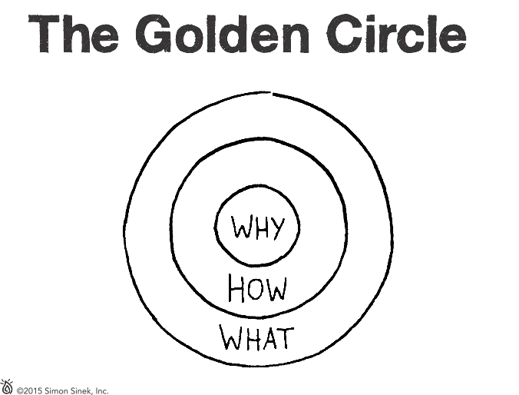
Relevant

Slide 7
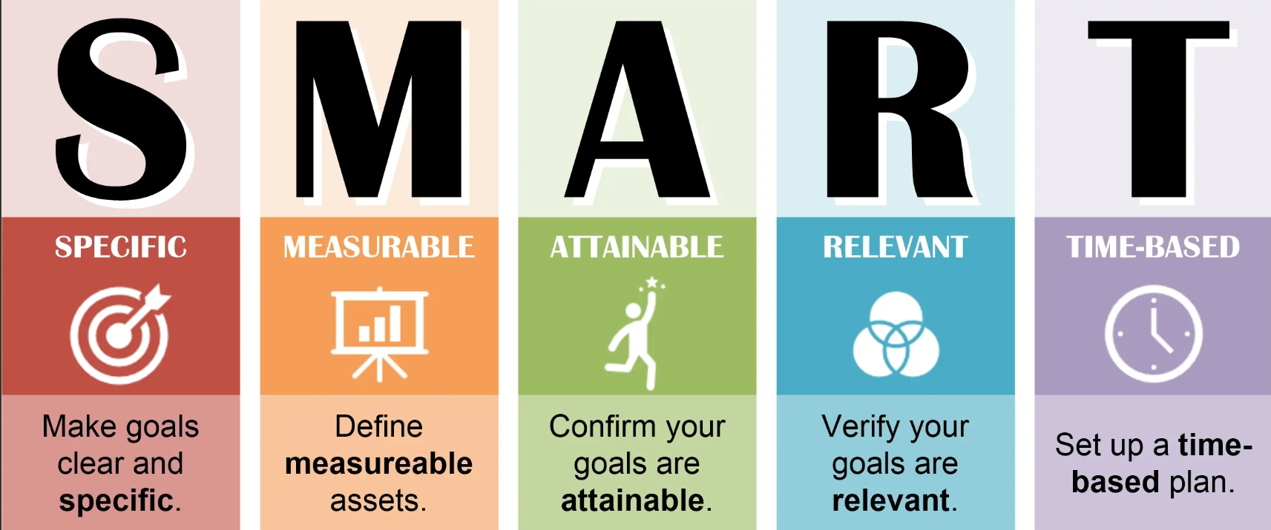
Preparation
You’ve decided to make a change, but you aren’t sure how to implement it.

Slide 8
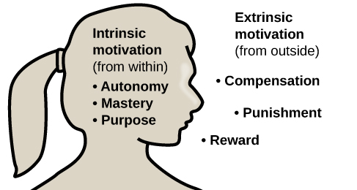
Key Points
Set a goal which aligns with your values
Intrinsically motivated
A goal which excites you
Motivation follows action
Establish a process which:
Is measurable, realistic and timely
Does not conflict with your core values
Consistency

Slide 9
Tips and tricks
Let’s go streaking!
Small, daily tasks
Record, track, visualize
Tracking will also help you reflect on why you did/didn’t follow through
Find a friend
Accountability partner, class, training – any sort of scheduled appt with another person will work
Habit stacking
Pair your new, desired habit with an already established one.
Give yourself grace
Don’t worry if you miss a day, or don’t fully complete the task as described.
https://pmc.ncbi.nlm.nih.gov/articles/PMC3505409/
Excellent resource!

Slide 10
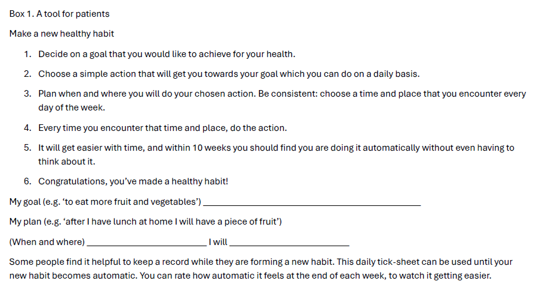

Slide 11
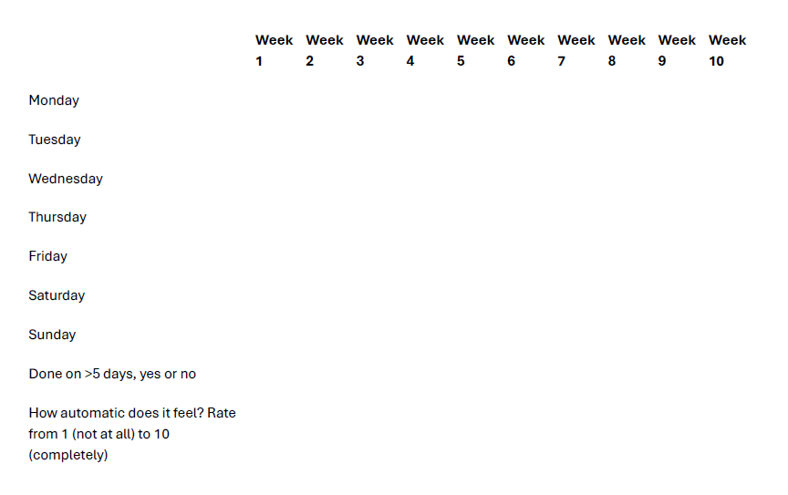

Slide 12
Questions or Comments?
Email me: joanna.ford@esso.ca
Looking for more targeted guidance?
Health Coaching (behaviour change)
Free consult. $250 -10 week package.
Personal Training
Free consult. Various packages.

