Slide 1
Intro to Hiking
Everything you need to know to get started

Slide 2
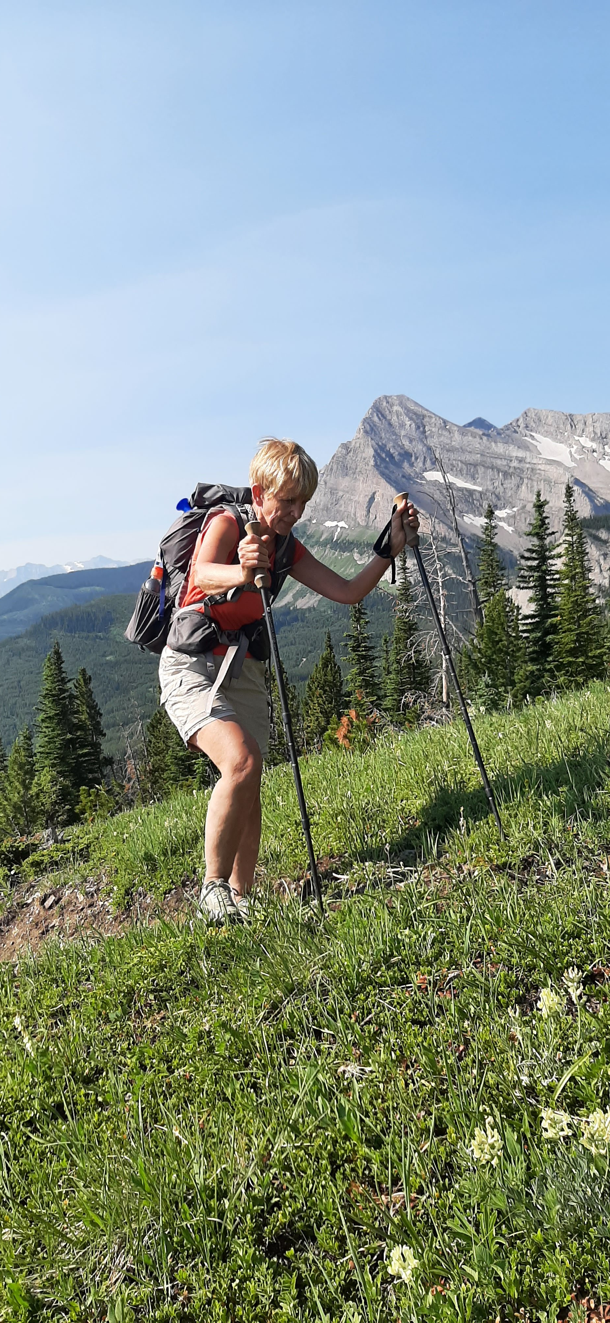
Overview
The Gear
Where To Go
The Fitness
Navigation
Wildlife
Weather

Slide 3
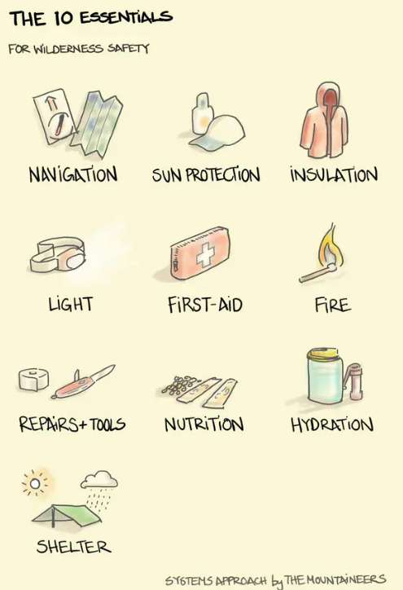
The Gear
Nutrition Basics
Easily accessible
Lightweight
Salty foods if hiking for more than a few hours.
Carbs – very often people think they are unfit, when really they are underfueled.
GORP – Good Old Raisins and Peanuts
Bars
Sandwiches
Avoid “sugar-free”
Frequent snacking

Slide 4
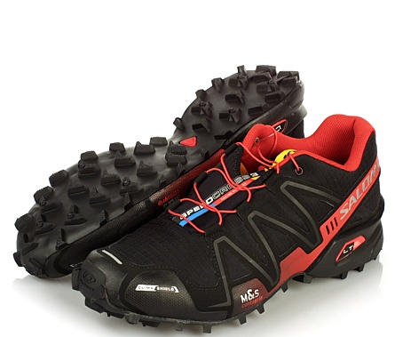
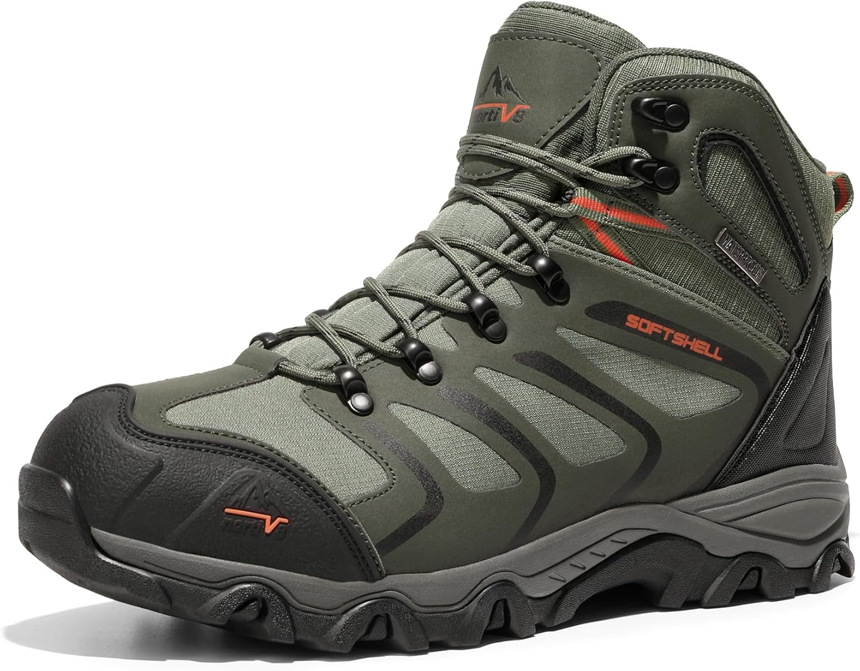
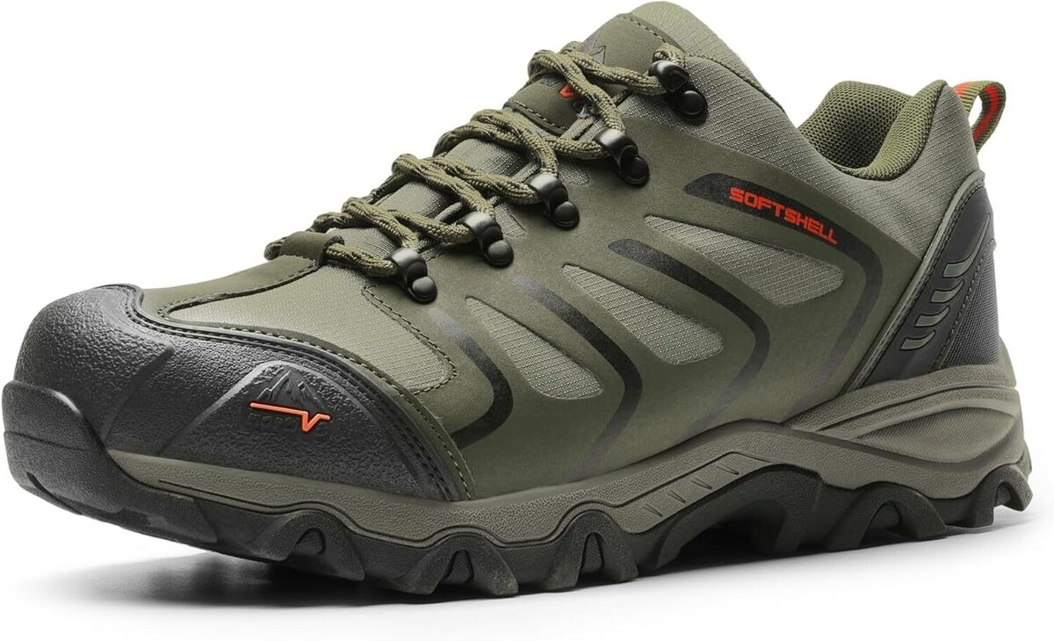
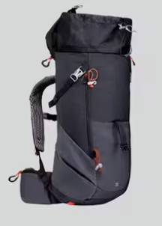
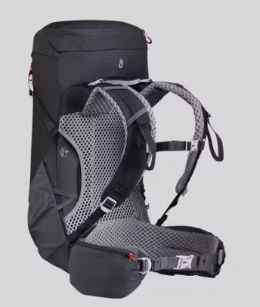
The Gear
Shoes
Comfortable
Lugs
No holes
Pack
Chest Straps
Front Access
Compressible
15-25L
Pole carrying capacity

Slide 5
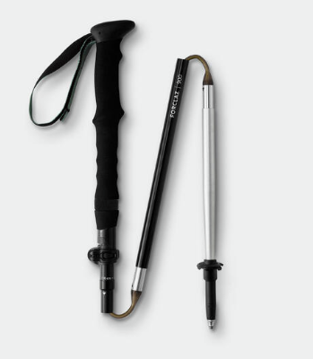
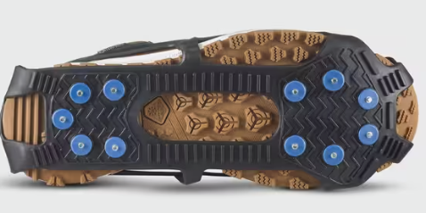
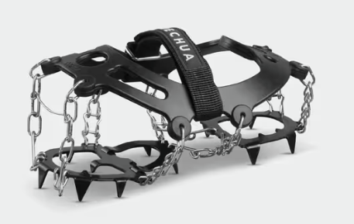
The Gear
Poles
Collapsible
Folding are lighter
Traction
Always bring unless you’re certain you won’t need it
Clothing
Insulative layer (ie long sleeve merino)
Emergency Rain Layer (ie garbage bag/emergency poncho)
Wind Layer (lightweight jacket)
Head Covering (can be a buff)
Extra gloves/mitts (can be extra socks)

Slide 6
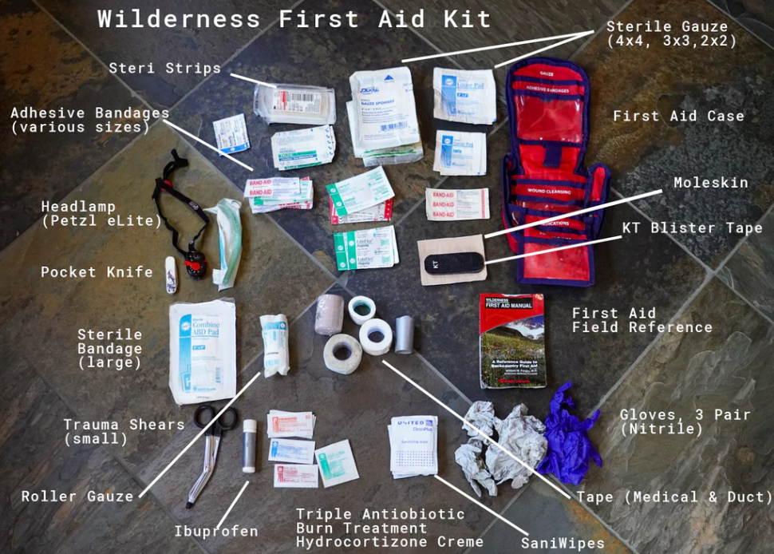
The Gear
First Aid
Bandages/wraps
Antihistamine and pain killers
Tweezers
Scissors/Multi-tool/Knife
Safety pins
Space blanket
Lighter wrapped in duct tape. Fire starter.
Communication Device
Zoleo, Garmin In-Reach, or similar
Phone
Whistle

Slide 7
Where to Go
Check official trail status first:
Alberta Parks
Banff National Park
Download offline maps:
Strava
Pay for offline downloads ($100/yr)
Caltopo
Free version has limited offline use. Paid version starts at $20 USD/yr
All Trails – aka All Fails
Pay for offline downloads ($36/yr)
Gaia GPS
Pay for offline downloads ($60/yr)

Slide 9
Where to Go – Easy, Early Season
Area | Trail Name | Distance (return) | Elevation Gain | Notes
Bragg Creek | Fullerton Loop | 6.5km | 220m | Good signage. Dogs permitted off-leash outside of parking lot. Good views and dry trail along the ridge. Ice flow and/or mud in the forest.
Canmore | Jura Creek | 3-7km | 170m | Not much signage, but an obvious route in a slot canyon. If you choose the canyon route, wear trail runners instead of boots as your feet will get wet. Early season, bring spikes. Dogs permitted off-leash outside of parking lot.
Canmore | Grassi Lakes | 3.5km | 170m | Good signage. Two trails – interpretive or upper. Interpretive trail has large stone steps and is hazardous when icy.
Banff | Lake Minnewanka/ Stewart Canyon | 1km-16km | 0-300m | Good signage. Trail is usually dry. Check trail report for bear restrictions. Turn around at Aylmer Junction (or sooner).
Kananaskis South | Mesa Butte | 4.4km | 300m | Primitive signage, but well-defined trail. Great views and a picnic table up top.

Slide 10
Where to Go – Moderate, Early Season
Area | Trail Name | Distance (return) | Elevation Gain | Notes
Bragg Creek | Prairie Mountain | 8km | 700m | Good signage. Dogs permitted off-leash outside of parking lot. Good views. Can be very muddy early season.
Kananaskis North | Prairie View Lookout | 12.5km | 500m | Good signage. Parking can be an issue. Small scramble to get to upper lookout. Dogs on-leash only.
Canmore | Yamnuska Easy Ridge/ Raven’s End | 7.2km | 500m | Good Signage. Dogs on-leash only. Trail is a scramble beyond the chimney, turn around and return the way you came. Very good views. Vehicle break-ins common.
Banff | Sulphur Mountain | 11km | 700m | Good signage. Could be muddy or icy. Parking can be an issue. Dogs on-leash only.
Kananaskis South | Mount Hoffmann | 9km | 500m | Road opens May 15th. Can be muddy. Awesome views. Not sure about signage as trail was renovated last year. Dogs on-leash only.

Slide 11
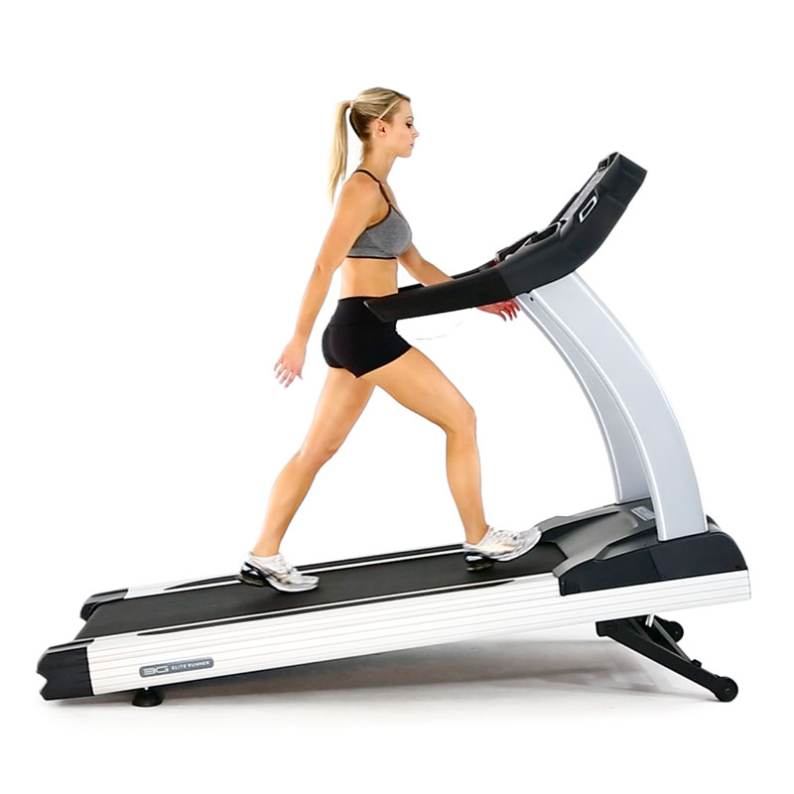
The Fitness
Staple Exercises
Incline Walk
3x/wk, 20min, 15% incline, no hands
Step Ups
2-3x/wk, 3x 10 reps
Calf Raises
2-3x/wk, 2-3x 10-20 reps
Single-leg Balance
2x 20s/leg. Can be done daily
Tricep Extensions (if using poles)
2-3x/wk, 3x 10 reps

Slide 12
Navigation
“Look Back”
Take photos for orientation
Bring paper map and compass if you know how to use it.
Foothills Orienteering
Notice your surroundings
South-facing slopes will be dry and dusty
North-facing slopes are often moist and mossy.

Slide 13
Wildlife
Check trail advisories.
Bring bear spray and know how to use it.
Make noise. The human voice is a much more effective deterrent than bear bells or Bluetooth speakers (also much less annoying).
Walk, don’t run.
Look for ticks. Wear a hat. Tuck pants into socks. Avoid sitting down.

Slide 14
Weather
Mountains and lakes create micro-climates. Check webcams and use websites for local weather.
Mountain-Forecast
Gives weather forecast at specific altitudes for named peaks
Spotwx
Gives weather forecast for specific location (only one altitude).
511 Webcams

Slide 15
Questions???
Email joanna.ford@esso.ca
Getting ready for something specific? I’m available for coaching ($70/month) or personal training.

