Slide 1
Health Coaching
Motivational Interviewing to Facilitate Behaviour Change

Slide 2
Definitions
Health Coaching
“National Board Certified Health & Wellness Coaches (NBC-HWC) support clients in activating internal strengths and external resources to make sustainable and healthy lifestyle behavior changes. NBC-HWCs use a client-centered approach wherein clients decide their goals, engage in self-discovery or active learning processes, and self-monitor behaviors to increase accountability, all within the context of an interpersonal relationship with a health coach.” (https://nbhwc.org/what-is-a-health-coach/)
Motivational Interviewing
“a client-centered yet directive approach for facilitating change by helping people to resolve ambivalence and find intrinsic reasons for making needed behavior change. Rather than advocating for and suggesting methods for change, this approach seeks to elicit the client’s own goals, values, and motivation for change and to negotiate appropriate methods for achieving it.” (https://dictionary.apa.org/motivational-interviewing)
Behaviour Change
Examples could include: smoking cessation, stress management, physical activity, nutritional interventions, sleep hygiene etc.

Slide 3
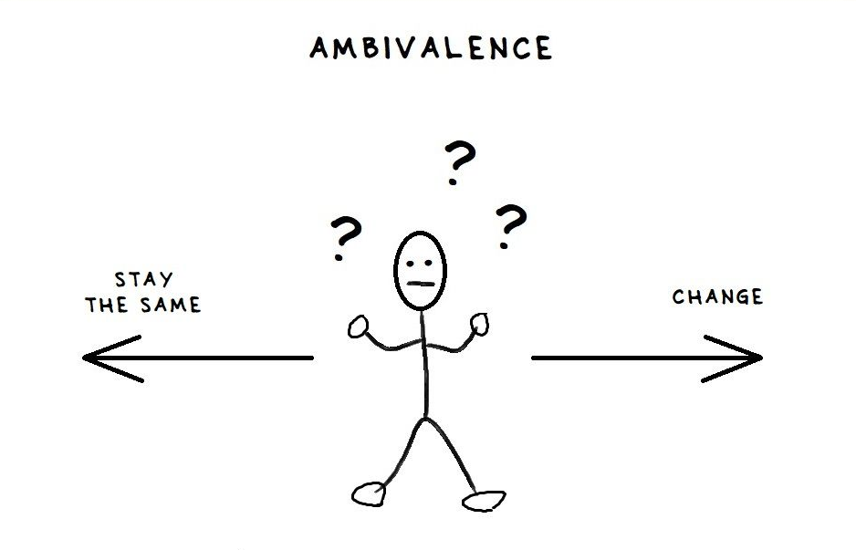

Slide 4
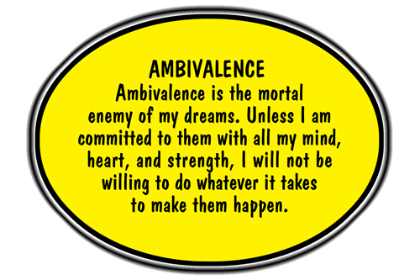

Slide 5
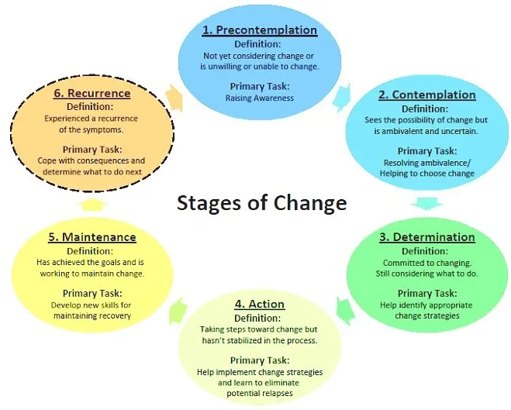
Stages of Change
Pre-contemplation
Contemplation
Preparation
Action
Maintenance
Relapse

Slide 6
Pre-contemplation
Not thinking about changing
Defending the status quo
Role for the health coach:
Create awareness
Ask “evoking” questions
Illicit change talk

Slide 7
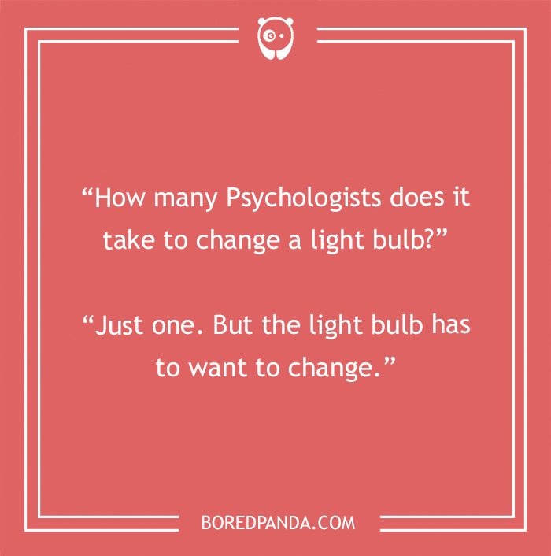
Contemplation
Weighing pros and cons
Ambivalence
Role for the health coach:
Motivational Interviewing using OARS questions

Slide 9
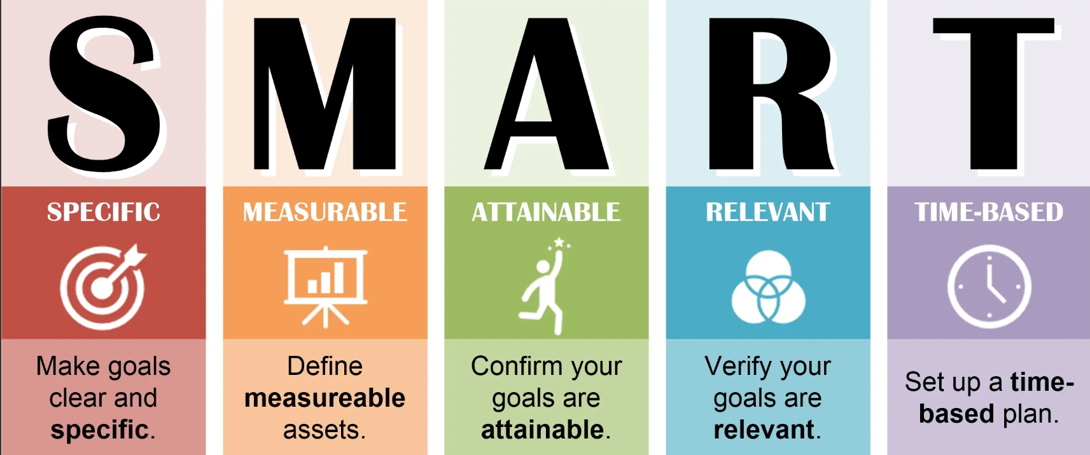
Preparation
You’ve decided to make a change, but aren’t sure how to implement it.
Role for the health coach:
Assist in planning using SMART goals

Slide 11
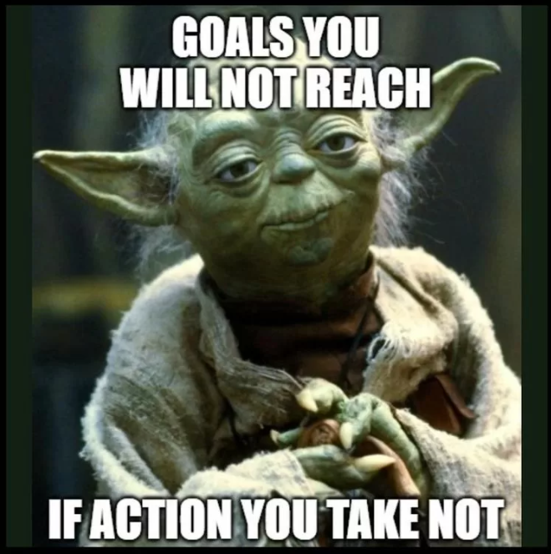
Action
Implementation of SMART goals
Work towards maintenance of change
Prevent relapse
Role of the health coach:
Identification of barriers
Development of strategies to overcome barrier
Celebration of small victories

Slide 12
Maintenance
Implementation of behaviour change for 6 months +
Primary goal is prevention of relapse
May consider working towards another behaviour change
Role of the Health Coach:
Accountability
Celebration of achievement
Exploration or new goals

Slide 13
Relapse
Revert back to an earlier stage of change
Can happen at any stage of change
Normal and expected aspect of behaviour change
Role of the Health Coach:
Ask questions to establish the client’s current new stage
Use OARS questions and MI to identify strategies for behaviour change

Slide 14
Health Coaching – what does it look like?
Initial consult and intake forms
30min conversation
Establish stage of change
Intake forms
Food log
Lifestyle questionnaire
Health questionnaire
Contract
Confidentiality
Payment terms

Slide 15
Follow Up
1-2 weeks after initial consult
45min session
Review intake sheets
Use MI techniques to discover strategies for implementing behaviour change
Develop action plan for implementing change
SMART goals
Accountability

Slide 16
Session 3
2 weeks after goal setting session
30min session
Assess implementation of action plan
Celebrate success
Trouble-shoot barriers to change
Make adjustments to action plan as needed
Schedule next follow up for 2-4 weeks

Slide 17
Cost – Introductory pricing
Available end of September
3 clients for free ($50 deposit)
3 session commitment over 2 months
$250 - 5 session package
3 month expiry
Questions/Inquiries
Joanna.ford@esso.ca

