Slide 1


WORKPLACE
WELLNESS

Slide 2


Cody Gramlich
Notes:
Practicing physiotherapist for 5 years. Completed physiotherapy Master’s at University of Alberta. Have additional training in acupuncture, dry needling and end stage rehab.
Spent first 2 years treating at a spine specialty clinic in NW Calgary. Treating at Peak Elbow location for 3 years.
Clinic Director at Peak Elbow location for 1.5 years

Slide 3

Dr. Brianne Horne
Notes:
Bachelor of science from Oakland University in Michigan. Doctorate degree from the Canadian Memorial Chiropractic College.
Additional training in integrated dry needling technique and spinal stenosis bootcamp.

Slide 4
Agenda for Today:
Introduction to Peak Health & Performance
Common Workplace Injuries/Conditions
Ergonomic Desk Setup
Workplace Exercise Options
Q & A
Notes:
BRIANNE

Slide 5
Peak Health & Performance
Experience Lasting Results in Fewer Appointments
Notes:
CODY
A little background on Peak: Peak Health and Performance is a multidisciplinary health clinic that offers chiropractic, physiotherapy, and massage services. We have a team of over 25 chiros and physios, 5 highly skilled registered massage therapists, and more than 15 amazing front desk staff to help keep operations running smoothly and our patients in great hands! Peak Health has been operating for over 10 years, with the original location just across Elbow drive in Britannia. We opened our second location in 2020 in Marda loop, and expanded operations in 2021 just off Macleod trail with a 3rd location, Peak Kids. We are also excited to announce a 4th location in Oakridge anticipated to open in April 2024.
We see a variety of patient populations across all ages, including workplace injuries, motor vehicle accident patients, athletes, and everything in between.
*CODY TO CONSOLIDATE SLIDES 5-9

Slide 6
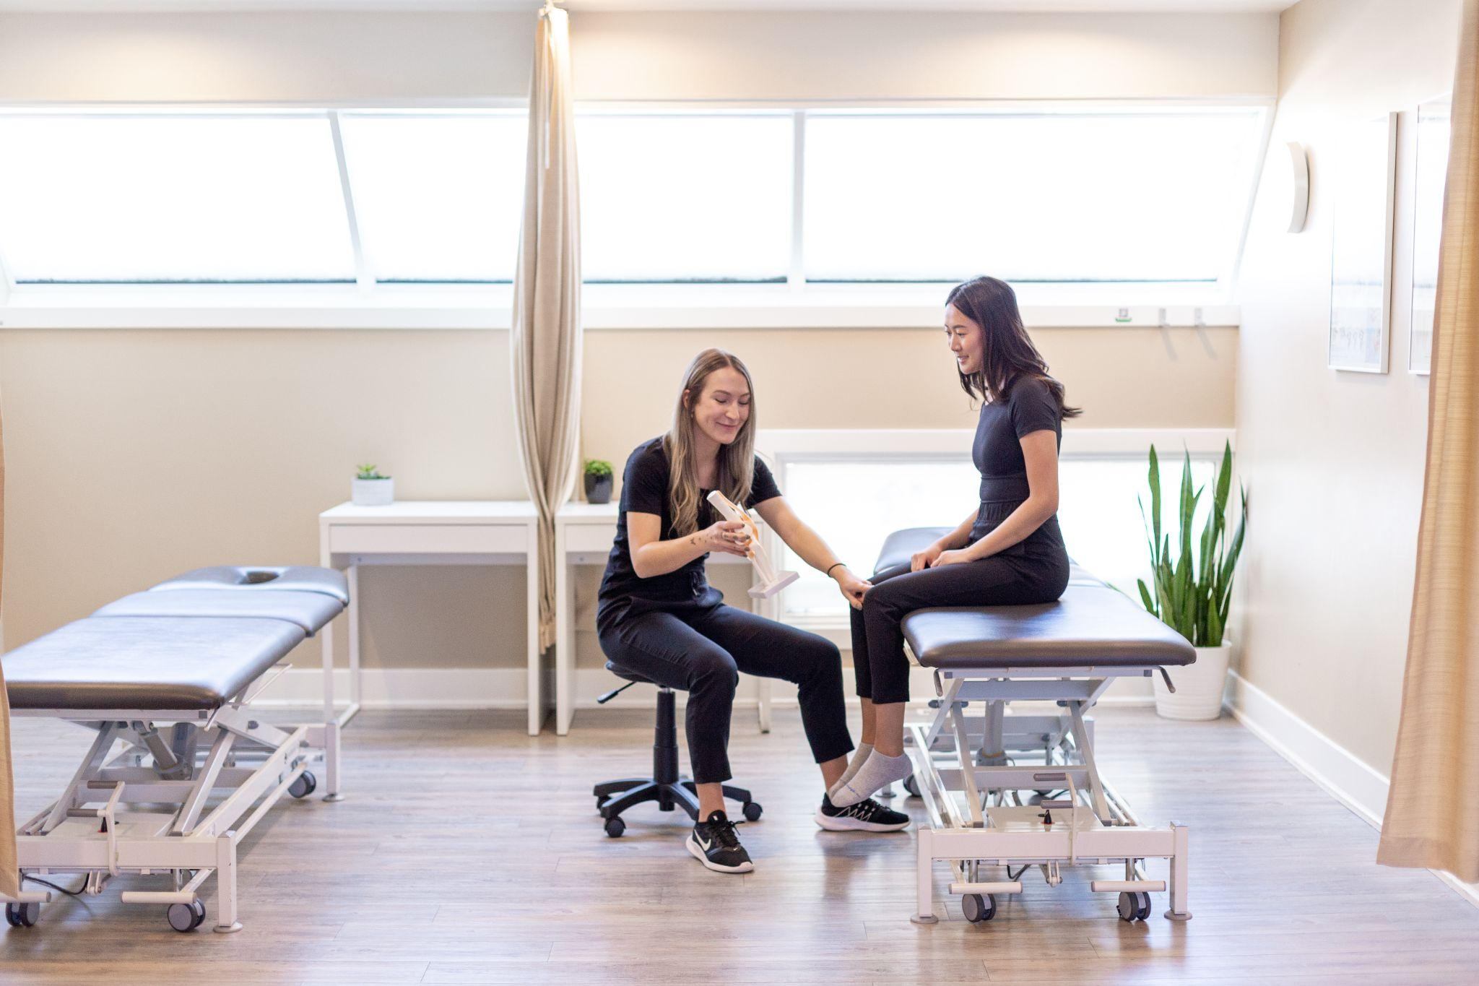

Notes:
Peak Elbow is our original location and offers a wide range of services including orthopedic assessment and treatment, concussion testing and management, pelvic floor physiotherapy, custom bracing and orthotic fitting, run assessments and gait analysis, osteoarthritis management through Peak Arthritis, and pilates based physiotherapy. Massage therapy is currently offered exclusively at our Elbow location.

Slide 7
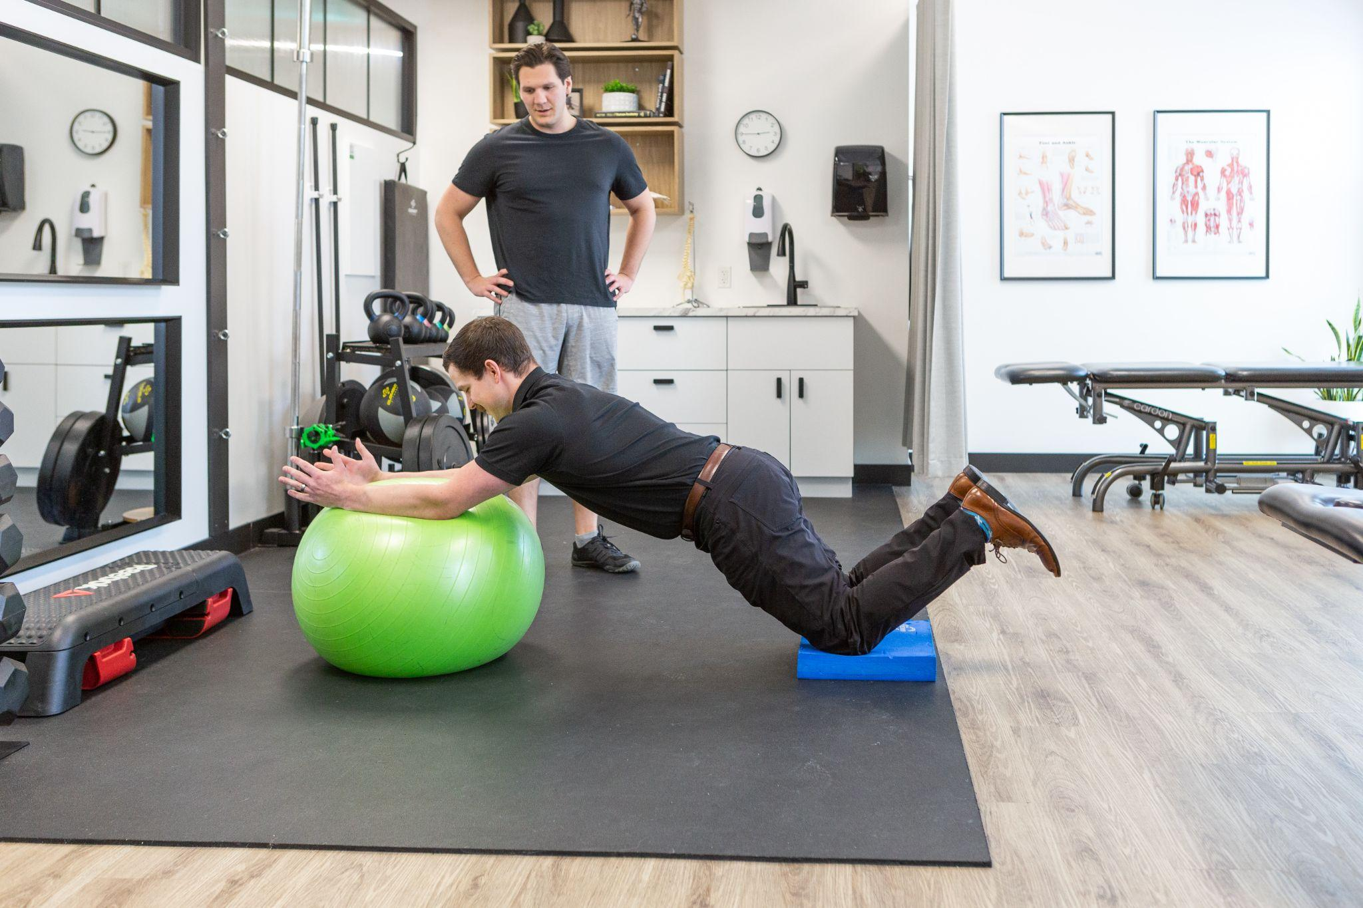

Notes:
Peak Marda offers physiotherapy, chiropractic, dry needling, and other treatment modalities such as ART, acupuncture, shockwave therapy, and graston. Marda also performs custom knee bracing, custom orthotics, exercise based rehab, as well as hand therapy and vestibular therapy.

Slide 8
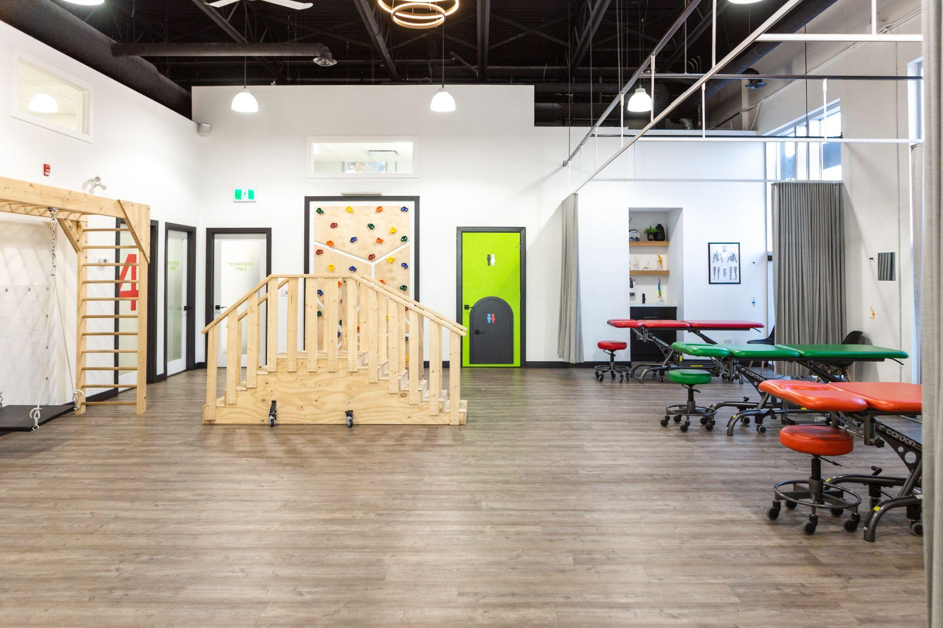

Notes:
Our Peak Kids location is geared towards the pediatric population, however we see patients of ALL ages there. We also see children with developmental disabilities funded through FSCD, Dynamic Movement Intervention for developmental delays, as well as scoliosis management. Pelvic floor physio (for males, females, and children) and vestibular rehab are offered out of this location as well.

Slide 9


Notes:
Personal passion as will be opening this location in partnership with my wife and the owners of Peak Health, Kate and Evan Durnin
Peak OakBay is anticipated to open April 2024.
Goal to have a collaborative space that integrates service such as chiro, PT, massage, and potentially even medical doctors and sport medicine
Rehab focussed space with large gym
Pelvic benchmark in Calgary to offer prenatal group programs, pessary fittings, and pelvic health for all genders/ages

Slide 10

Common Workplace Injuries/Conditions
Notes:
BRIANNE

Slide 11

Mechanical Neck Pain
Symptoms:
Sore neck
Stiffness into muscles
Referral into upper back and arms
Reduced range of motion
Headaches
Notes:
Mechanical neck pain is an overarching term to describe pain that is coming from the neck. This can be a result of an irritation of dysfunction of the joints of the neck, the muscles of the neck or a combination of the two. These dysfunctions can be the related to stiff joints, weka muscles and/or poor/sustained postures.
Symptoms of neck pain include sore/stiff neck, tension into the muscles surrounding, referral or radiation into the upper back or neck, reduced range of motion and/or headache.
Stiffness or soreness into the neck after a long day at work can be common if it resolves by the next day. Those persistent symptoms are something that manual care (physio, chiro or massage) can help with.

Slide 12
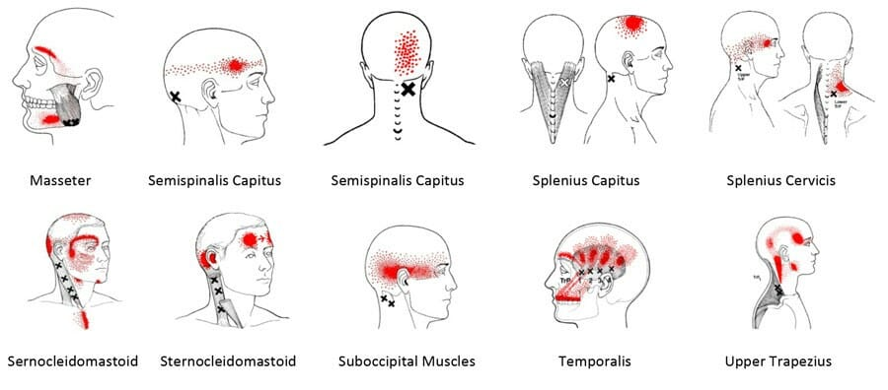
Headaches
Symptoms:
Pressure or tension in the head
Back of the head, in the temples, a band-like referral across the forehead or behind the eye
Can be accompanied by symptoms such as: dizziness, fatigue and nausea.
Notes:
Headaches can come from a variety of reasons. The main headaches that we see in clinic are those that result from poor posture, which causes a build up of tension into the muscles of or neck and upper back. Our heads weigh about 10lbs, so any sway from a neutral head position, puts a lot of pressure onto the muscles which puts them at risk of being overworked. As seen from this photograph, those overworked muscles can cause referral patterns into the head.
Symptoms of these headaches include pressure or tension into the head, symptoms into the back of the head, temples, band-like referral across the forehead and behind the eye. These symptoms can also be accompanied by dizziness, fatigue and nausea.
It is important to keep our desk setup in a way that we can keep the head centred over the body, reducing the load on any particular muscles and distributing it.

Slide 13
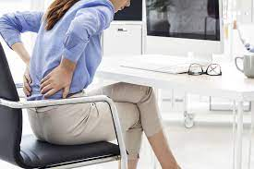
Low Back Pain
Symptoms
Pain, ache, stiffness into lower back
Pain radiating into the buttock
Pain increasing with postural changes
Notes:
Mechanical low back pain is an overarching term to describe Ian between the bottom of the ribs to the top of the hips. There are several pain generating structures within this area including the discs, ligaments, muscles and the joints themselves.
Symptoms of low back pain include achiness/stiffness into the lower back, pain radiating down into the buttock region and pain increasing with changes in position/postures.
We see often, is low back pain from sitting - which results from being in the same position for extended periods of time, uninterrupted. When in a slouched position for prolonged periods, the ligaments of the lower back become the main stabilizers, causing them to be stretched. When this happens, the discs and joints are not in the optimal position for stability, putting a lot of strain on the structures surrounding them.
As we will talk about later, movement, in most cases, is the best posture. Studies have shown that disc strain can be mitigated by moving or chaining positions every 30 minutes.
*Refer to blog on Mechanical Low Back Pain

Slide 14
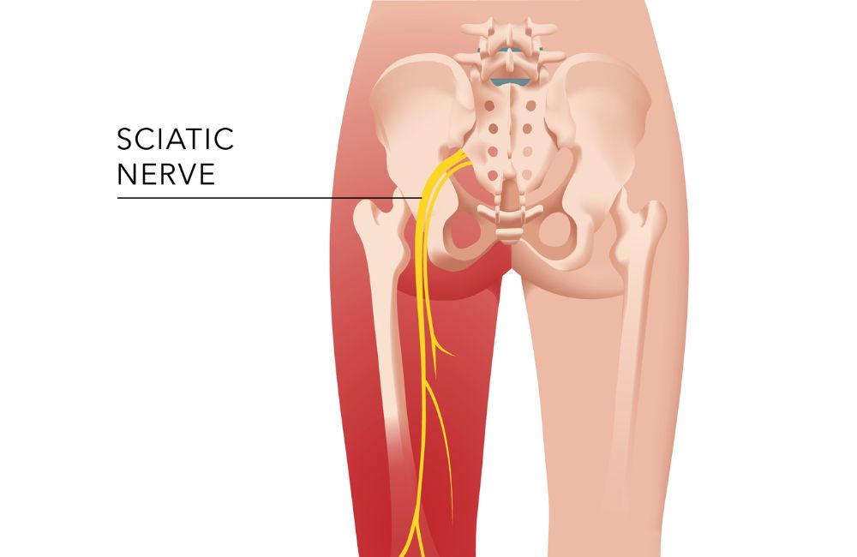
Sciatica
Symptoms
Pain in the lower back and buttock
Radiation (spread) to the back of your thigh
Pain that extends from your glutes to your foot
Numbness/Tingling or Weakness
Notes:
The term sciatica comes from the nerve, the sciatic nerve, and the symptoms that contribute to a disruption or compression of this nerve. This nerve runs from our low backs, through our glutes, down the back of the thigh, ending up in the feet. These symptoms include pain into the lower back and buttock, pain radiation from the back to the thigh, pain down the entire leg into the foot and numbness/tingling or weakness.
These symptoms can be caused by sitting for extended periods of time. When we are sitting in potentially non-optimal ways, we can be putting excessive compression/pressure through the glutes, especially a muscle called the piriformis.
If we can optimize our seated posture, by sitting on our “sit bones”, with feet flat on the floor or stool, our seat pan 1-2 inches away from our knees, we can mitigate the compression on this nerve and reduce the symptoms associated with it.

Slide 15
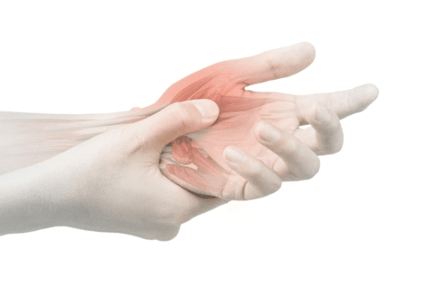
Carpal Tunnel
CAUSES
Repetitive small movements
Frequent or repetitive grasping movements
Family history
Joint or bone disease
SYMPTOMS
Numbness
Tingling
Pain
Weakness
Burning
Notes:
CODY
Carpal tunnel syndrome occurs when the median nerve or neurovascular structures are compressed as they pass through the carpal tunnel. This is a tunnel in your wrist formed by bones and ligaments.
Common symptoms and things to watch out for:
weakness when gripping objects: like a pen, coffee cup
pain or numbness in the hands (can radiate into forearms)
a pins and needles sensation - like your hand is falling asleep - this is very common at night - people wake up and have to shake out hands
a swollen feeling in the fingers
burning or tingling: especially in the 1st 3 fingers
One of the main factors that contributes to the development if carpal tunnel syndrome is repetitive small movements with the hands: like typing, using a mouse or keyboard
for this reason your keyboard and wrist set up if very important.
while working @ your desk keep your hands and wrists in line with you forearms. Your elbows should sit at about 90 deg. Your wrist should not bend to tilt your hand up or out to the side - this setup may come from adjusting desk or chair height or using a keyboard pad for your wrists

Slide 16

Tennis Elbow
SYMPTOMS
Pain and tenderness on the outside of the elbow
Burning sensation
Grip strength weakness
Pain going down the forearm
Notes:
Not just caused by playing tennis - this is a repetitive strain injury that occurs on the outer portion of your elbow and can be caused by repetitive combined wrist and forearm movements or gripping activities, like using a mouse or a keyboard. Although we don’t think of using a mouse as a strenuous activity, repeated use over time, day in and day out, can cause your forearm muscles to fatigue, resulting in the contraction of the muscles. this reduces blood supply and cause pain on the outer portion of the elbow. If not treated quickly this can also result in pain down the forearm and into the wrist and hand.
To reduce strain on your forearm muscles:
maintain 90 degree ankle
keep shoulder relaxed
As a preventative measure at home:
strengthen your wrist and forearm muscles
Often tendon and muscle issues (especially a repetitive strain issue) come down to capacity vs demand. If your workplace or home activity demands more of what your muscles can tolerate (or have capacity for), this can lead to issues. By strengthening your muscles, this increased their capacity and you can better withstand the demands of you hobbies or occupation
*Refer to blog on Tennis Elbow

Slide 17

Subacromial Pain Syndrome
PRESENTATION
No injury or trauma (gradual onset)
Pain on the anterior (front) or lateral (outer) aspect of shoulder.
Pain when lifting arm or with arm in overhead positions.
Pain while lying on the affected side.
Pain when lifting or holding objects in front of the body.
Notes:
Subacromial Pain Syndrome is more of an umbrella diagnosis for any generalized and non-traumatic pain in the anterior/outside aspect of your shoulder.
You may have heard of this referred to as Shoulder Impingement. It is a type of impingement, and it is more of a nuance thing to label it as Subacromial Pain because it isn’t the ONLY cause of impingement.
So, while working at a desk - your arms are in front of you - either on your keyboard or mouse or even resting on your arm rests in your chair. This position constantly pulls at the muscles of the back of our shoulders and allows the pecs to tighten - over time this contributes to weakness in shoulder and back muscles.
Add in some slouching, or repetitive reaching and the structures at the front of the shoulder (or in the subacromial space) get compressed repeatedly - this leads to irritability/swelling of the rotator cuff tendons or bursa - meaning there is less space available in the front of your shoulder - causing pain, pinching, and discomfort.
Common symptoms of subacromial pain are pain sleeping on the affected shoulder, pinching with overhead mvmts or reaching.
Postural awareness and desk setup is big for this issue - the idea is to bring your shoulders into a position that reduces potential of irritation or compression of structures in the front of the shoulder.
Chair close to keyboard so you aren’t reaching
Chair height so shoulders can sit relaxed
Taking breaks and switching up positions throughout the day
*Refer to blog on Subacromial Pain Syndrome

Slide 18
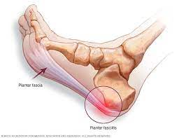
Plantar Heel Pain
PRESENTATION
Pain at the bottom of the heel
Worse with weight bearing
Worse first thing in the morning
Better with rest
Notes:
Plantar Heel Pain refers to a group of issues that result in pain on the bottom of the foot or in the heel. This can be a nerve entrapment, fat pad issue, or most commonly, plantar fasciitis or plantar fascia pain.
A couple causes of this:
If you sit with your knees bent and toes pointed down (rather than feet flat) - your calf muscles are in a shortened position - long term this can contribute to the development of plantar fascia pain because it constantly pulls @ the plantar fascia and causes irritation
Wearing heels @ your desk keeps your feet and calves in this shortened position all day so also not ideal when it’s done repeatedly
Commute to work - just like we talked about capacity and demand in previous slides - walking (especially in improper footwear) can lead to this irritability on the bottom of the foot.
Presentation or symptoms listed on the slide.
Prevention Strategies for this issue:
Proper footwear - even if this means comfortable shoes for your commute to work and switching into something more professional afterwards
Proper desk setup to allow your feet to sit flat
Calf stretching or rolling on the bottom of the foot.
*Refer to blog on Plantar Fasciitis

Slide 19

Treatment Options and Prevention Strategies
What can we do?
Massage, Physiotherapy, Chiropractic
Diagnosis and Education
Biomechanical Assessment
Interventional Care: manual therapy, graston, shockwave, cupping, exercise, etc.
What can you do?
Preventative treatment
Consider footwear choices
Change positions often
Take opportunities to move
Be aware of posture
Ergonomic setup
Preventative exercises
Notes:
CODY
If you have any of these specific issues happening, I highly recommend you see a healthcare professional to have an assessment and formulate plan!
OR even if you aren’t having significant issues, can help identify risk factors and come up with strategies for prevention
We are happy to help in whatever capacity you may need, and some of the strategies are listed above!
In addition to the strategies we discussed for each specific condition, there are also lots that you can do yourself to help manage or prevent aches and pains that may come along with office work.
In terms of ergonomic setup, Dr. Brianne will go over this in more detail. We will then review a few preventative exercises that are easy to do at a desk or in your office.

Slide 20
Ergonomic Desk Setup
Notes:
BRIANNE

Slide 21
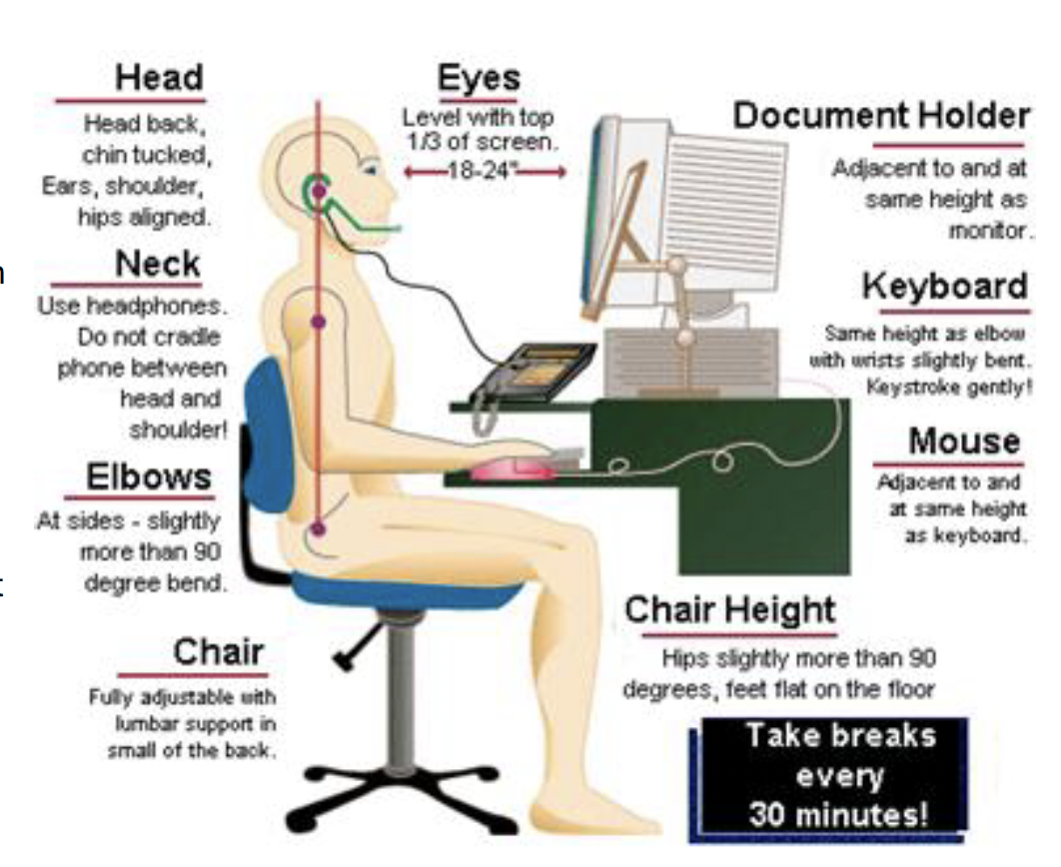
Desk and Computer Setup
Setup:
Desk
Monitor
Keyboard + Mouse
Chair
Notes:
The first step is to adjust your workstation around whichever object is immovable. This is most commonly the height of your desk.
Desk:
Make sure your legs fit comfortably under your desk.
Monitor:
Your computer screen should be directly in front of you and about 18-24 inches away from your face
Your eyes should be level with the top ⅓ of your screen to decrease the amount you are looking down.
If the monitor is not at this height, try adding books under you screen to raise it up.
Keyboard and Mouse:
Your mouse and keyboard should be on the same flat surface.
Your keyboard should be in a spot where your arms are able to comfortably be positioned by your side and wrists in a neutral position.
Chair:
First step is to find a chair that you find comfortable and supports your specific needs!
Your chair should be up high enough that your elbows can be bent to 90 degrees with neutral wrists while using the desk/arm rests
Sit back to allow the chair to support the natural curvatures of your back (use your lumbar support)
You should have 2-3 fingers breadth between the end of the seat pan and the back of your knees.
Make sure your feet are flat on the floor. If this is not possible with the height of the chair, have a footrest under your desk to keep your feet flat.
Desk Posture:
Head: head should be directly over your neck and in line with the rest of your spine
Back: keep your back relatively straight and supported by your chair - results in less fatigue of the structures in your back
Elbows: should be positioned close to your body and bent to around 90 degrees. From here, your forearms and wrists should be in line with your elbows
Wrists: keep them in a neutral position when using a keyboard or mouse
Hips: should be in line with your spine (no slouching) to reduce tension.
Knees and feet: keep knees bent and your feet flat on the floor or footrest.

Slide 22
Desk Mobility & Exercises
Notes:
BRIANNE

Slide 23


Neck Stretches
Notes:
These stretches can alleviate tension through the neck and upper back.

Slide 24
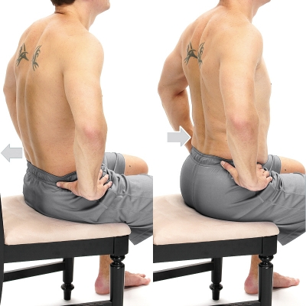
Pelvic Tilts
Notes:
Help with back pain and promote movement through the spine when seated

Slide 25
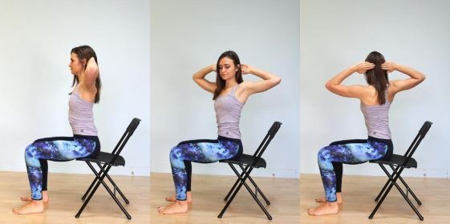
Thoracic Mobility
Perform all 3:
Rotation
Side Bend
Extension

Slide 26
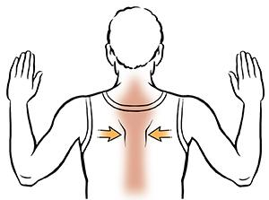
Postural Strengthening (W’s)
Notes:
CODY

Slide 27
Forearm Stretches
Notes:
These will help with carpal tunnel and tennis elbow onset or symptoms

Slide 28
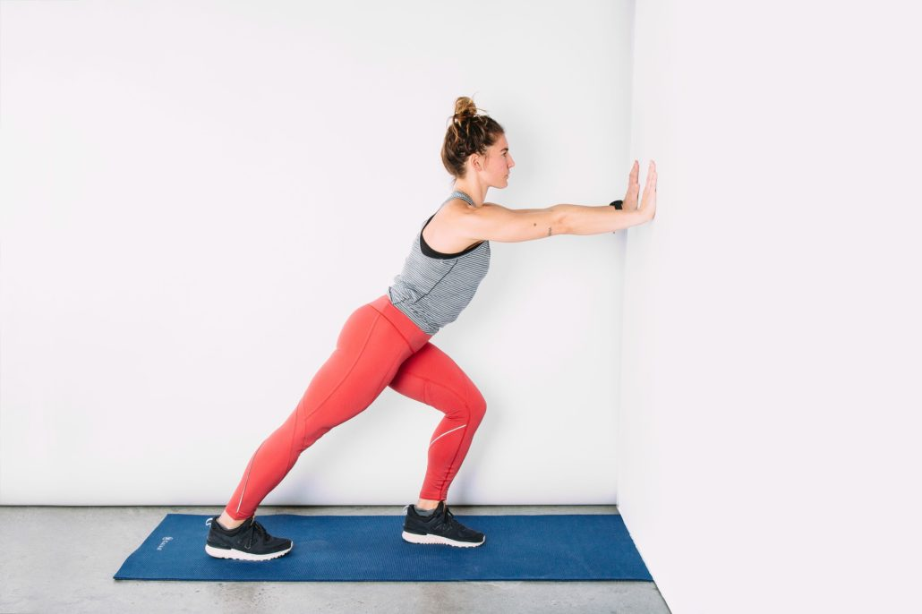
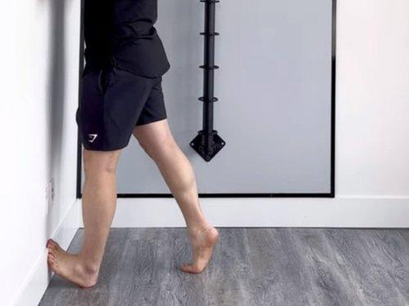
Calf and Plantar Fascia Stretching

Slide 29
“A moving posture is the best posture”

Slide 30
Thank You!
Any Questions?

Slide 31
Scan below if interested in booking!
Notes:
INSERT QR CODES

Slide 32
Scan below if interested in booking!
Notes:
INSERT QR CODES

Slide 33
Scan below if interested in booking!
Notes:
INSERT QR CODES

Slide 34
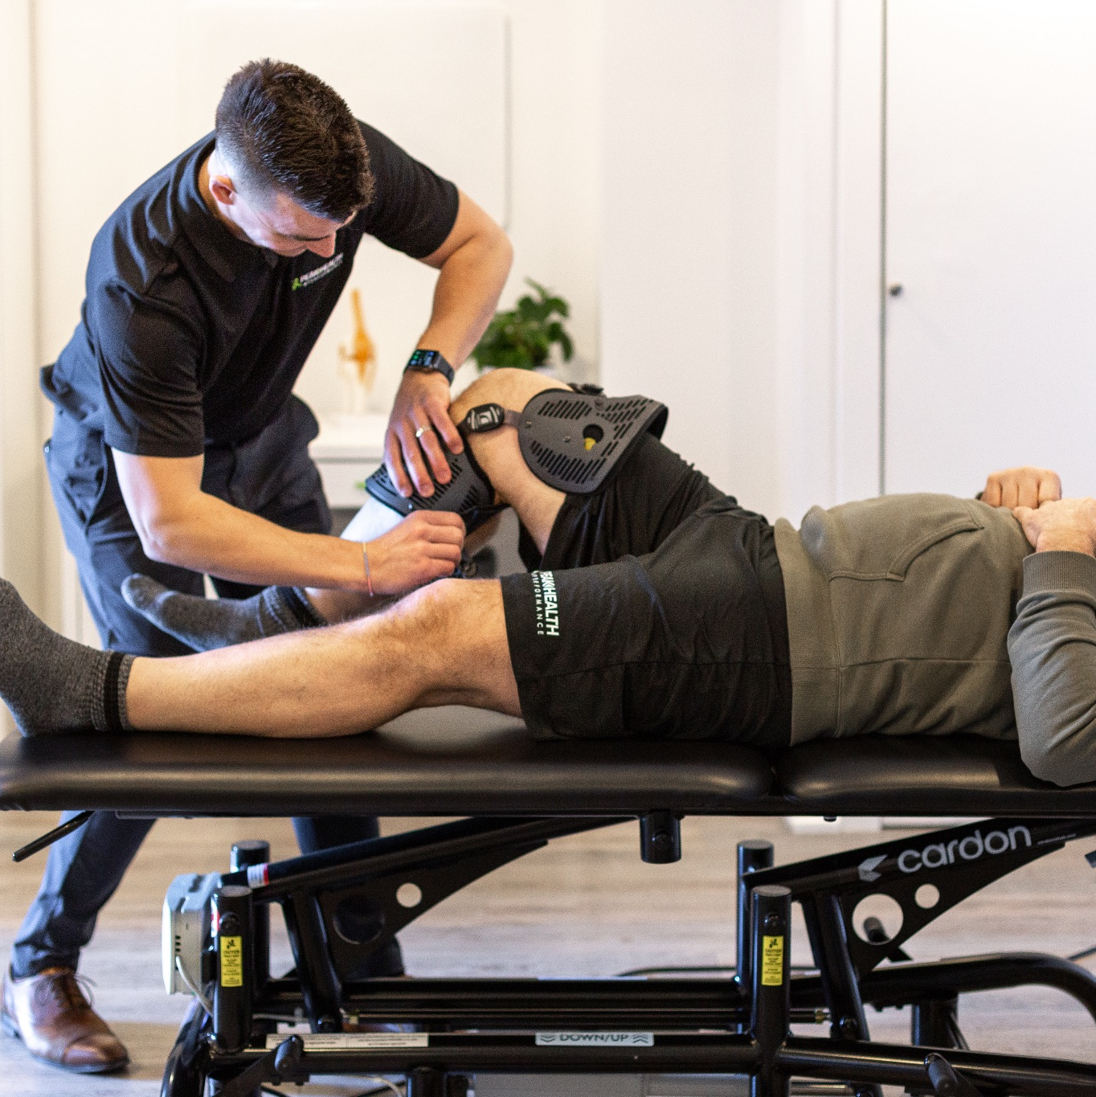
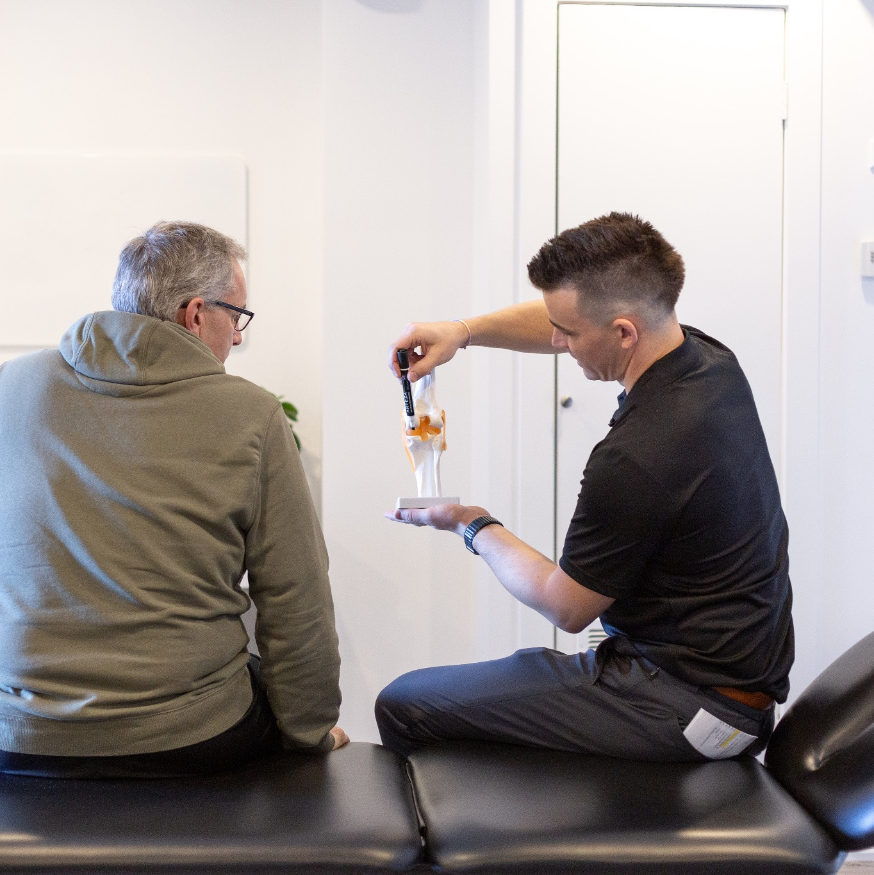
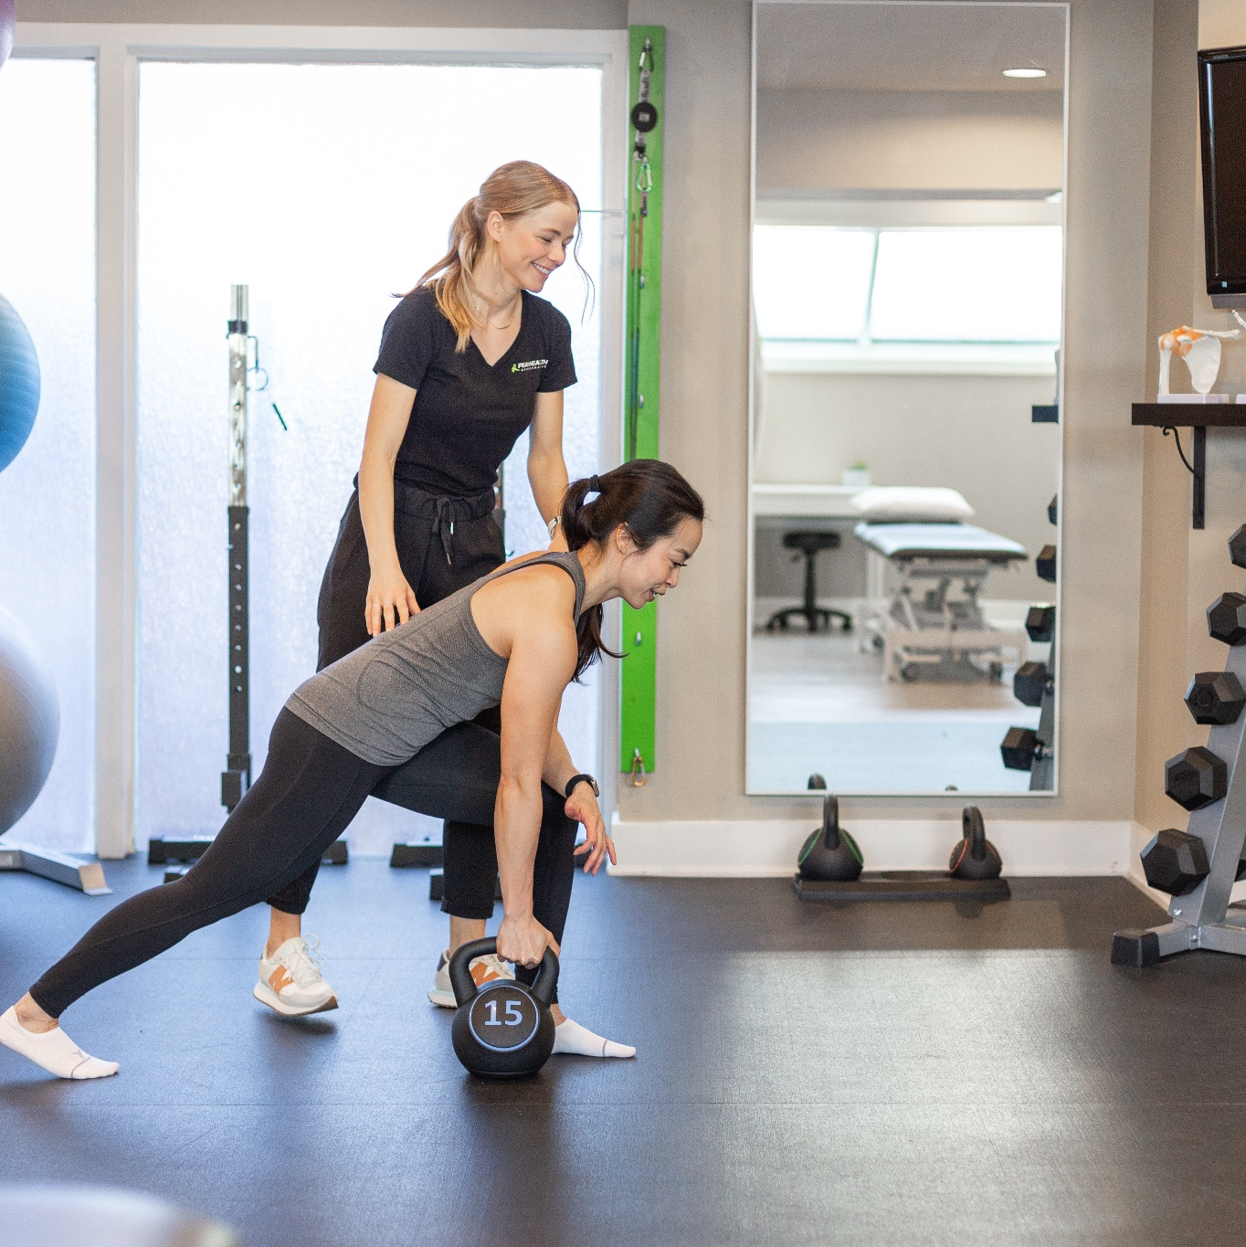
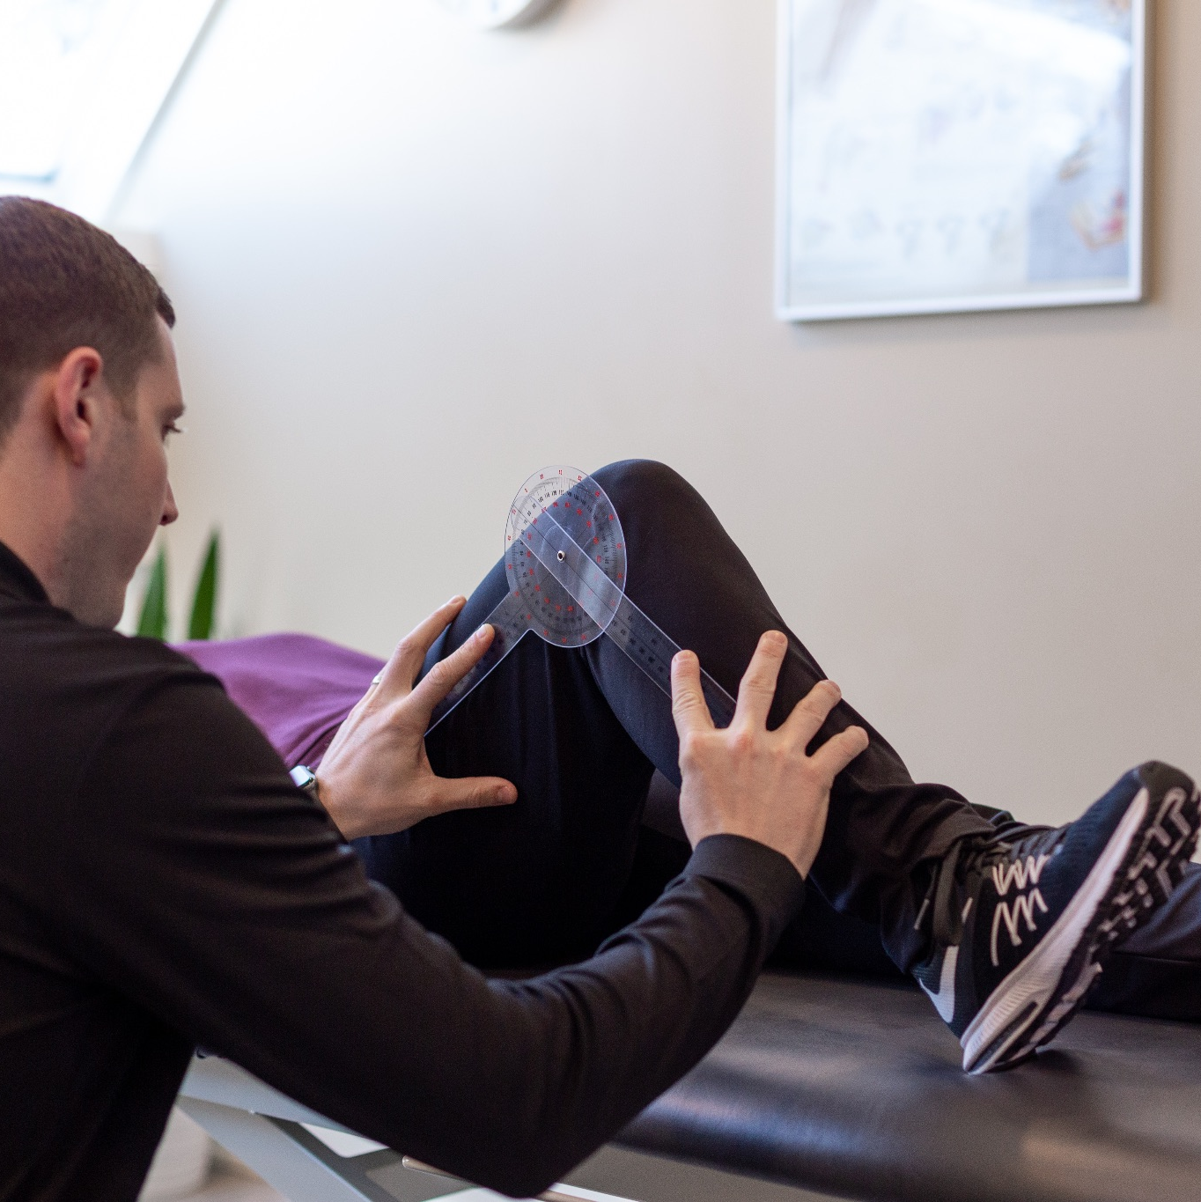
TEAM PRESENTATION
1
SUB
Text

Slide 35







Slide 36

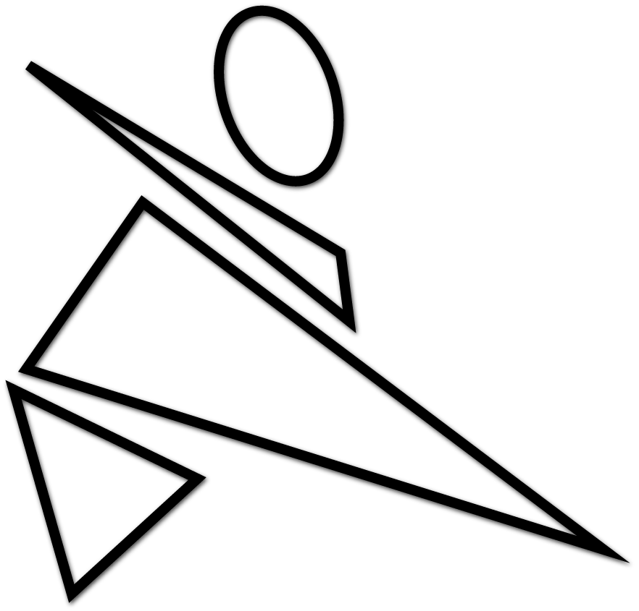

Slide 37


Slide 38
