Slide 1
Golf 2.0
Mobility assessment
CSEP CPT Sarah Tooke

Slide 2
Overview
What is mobility?
Common swing characteristics caused by poor mobility
Is it a mobility or stability issue?
Improving mobility
Monitoring progress

Slide 3
What is mobility?
Mobility is the combination of normal joint range of motion and proper muscular flexibility
Mobility is a must for proper mechanics and to prevent injury
Mobility allows for the generation of elastic energy between muscles, and therefore establishes a base for efficient power production.

Slide 4
Common golf swing characteristics that can be caused by poor mobility

Slide 5
Golf stance
Do you
have “C”
or “S”
posture

Slide 6
Proper golf stance
C or S posture is often a result of muscle and joint imbalances that are developed over many years
“C” posture – tight or shortened pec major and minor, upper trap, levator scapula, lats and SCM with weak or inhibited serratus anterior, deep neck flexors and lower traps.
“S” posture – tight or shortened hip flexors and lower back with weak or inhibited abs and glutes

Slide 7
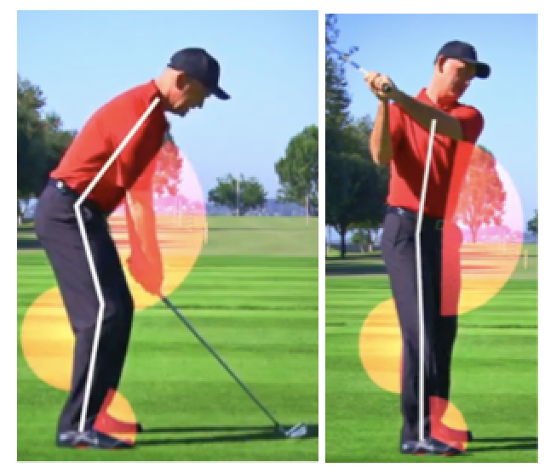
Loss of Posture
Any significant alteration from the body’s original set up angles during the golf swing
Requires good flexibility in the his and shoulders

Slide 8
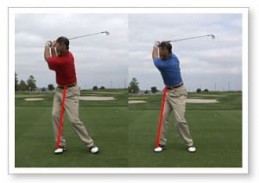
Sway
Any Excessive lower body lateral movement away from the ball during the backswing that forces the weight to the outside of the back foot.
Hip internal rotation on the back leg is paramount for full rotation without any lateral sway

Slide 9
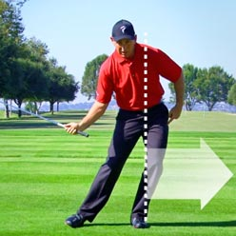
Slide
Any excessive lower body lateral movement toward the target during the downswing.
Hip internal rotation on the front leg is paramount for full rotation into the lead hip without any lateral sway.

Slide 10
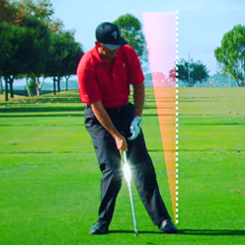
Hanging back
When a golfer does not shift their weight correctly back onto the front side of the downswing.
Limited mobility in the front hip can result in a player hanging back

Slide 11
Other reasons that can be the cause
Improper technique
Stability or balance issues
Improperly fit clubs

Slide 12
Mobility vs stability
Something that seems like a mobility issue may actually be a stability issue
Stability is the ability of any system to remain unchanged or aligned in the presence of change or outside forces
Stability is created by combining 3 things – balance, strength and muscular endurance.
Think of drawing back on a bow

Slide 13
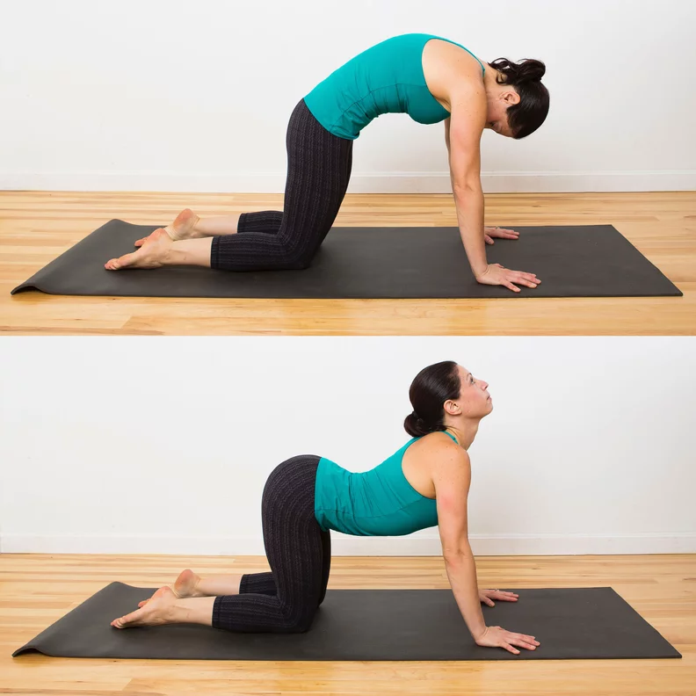
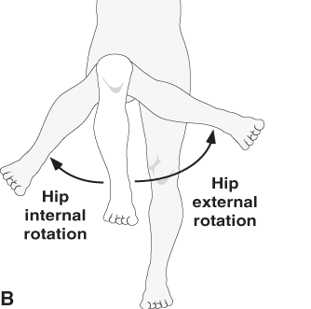
How to figure out if it’s a mobility or stability issue

Slide 14
If mobility, now what?
First – Use a form of soft tissue rolling to break down adhesions and flush the area (deep tissue massages as well)
Second – Provide isolated stretches that target the problem area specifically
Third – Monitor for progress and if no change or pain – contact a healthcare provider like a physio or athletic therapy.
Keep in mind that many mobility problems can not be solved by exercise alone

Slide 15
Any questions?

