Slide 1
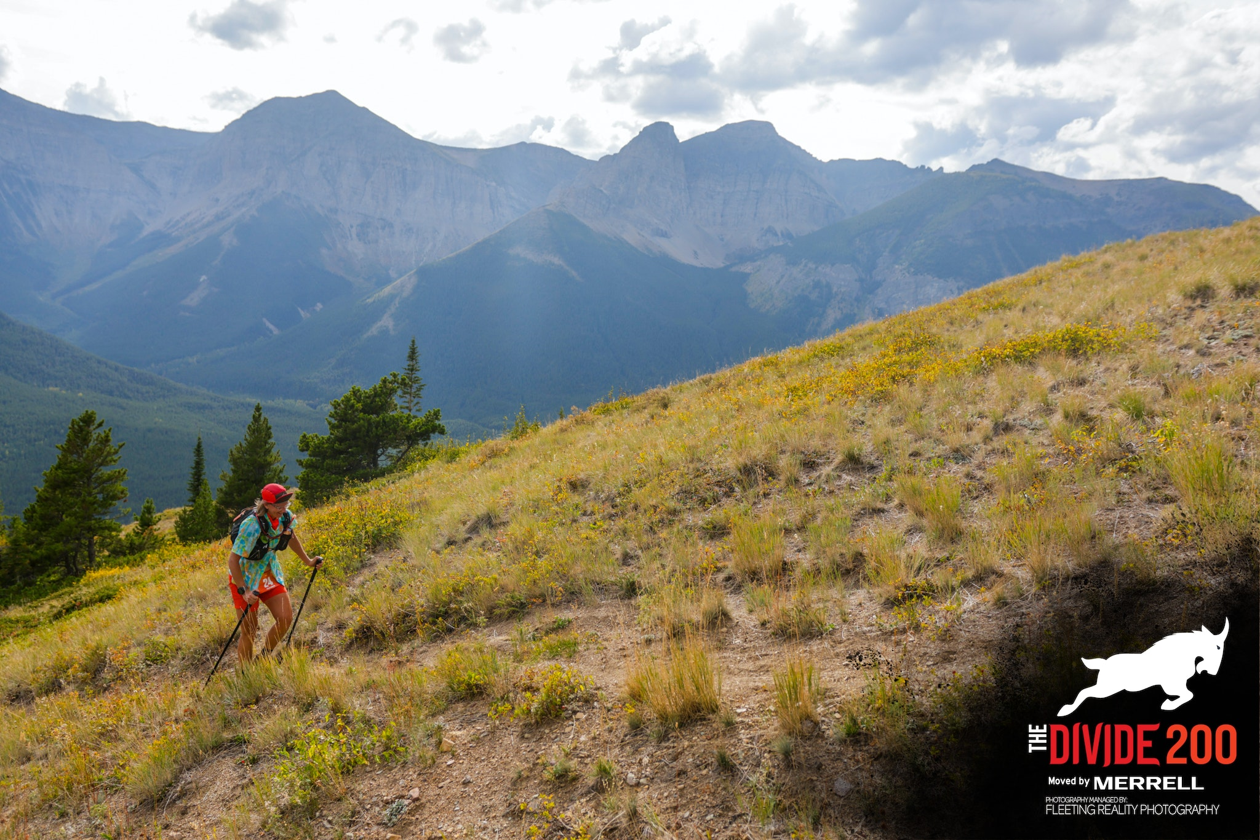
Running the Divide
Lessons learned while running 200 miles

Slide 2
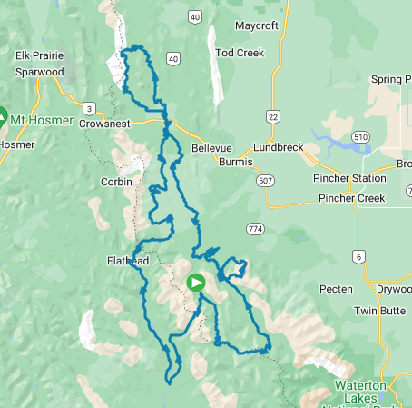
The Divide 200
200 miles (330km)
11,500m elevation gain
100 hour time limit
100 competitors

Slide 3
The Preparation
Longest Run = 78.5km
Longest Backpack = 130km
2 weeks off work to train (July and August)
Primary Objectives
Problem solving
Resilience/capacity

Slide 4
The Start
Tuesday @ 8am
69km, 3 mountains
La Coulotte Ridge
Whistler Mountain
Table Mountain

Slide 5
The Strategy
Don’t mess up
Stay within yourself
Familiar Foods
Hydrate
Take care of yourself

Slide 6
The Challenges
Apparent High Sweat Rate
Maple Syrup
Tracking System
Water

Slide 7
The Solutions
Keep Calm and Hike On
Deal With It
Let It Go
Big Picture

Slide 8
The Divide 200
Beaver Mines Lake to York Creek
1 Crew Stop, 1 Check Point
Willoughby Ridge
1st night and next morning
Km 69

Slide 9
Prepare for the 1st Night
Drink
Gatorade
Eat
Mashed Potatoes
Burger to go
Tape and lube feet
Reapply KT tape
Pop blisters
Headlamp
Clothing
Long Sleeves
Pants

Slide 10
The Challenges
Nausea
Brain Fog
Sore Feet
Disappointment

Slide 11
The Solutions
Know your “why”
Learn
Explore
Experience

Slide 12
The Divide 200
66km loop
Spoon Valley to Racehorse Pass
Return via the High Rock Trail
2 checkpoints
2nd afternoon, 2nd night
Km 135

Slide 13
The Strategy
Keep Moving
Gratitude
Use Your Support

Slide 14
The Challenges
Burning Feet
Sleep Deprivation

Slide 15
The Solutions
KT Tape Allergy
Tincture of Benzoin
Trust

Slide 16
The Divide 200
Lost Creek
39km ATV Trails
No checkpoints
3rd Day
Km 201

Slide 17
The Challenges
SLEEP

Slide 18
The Solutions
Dirt naps
Caffeine
Music

Slide 19
The Divide 200
90km
North and Middle Kootenay Pass
1 Crew Station, 2 Checkpoints
3rd evening/night, 4th day
Km 240

Slide 20
The Challenges
Terrain
Motivation

Slide 21
The Solutions
Carrot and Stick
Mindfulness

Slide 22
Reflections
Capacity

Slide 23
Reflections
Community

Slide 24
Reflections
Gratitude

Slide 25
QUESTIONS??? JOANNA.FORD@ESSO.CA

Slide 26
Dali Thinks You Should Join The Fitness Centre
www.505qpwellness.ca
$35/mth, no contract
Open 24/7
Run coaching
Starts at $70/mth
No membership needed

