Slide 1
Everything Core
With Sarah Tooke

Slide 2
Overview
What is your “core”?
Stabilizers vs Movers
Core exercises vs ab exercises
Designing a core program
How to work your core more during weight training
Question and answer

Slide 3
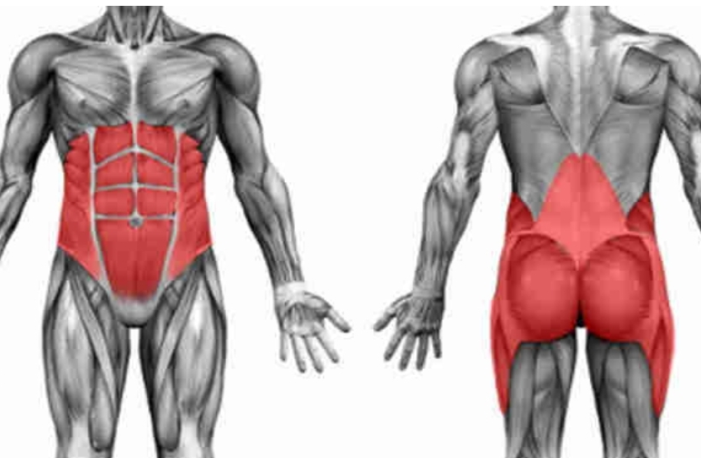
The term core refers to a group of muscles that together stabilize your spine and hips.
Core muscles are essential for proper load balance within the spine, pelvis, and kinetic chain
They spare the spine from excessive load
Essential for load transfer between the upper and lower body

Slide 4
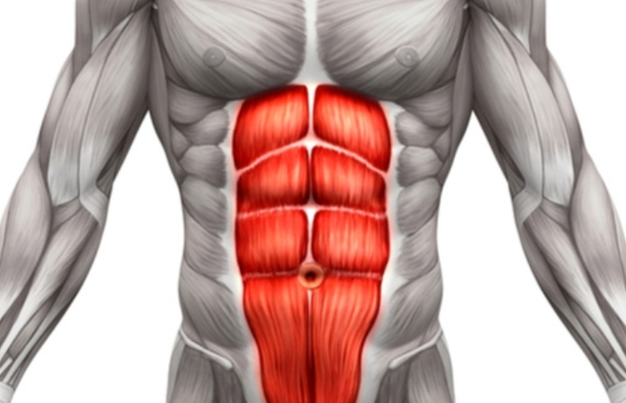
Stabilzers vs. Movers

Slide 5
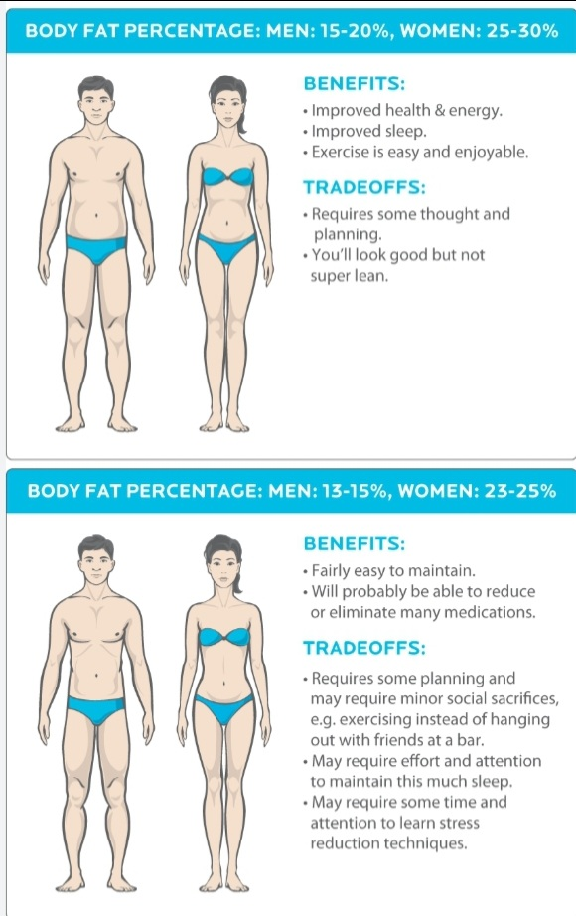

Slide 6
Core exercises vs. Ab exercises

Slide 7
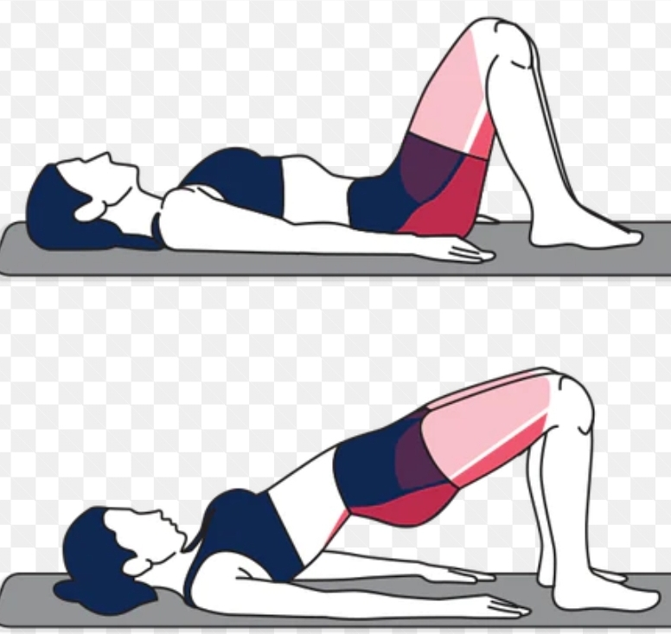
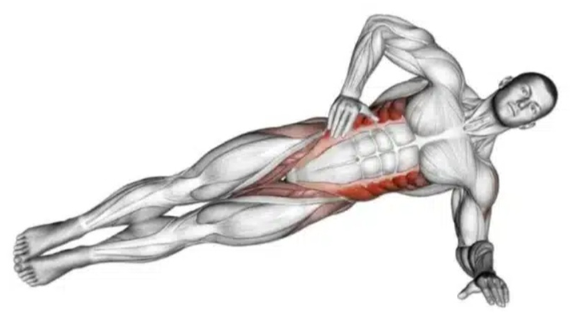
Core exercises

Slide 8
Ab exercises

Slide 9
Advanced core exercises

Slide 10
Designing a Core Program
Plan 2-3 core workouts a week (approx. 20 to 30 mins)
Start with static planks and perfect the form before moving onto more advanced core moves
Use ab exercises as a way to address specifically weak areas or correct muscle imbalances
Work on engaging your Transverse abdominals (TVA)
Short on time? Incorporate core training into your weight training

Slide 11
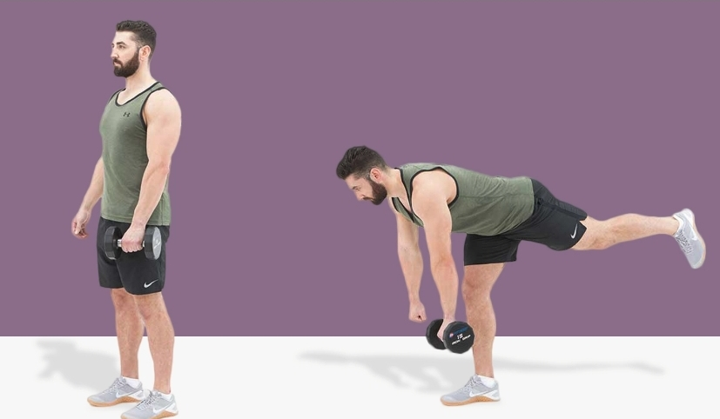
Incorporating core into your Weight training

Slide 12
Question and Answer
Sarah’s email - Stooke@livnorth.com

Slide 13
TVA activation
https://youtu.be/Ielt7Mj-F_I

