Slide 1
Bodyweight Training
A starter’s guide

Slide 2
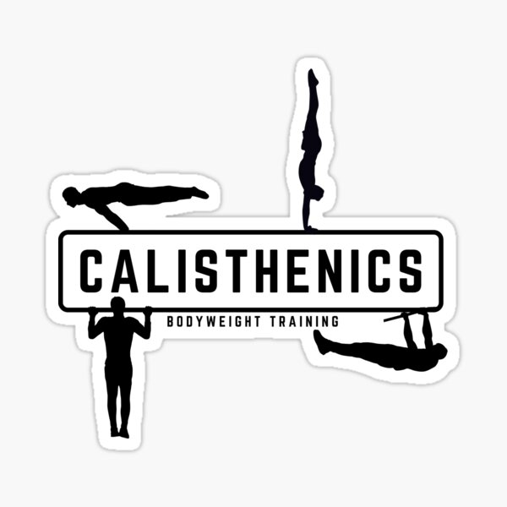
Overview
What is bodyweight training?
Advantages
Disadvantages
Basic Exercises
Adapting Exercises
Designing a Program
Resources
Questions

Slide 3
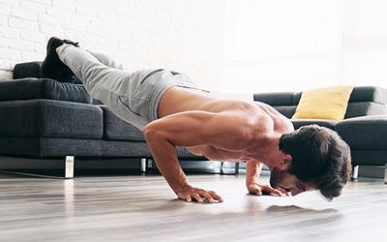
Bodyweight Training
Uses your own bodyweight as resistance
AKA: Calisthenics
Minimal Equipment
Wall
Mat
Bars of various height
Other (TRX, balls, towels etc)

Slide 4
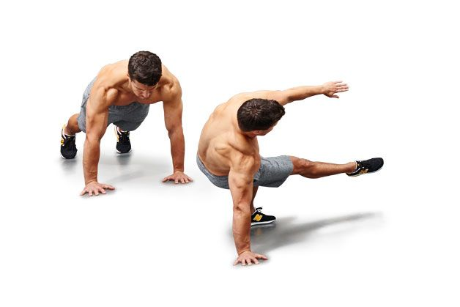
Advantages
Inexpensive
Can be done anywhere
More “natural” movement
Looks cool

Slide 5
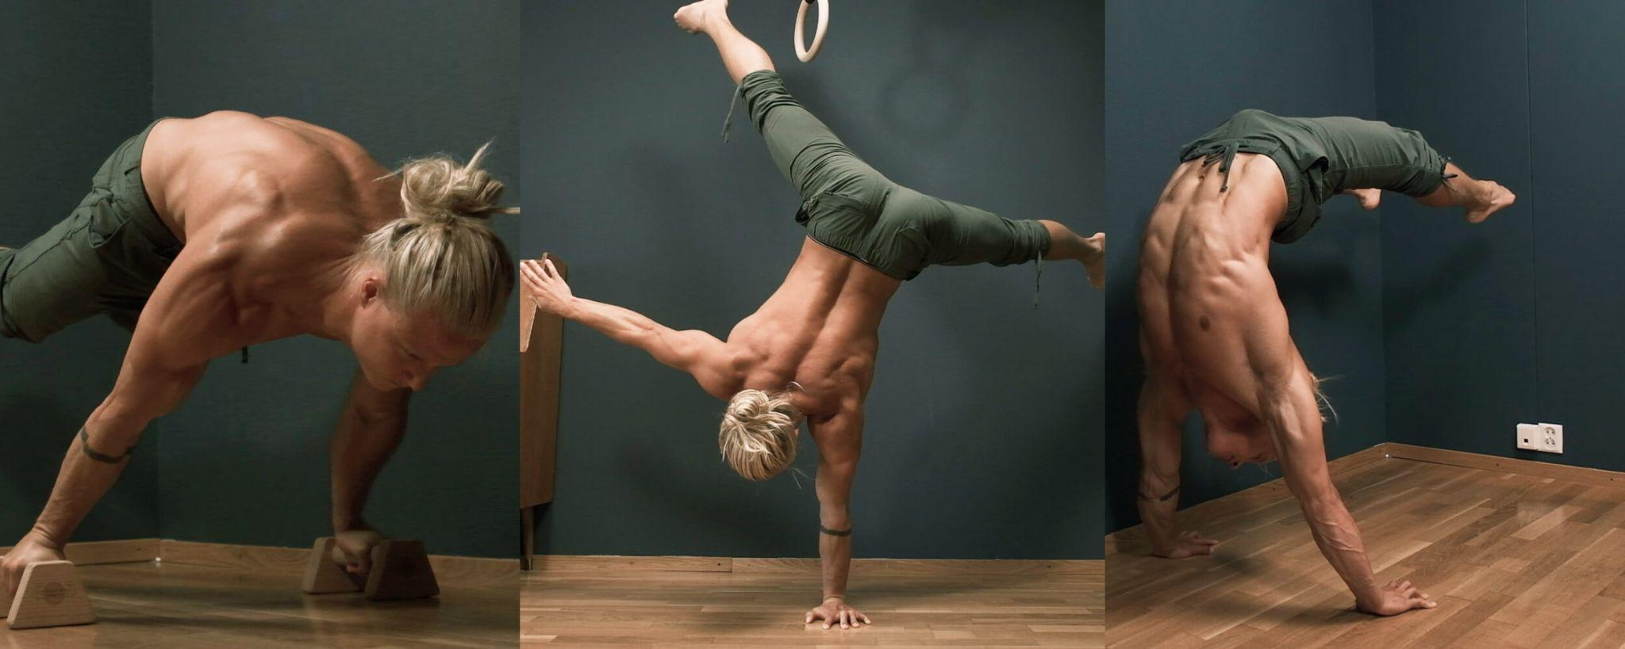
Disadvantages
Requires coordination
Can be difficult to scale
Injury risk
Often requires more in-depth understanding of biomechanics

Slide 6
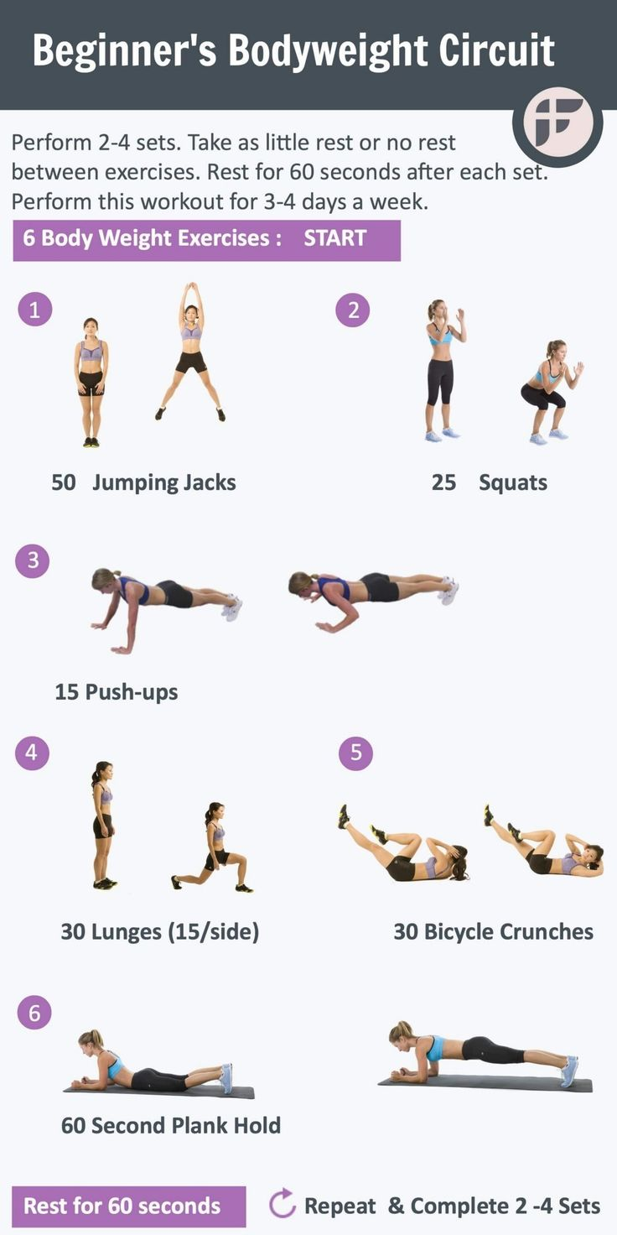
Basic Exercises
Squat
Lunge
Push-Up
Pull-up
Work your back without hanging
Sit-Up
Hang

Slide 7
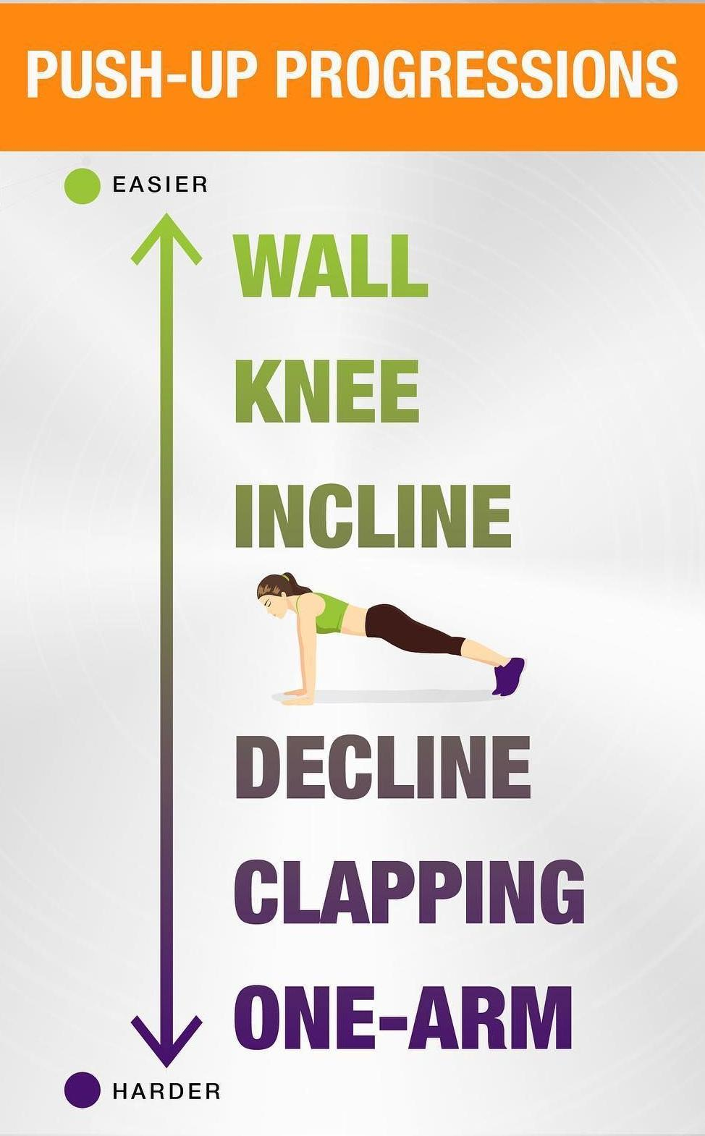
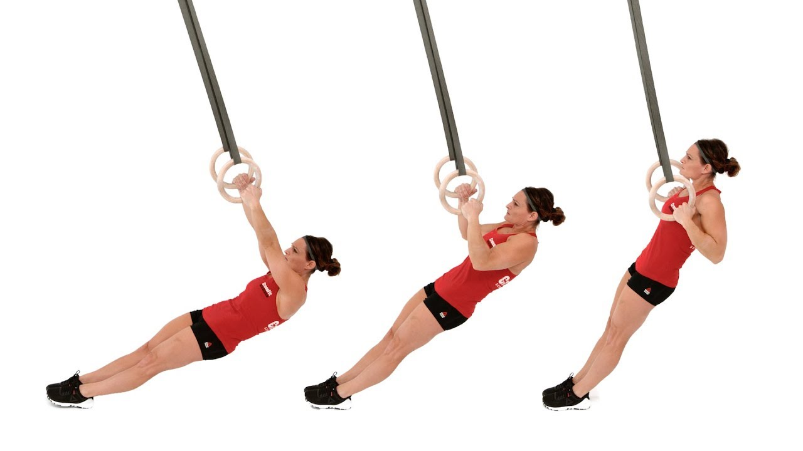
Adapting Exercises
Lever Length
Angle of Pull
Stability
Tempo

Slide 8
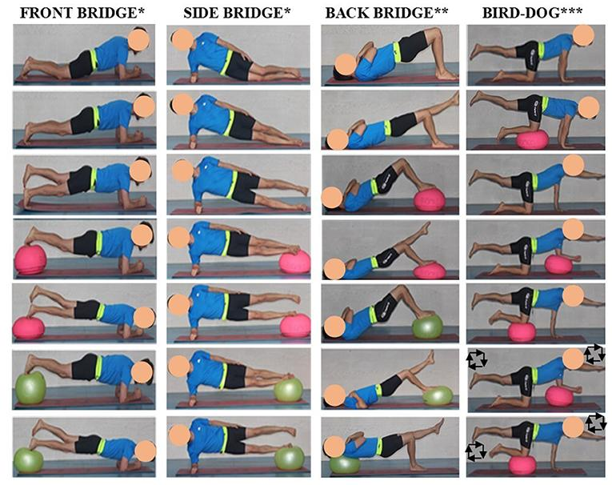

Slide 9
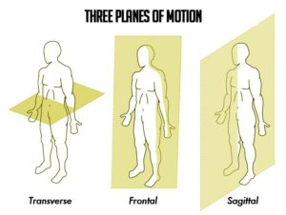
Designing a Basic Program
Planes of Motion
Frontal – side to side
Sagittal – front to back
Transverse – rotational
Push/Pull
Push – push-ups, shoulder presses, squats
Pull – pull-ups, inverted rows, heel slides
Create/Resist Motion
Create motion – sit up, v-sit, back extension
Resist motion – planks, boat pose, bird dogs

Slide 10
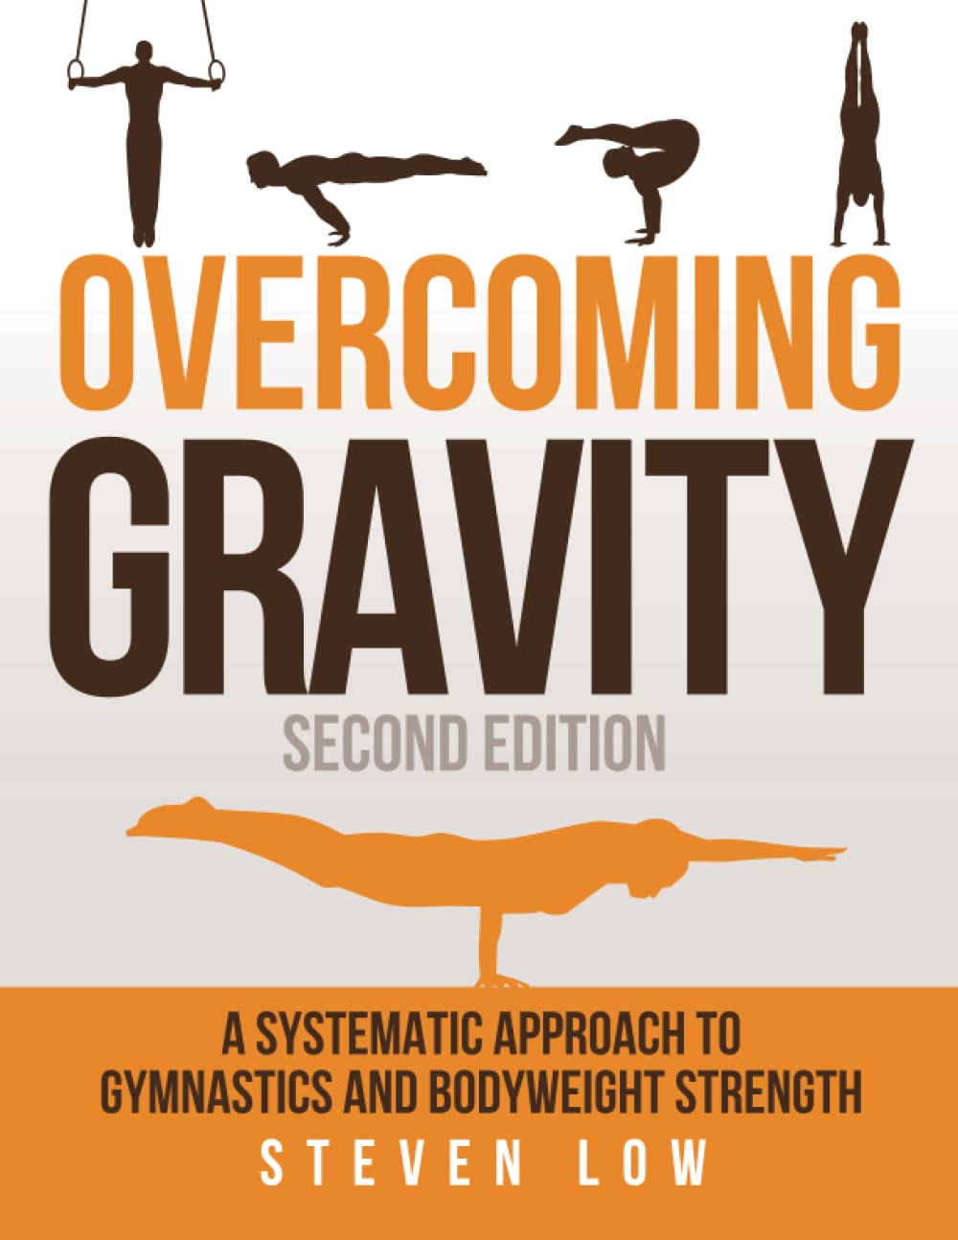
Resources
GMB
Beginner Bodyweight Exercises
Wrist warm-up routine
All the articles (use the search bar)
Start Bodyweight
Basic bodyweight routine (download the PDF)
Exercise progressions
Overcoming Gravity
The “bible” of bodyweight training
https://stevenlow.org/overcoming-gravity/
r/bodyweightfitness
Beginner routines

Slide 11
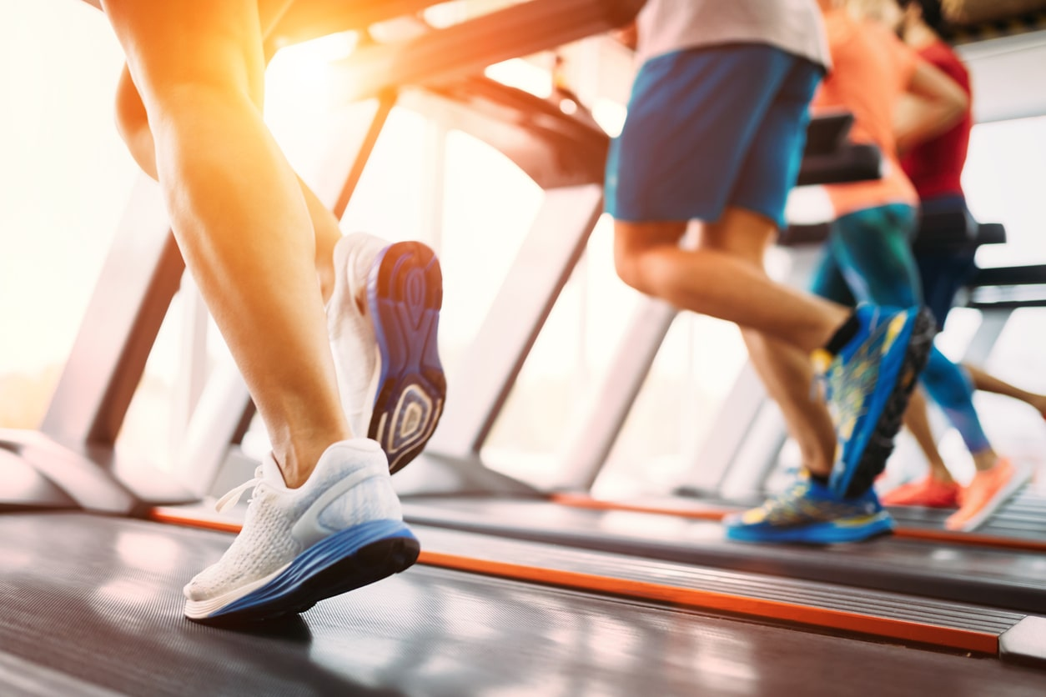
Campus Wellness Centre
Open 24/7
$35/month
No minimum contract
Open to all Campus residents
www.505qpwellness.ca

Slide 12
Questions???
Email:
jford@livnorth.com
Presentation is posted here.

