Slide 1
Effective Goal Setting
It’s not about motivation

Slide 4
You have the desire to change and you have a reasonable amount of will power.
Give yourself some grace. You just need the right tools, and to set the right goals.

Slide 5
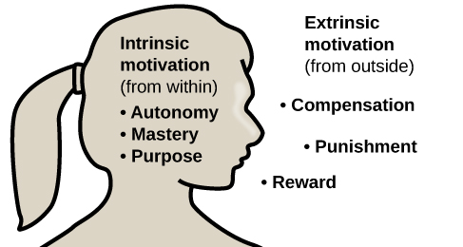
Key Points
Set a goal which aligns with your values
Intrinsically motivated
A goal which excites you
Motivation follows action
Establish a process which:
Is measurable, realistic and timely
Does not conflict with your core values
Consistency

Slide 6
Setting a Goal that Excites You

Slide 7
Identify Your Values
“What” is the outcome, “How” is the process, and “Why” is your motivation.
Values may include family, mental health, physical well-being etc.
The “why” comes from our limbic system, and it influences all of our decisions.
Why is this goal important to you? How does this goal reflect and support my values?
Goals which are in conflict with your values will fail.
A difficult, but important process

Slide 9
Personal Example – Why and What
Personal learning
Explore limits
Fully experience life

Slide 10
Personal Example – How
Consistency
Structured training plan
Group runs (accountability)
Incorporate family and friends (values)
Resiliency
Strength training
Sleep and nutrition
Self-care

Slide 11
Personal Example – Value conflicts
Personal relationships
Financial
Safety

Slide 12
Sound Familiar?
I’m going to try to…
I wish I could …
I want to start …
I am planning on …

Slide 13
DO OR DO NOT, THERE IS NO TRY

Slide 14
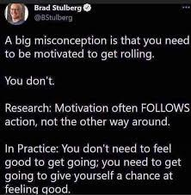
Motivation Follows Action

Slide 15
Motivation Follows Action: Change your language
I’ll try …→ I WILL do
Commitment
I think I might → I KNOW I will
Self-belief
I have to → I GET to
Gratitude
Embracing the process

Slide 16
SMART is your “How”
Specific
Measurable/Tracking
Action-oriented
Action – factors that are within our control, AKA process goals
Realistic – beware of goal creep
Timely

Slide 17
The Process
The process (your action steps) are within your control
Eg. I WILL exercise for one hour each day, 5x/week. I WILL follow this schedule for 2 months.
Document the process - TRACKING
Watch your language
Your process must align with your values and relate to your WHY

Slide 18
Roadblocks to Change
Friction with core values
Lack of education
Self-belief

Slide 19
Lack of education
Don’t know where to start
Injury
Ineffective strategies
Unreasonable expectations

Slide 20
Self-belief
Set small, manageable goals which you can build from
Keep a record
Test yourself (the “M” in SMART)
Find help
partner with a similar goal, personal trainer, dietician, financial advisor etc.

Slide 21
Summary
Ensure your goals align with your values, then map out the process.
Use affirmative language
Consult with experts to develop your “how”
Dietician, financial advisor, personal trainer, psychologist etc.
Consistency is king, something is better than nothing
Track your progress
Crucial for problem solving, self-belief and to prevent goal creep

Slide 22
Questions??
Sign up for the fitness centre at www.505qpwellness.ca
Open 24/7
$35/month
Includes daily drop-in classes, towel service and more!
Email me at joanna.ford@esso.ca
Presentation is posted at
http://www.505qpwellness.ca/sustainableme/

