Slide 1
Q and A Session
The Campus Wellness Centre’s Most Frequently Asked Questions

Slide 2
How Much?
Minimum amount to gain fitness
1x/week, 10min
Optimal for health
150min cardio, including 2x/wk higher intensity
Weights 2-3x/wk
Weight loss
7hr/wk minimum cardio
2-3x/wk strength
Maximum amount
Full rest day every 7-10 days
Strength, recover 48-72hrs
Cardio 2-3 high intensity workouts/wk

Slide 3
How Long Until I See Results?
Highly variable
Larger results, more quickly for beginners
Skill-based improvements within one session
Cardio improvements - 10 days
Muscle building – at least 4 weeks, 10 sessions

Slide 4
Supplements
Protein
Recommend 20-40g immediately post-workout through real food or supplementation.
Recommend minimum 3 “protein feedings” at least 3 times per day.
Creatine
Highly researched, scientifically supported and generally safe.
Water retention.
Magnesium – link for general recommendations.
Pre-workouts
Usually a mix of stimulants and vaso-dilators.
Caffeine and beet-root juice have scientific support.
Fat burners
Usually a mix of stimulants. Not scientifically supported.
Avoid if you have any heart issues, anxiety, or are trying to manage your stress.

Slide 5
Weight Loss
Exercise is great for building and maintaining muscle mass, as well as promoting overall health
Exercise is great for weight maintenance
Exercise is poor for weight loss
3500 calories in 1lb of fat = approx. 7hrs of moderate intensity cardio.

Slide 6
Exercise Form - Squats
Squats - link
Width and foot angle are dependent on individual comfort. Choose a stance which feels strong and comfortable. Practice with bodyweight or an unloaded bar.
Feet stay flat on floor. Choose a flat shoe (running shoes are not ideal).
Screw your feet into the floor. Pull the floor apart with your feet.
Brace your core, as though you were pushing your abs into a corset (or weight belt).
Sit hips down and back, keep your chest up.
Below parallel squats have greater activation of glutes and inner thighs. Stay pain-free, avoid butt-wink.
Competition squats – hips must drop below knees.

Slide 7
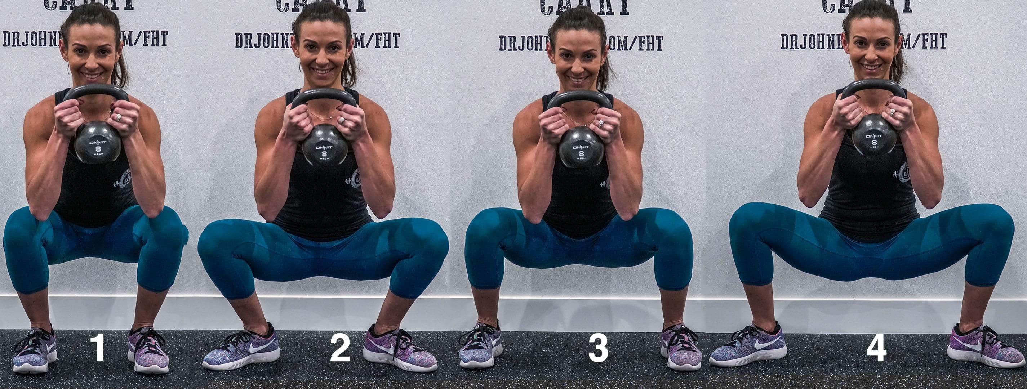
https://themovementfix.com/how-to-find-your-best-squat-stance/

Slide 8
Splits – Organizing Strength Workouts
5 Day Split (Arms, Chest, Back, Shoulders, Legs, Core)
Hit muscle groups hard, time consuming, low frequency
Upper/Lower
Push/Pull
Full Body
Efficient. Ideal for secondary sports.
Ideally target 48-72hrs rest between muscle groups (2x/wk)

Slide 9
Motivation
Find your why – Simon Sinek
Internal vs external motivators
Process vs outcome
Develop Routine
Morning workouts
Block off calendar
Identify Barriers and Mitigators

Slide 10
Injuries
Most commonly caused by “too much, too soon”
Almost always have a stretching and strengthening component. Rarely, if ever, can be solved by stretching alone.
A good practitioner will:
Assess neighbouring joints and look at movement mechanics
Ask lots of questions
Give challenging homework
Empower the patient

Slide 11
What do you eat?
Everything
Enough
Focus on fibre, protein and what feels good

Slide 12
Hiking/Skiing
Resources:
Trail Forks (Outside +)
Gaia GPS (Outside +)
www.kananaskistrail.com – maps and education
www.mountain-forecast.com – detailed weather
Alberta Parks – Trail Reports
Banff National Park – Trail Conditions
www.skierroger.ca – XC skiing conditions
Avalanche Canada – Mountain Information Network

Slide 13
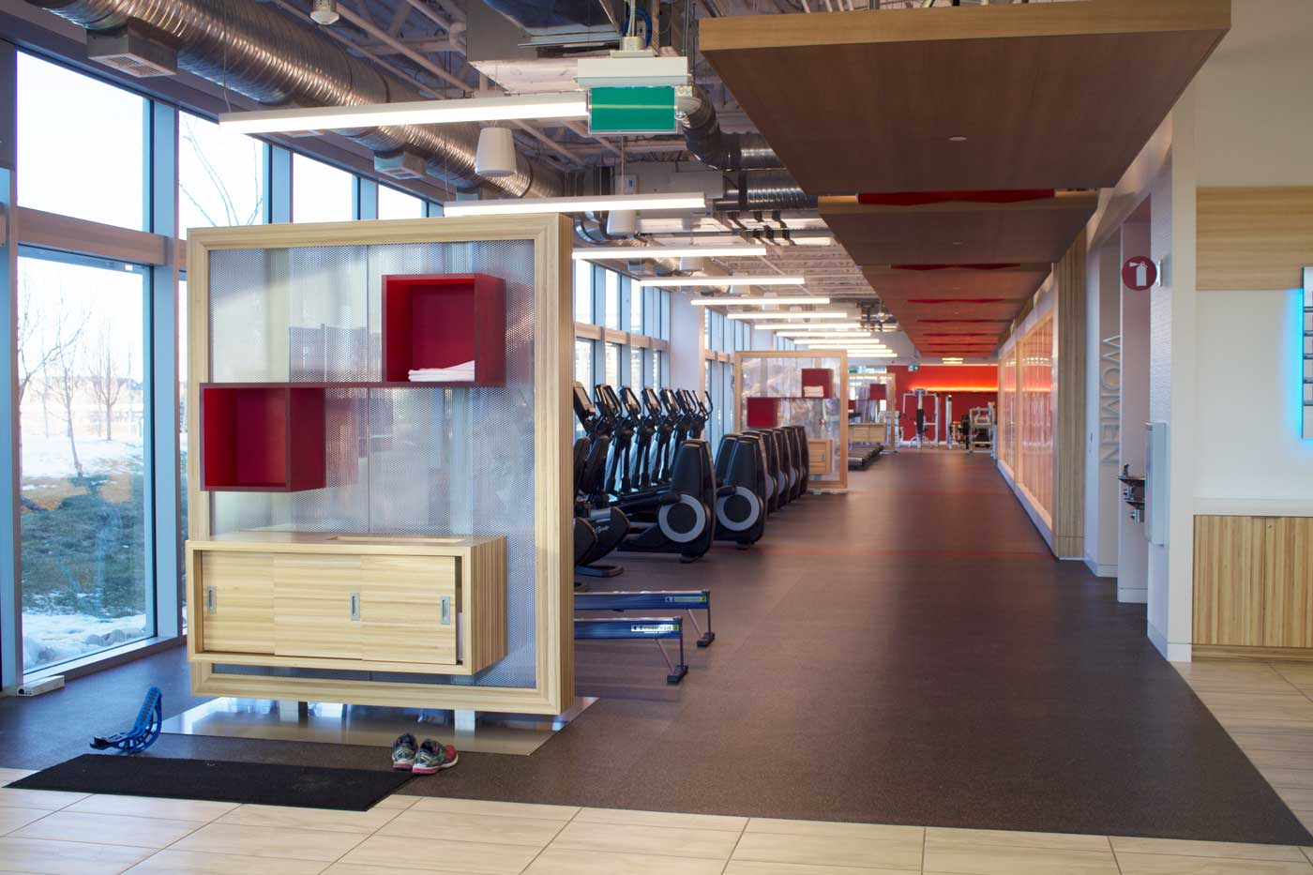
Campus Wellness Centre
www.505qpwellness.ca
$35/month, open 24/7
Classes included Mon-Fri

Slide 14
Contact Me/Additional Resources
Joanna.ford@esso.ca
www.505qpwellness.ca
Resources, Sustainable Me
Social Media:
@thefitnesschef_ (Graeme Tomlinson)
@soheefit
@bdccarpenter (explicit)
@foodsciencebabe
@pheasyque
@andrewcoatesfitness
@ylmsportscience

