Slide 1
Recovery Strategies
Exercise more and be less sore

Slide 2
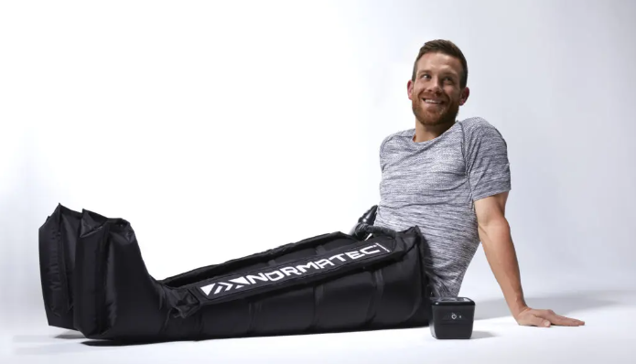

Slide 3
Supercompensation

Slide 4
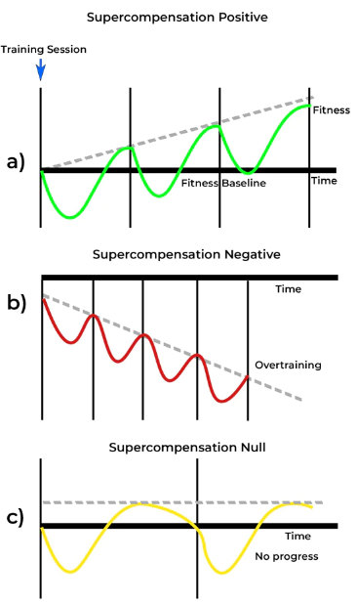
SUPERCOMPENSATION
Goldilocks
OVERTRAINING
Training prior to supercompensation
Too much frequency and/or intensity
Nutritional deficiency
UNDERTRAINING
Too little frequency and/or intensity

Slide 5
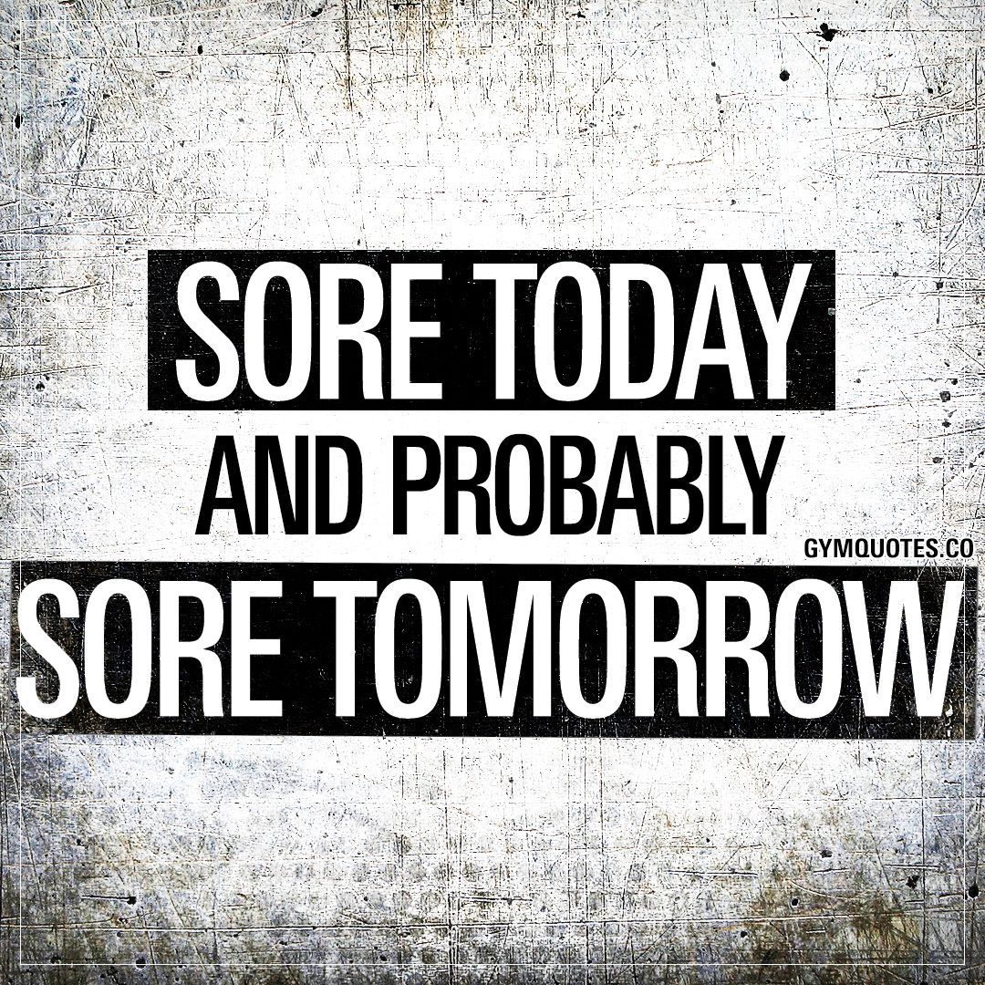
Why Recover
Reduce soreness
DOMS (delayed onset muscle soreness)
Enhance training adaptations
Muscle protein synthesis (muscle growth)
Glycogen repletion (muscle fuel)
Allow more frequent training/activities
Greater training stimulus (bigger gains)
Active lifestyle
Tournaments

Slide 6
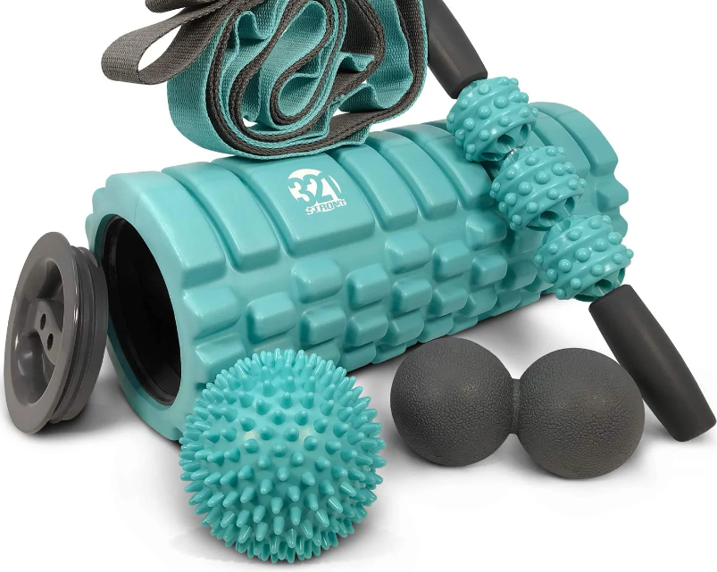
Recovery Strategies
Stretching
Foam Roller/Massage
Heat
Cold (cryotherapy)
Compression (Normatech)
Hydration
Nutrition
During/post-activity
Carbohydrates and protein
Supplementation
BCAAs
Leucine
Whey Protein Isolate/Concentrate

Slide 7
Stretching
Does it help with recovery?
Evidence is unclear (https://www.frontiersin.org/articles/10.3389/fphys.2021.677581/full)
Recommendations:
Stretching should be used to improve flexibility in restricted joints
Stretch if it feels good and if you have the time

Slide 8
Foam Roller/Massage
Does it help with recovery?
Yes. Foam rolling immediately post-exercise can reduce DOMS and improve muscle function 24 and 48hrs post-exercise.
https://www.ncbi.nlm.nih.gov/pmc/articles/PMC4299735/#:~:text=After%20an%20intense%20bout%20of,the%20recovery%20of%20muscular%20performance.
Recommendations:
Foam roll 10-20 minutes immediately post-exercise.
Foam roll for 20 minutes every 24hrs after exercise.

Slide 9
Heat
Does it help with recovery?
Yes. Can help to reduce soreness and enhance recovery of metabolic fatigue factors.
https://www.frontiersin.org/articles/10.3389/fspor.2021.707503/full
Recommendations:
Can be done with a hot bath, sauna, or steam. Protocols are highly variable.

Slide 10
Cold
Does it help with recovery?
Yes. Cold is the most effective way to prevent/reduce DOMS.
Be careful, cold can also interrupt, reduce or inhibit training adaptations.
https://www.frontiersin.org/articles/10.3389/fspor.2021.707503/full
Recommendations:
Use in tournament situations, multi-day events.
Use for chronic swelling.
DO NOT use as standard protocol from workouts on a regular basis.

Slide 11
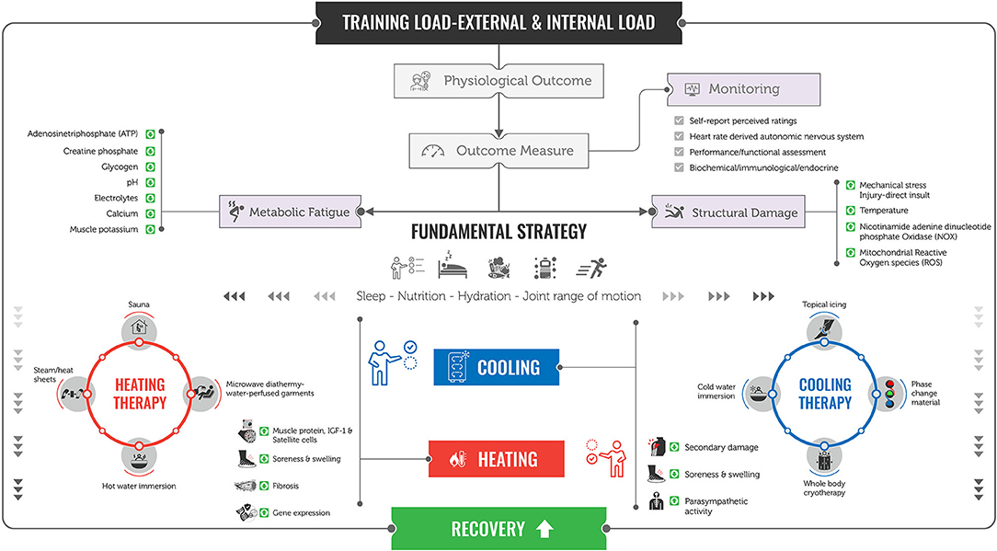
LINK

Slide 12
Compression
Does it help with recovery?
Yes, at least in the short term. Evidence for compression boots is stronger than compression garments.
Recommendations:
Consider compression garments during exercise (if they don’t restrict movement), and compression boots post-exercise for best results.

Slide 13
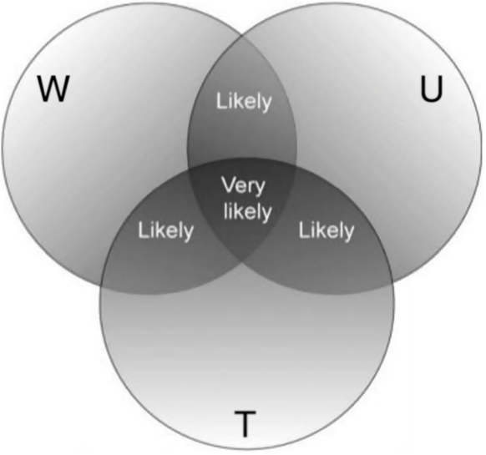
Hydration
Does it help with recovery?
Yes. Dehydration impairs performance (decreases in power, strength and endurance) while euhydration enhances performance and recovery.
Recommendations:
Rehydrate with a mixture of 4-6% CHO and electrolytes for prolonged or intense exercise. Use Venn diagram to guide hydration levels.
ACSM Position Statement
—The Venn diagram for athlete self-assessment of day-to-day hydration status (Cheuvront & Sawka, 2005). If two or more of the signs (W = reduced body weight, U = dark urine color, and T = feeling thirsty) are present, then correction of fluid balance is required.

Slide 14
Nutrition
Does it help with recovery?
CHO during cardio activity (>1hr). CHO immediately post-activity if exercising again within 24hrs.
Protein generally not during activity, but recommended after strength training and high-intensity or long-duration cardio.
Recommendations:
See next slides

Slide 15
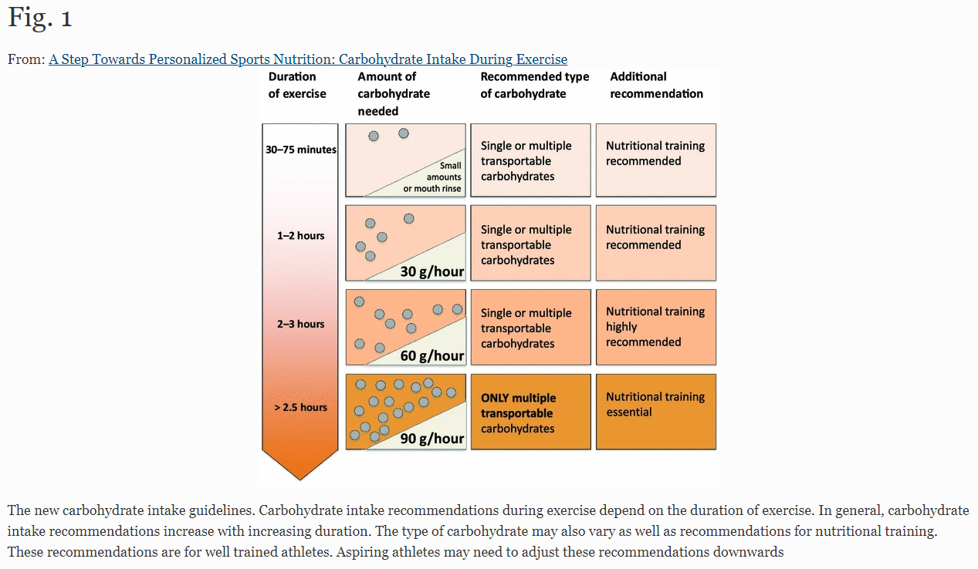

Slide 16
ISSN Position Statements
International society of sports nutrition position stand: nutrient timing
International Society of Sports Nutrition Position Stand: protein and exercise

Slide 17
Supplementation
Does it help with recovery?
BCAAs – glutamine helps in theory. Some support in experimental trials.
Leucine – Increases muscle protein synthesis, but may not improve recovery.
Whey protein powder – increases muscle protein synthesis, reduces DOMS. Whey protein more effective than casein.
Recommendations:
Muscle Recovery and Nutrition

Slide 18
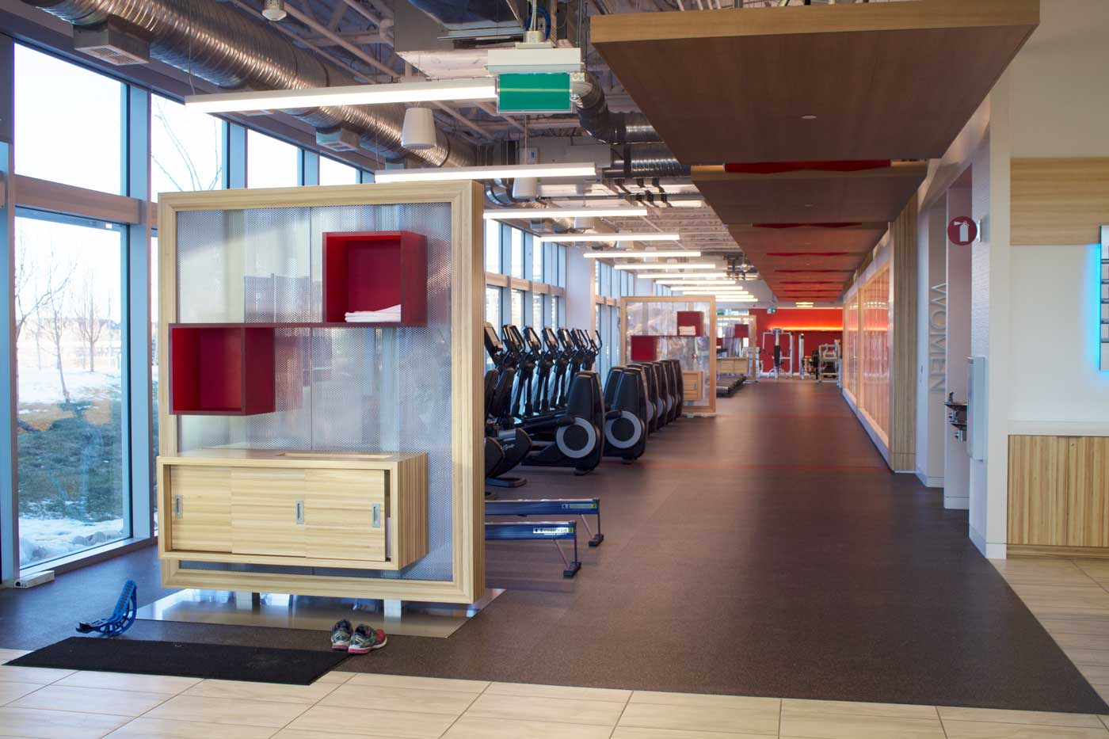
Campus Wellness Centre
$35/month
Open 24/7
No minimum contract
Classes included
Sign up – www.505qpwellness.ca

Slide 19
Questions??
Joanna Ford – Joanna.ford@esso.ca
Slides are posted at: www.505qpwellness.ca/sustainableme/

