Slide 1
Do Hard Things
Practicing Mental Resilience

Slide 2
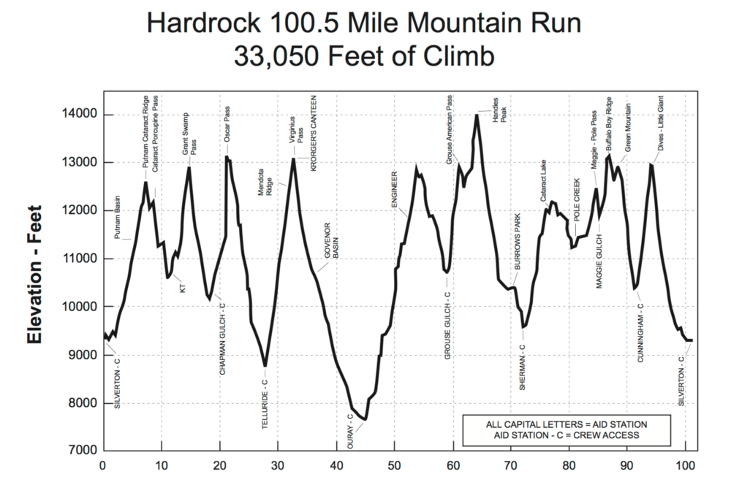
Do Hard Things
Steve Magness
4 pillars:
Embrace Reality
Listen to your Body
Respond instead of React
Transcend Discomfort
Hardrock 100
145 Runners
48hr time limit

Slide 3
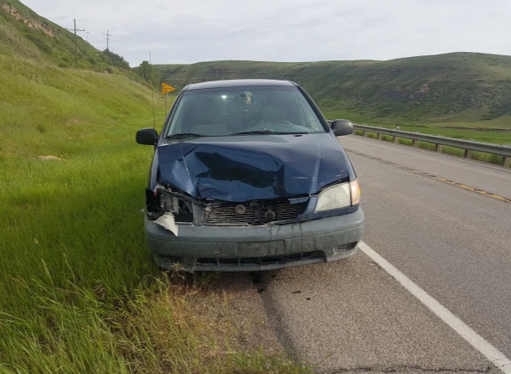
Hardrock 100
Lottery entry process
Pine to Palm 100 Mile 2013
Intro to 100 mile racing
Fat Dog 120 Mile 2015
“Wet Dog”
Bighorn 100 Mile 2017
Mud
Bighorn 100 Mile 2019
Car accident

Slide 4
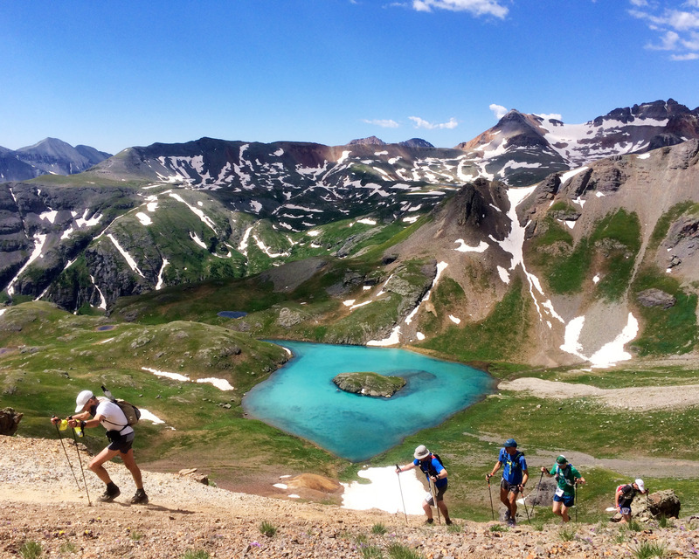
Hardrock 100 – embrace reality
Counter-argument: “Fake it ‘til you make it”
Acknowledge the challenges so that you can formulate solutions
Life Stress
Altitude
Elevation Change
Weather
Crew Challenges

Slide 5
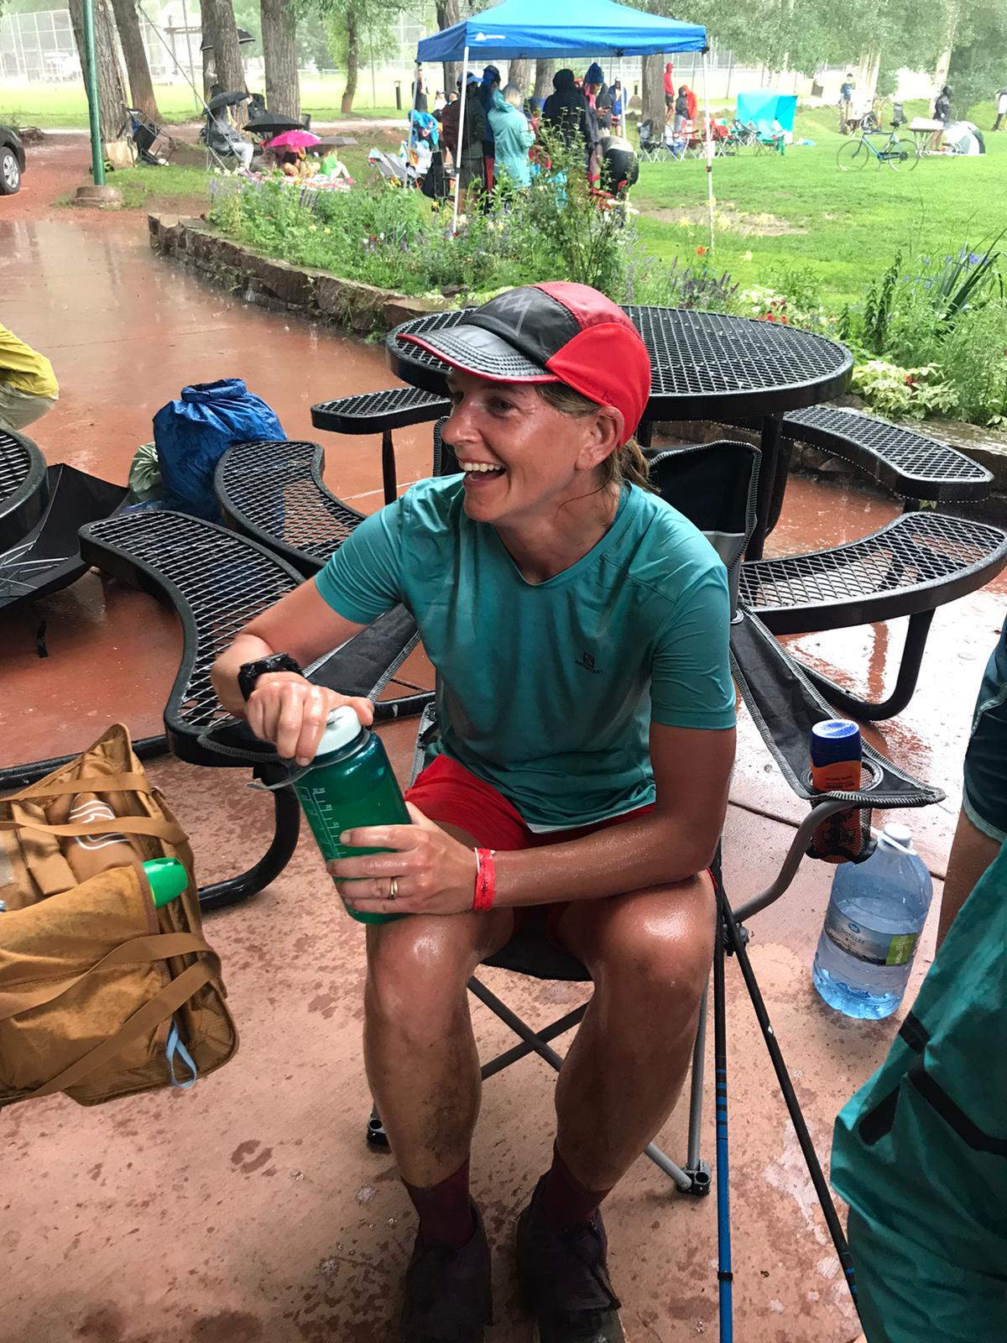
Hardrock 100 – listen to your body
Body Scans
Head to toe physical
Effort
Headspace
Non-judgement
Problem-solving

Slide 6
Hardrock 100 – respond instead of react
Nausea
First incident at Gorge Waterfalls 100km (DNF)
Hydrate
Broth
Replenish
Saltine Crackers
Find what works
Elecrolytes
Avocado
Quesadillas

Slide 7
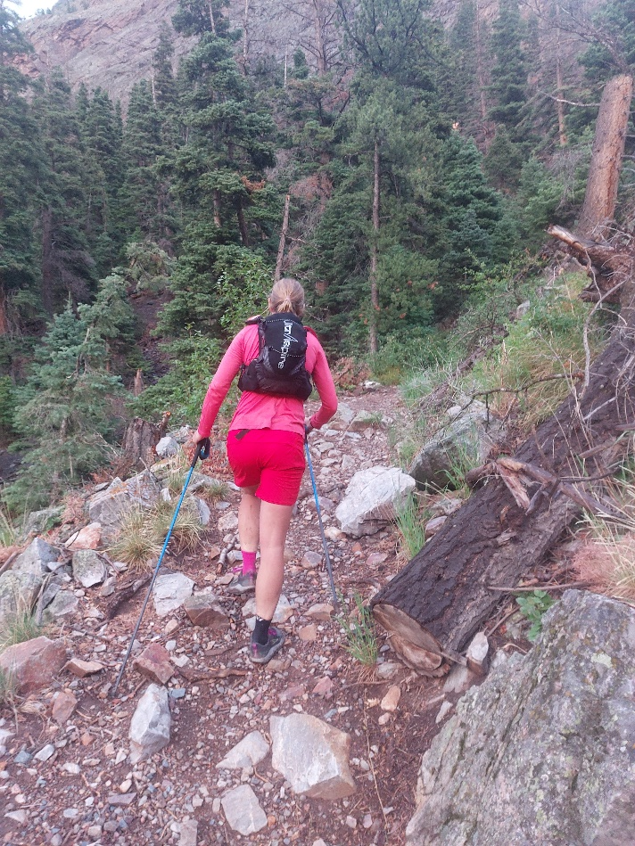
Hardrock 100 – Transcend Discomfort
“Just Keep Swimming”
Mantra
“I am tough, I am strong”
“Full send”
“Try hard”

Slide 8
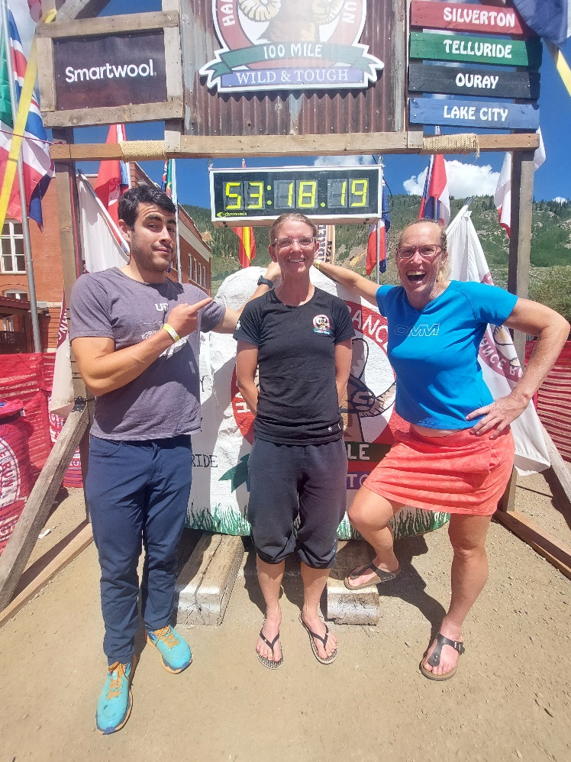
Bonus Pillar – we’re stronger together
Don’t be afraid to ask for/accept help
Foster and build a sense of gratitude
Take the time to be involved in your community

Slide 9
Additional reading
Do Hard Things
My Hardrock 100 race report
Building Resilience
(American Psychological Association)
Resilience and Gratitude
(Positive Psychology)

Slide 10
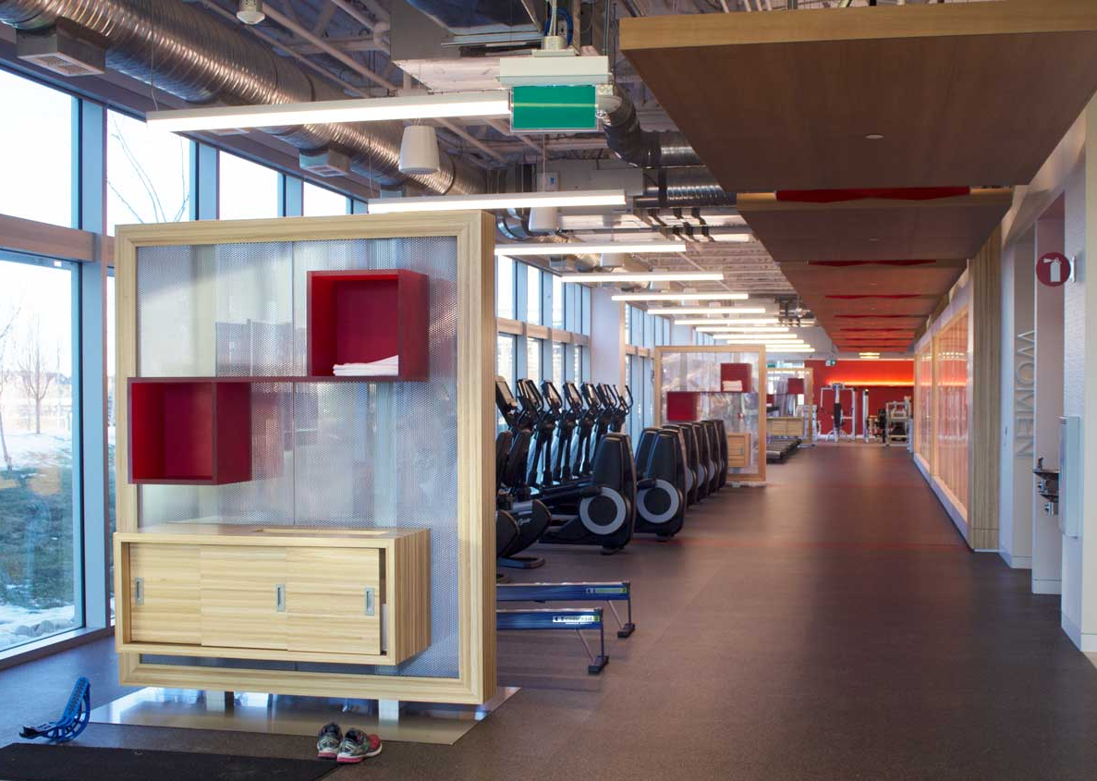
Campus Wellness Centre
Open 24/7
Drop-in class schedule begins in September
Free trial week September 6th-9th, 10am-3pm
Towel service
No equipment sign-up or time limits

Slide 11
Questions??
Presentation
www.505qpwellness.ca – Sustainable Me
Contact me:
Joanna.ford@esso.ca
Stop by the front desk
Mon, Wed, Fri - 6:30am-3pm
Tues, Thurs – 10am-6:30pm

