Slide 1
Hydration
Why fluid balance is so important and how to maintain it

Slide 2
What’s the Big Deal?
Water is single biggest constituent in the human body
70-75% of fat-free mass, 10-40% of fat mass
Avg 60% of total body weight
Essential for maintaining homeostasis (life)
Thermoregulation
Blood sugar maintenance
Transport of nutrients/waste

Slide 3
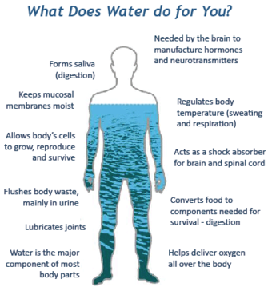
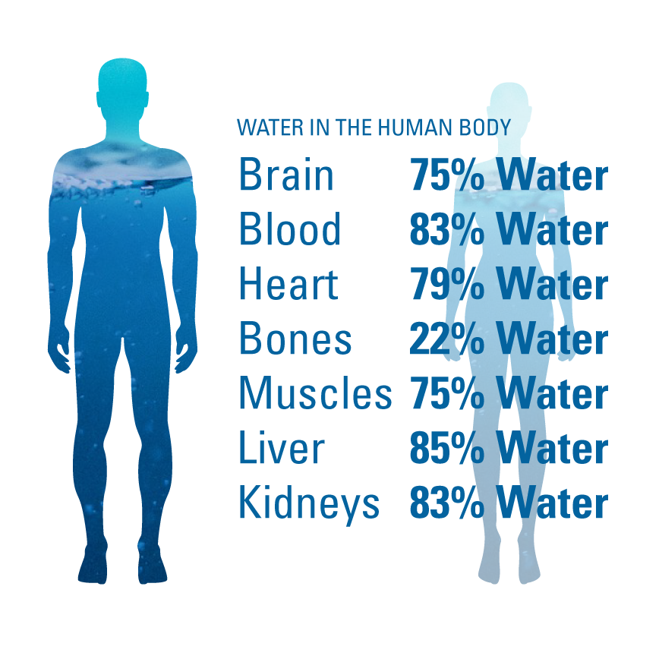

Slide 4
Basic recommendations
Total water intake (twi) – includes drinking water, water in beverages, water in food
Adequate Intake (ai) established by median twi intake from US survey data (ages 19-30)
3.7l men (0.7l from food)
2.7l women (0.5l from food)
AI is established to Prevent acute effects of dehydration
High interpersonal variance
Does not account for ambient temps or activity level

Slide 5
Upper limit
No tolerable upper limit (ul)
Excrete excess through urine and sweat
Acute water toxicity (hyponatremia) rare in healthy individuals under normal conditions
Low sodium intake
Rapid ingestion exceeding kidney’s maximal excretion rate
0.7-1.0l/hr

Slide 6
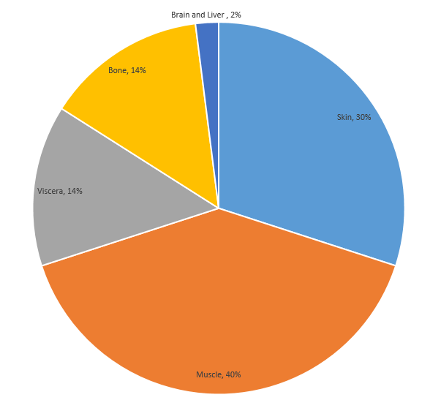
Dehydration
Water loss is not equal.
10% dehydration in rats ->
Symptoms:
Thirst
Dry mouth
Headache
Muscle cramps
Dark yellow pee
Dizziness (severe)
Sleepiness (severe)
Rapid heart rate (severe)
Rapid breathing (severe)

Slide 7
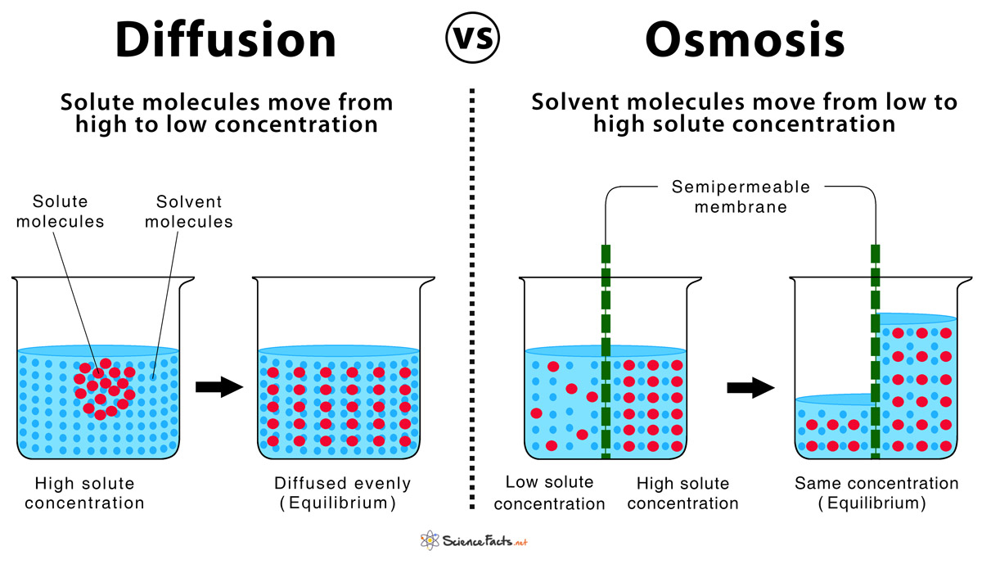

Slide 8
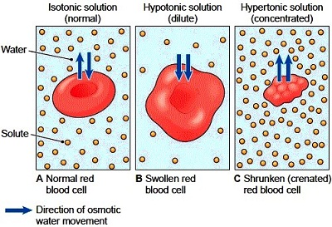

Slide 9
rehydration
osmosis
Isotonic (milk, pedialyte, some sports drinks)
Ideal for rehydration
Hypertonic solutions (soda, liquor) draw water into intestine
Can be dehydrating
Hypotonic (distilled water)
START PEEING BEFORE FULLY REHYDRATED
HIGHER RISK OF HYPONATREMIA
Best hydrating liquids have some sugars, proteins, electrolytes
https://www.cnn.com/2019/09/25/health/best-drinks-for-hydration-wellness/index.html

Slide 10
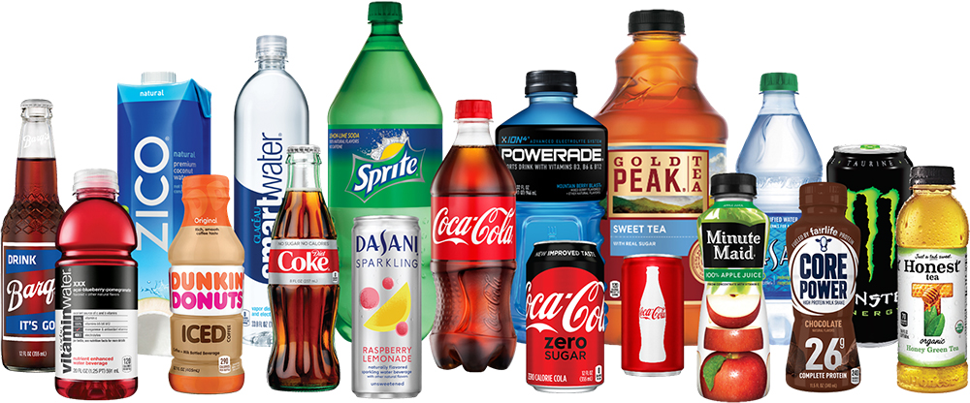

Slide 11
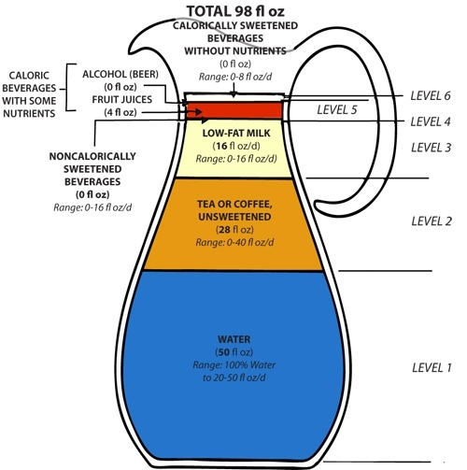
https://www.hsph.harvard.edu/nutritionsource/healthy-drinks-full-story/

Slide 12
Underhydration
Full details - https://link.springer.com/article/10.1007/s00394-018-01889-z
Is low water intake, in the absence of dehydration, associated with negative health or performance outcomes?
Urinary Tract infections
Diabetes (blood sugar regulation)
Cognitive performance
Endurance performance

Slide 13
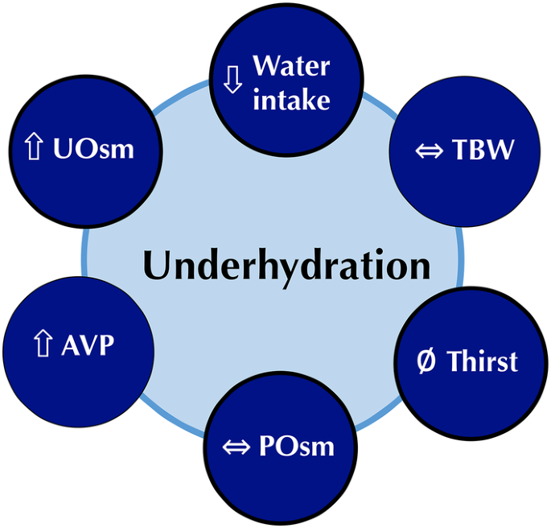
Chronic low water intake simulated increased vasopressin (ADH)
Increased urine concentration
Plasma concentration unchanged

Slide 14
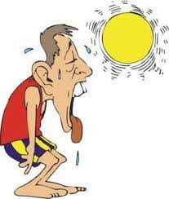
Recommendations
High variation in fluid needs
Gender
Age
Activity level
Temperature
Sweat rate
Electrolyte status

Slide 15
Recommendations (general)
AI is a good starting point
Pee should be light yellow (ADH concentration affects colour)
Combine with food
No need to supplement electrolytes unless you have an unprocessed diet

Slide 16
Recommendations – pre-exercise
For exercise longer than 1hr, or multiple workouts/day
Goal – Start exercise euhydrated
500ml – 1000ml, 1-2hrs before onset of exercise
Avoid stomach sloshing, excessive urination
Electrolyte/sodium supplementation may be useful

Slide 17
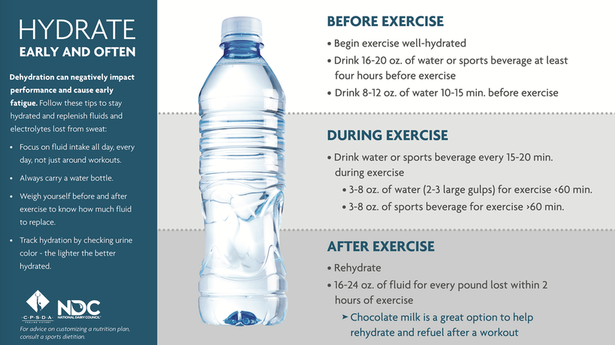
Recommendations – during exercise
Goal – Limit dehydration to <2% BW
Plain water up to 1hr
Sip frequently, drink to thirst
500-800ml/hr generally adequate
Electrolyte supplementation 1hr+
Drink with any food/gel intake

Slide 18
Recommendations – post-exercise
Goal – replace lost fluid based on body weight
Will overestimate sweat rate for exercise >3hrs
2cups (500ml) for every lb lost
Body weight baseline =
Avg of 3-5 morning weigh ins (after urinating)
Women may need more measurements to account for menstrual cycle
Sodium assists with water retention

Slide 19
Recommendations – special populations
Vomiting/diarrhea/GI conditions
May need iv fluids, blood test, additional supplementation
High blood pressure
Monitor sodium intake
Seniors
Decreased thirst drive
Extreme environments
Humidity, hot, cold, impermeable clothing
Athletes
Prolonged exercise, tournaments (recovery)

Slide 20
Questions??
Email me: joanna.ford@esso.ca
Links:
Acsm position stand: https://journals.lww.com/acsm-msse/Fulltext/2007/02000/Exercise_and_Fluid_Replacement.22.aspx
Underhydration vs dehydration: https://link.springer.com/article/10.1007/s00394-018-01889-z
Precision nutrition: https://www.precisionnutrition.com/all-about-dehydration
Healthy beverage guidelines: https://www.hsph.harvard.edu/nutritionsource/healthy-drinks-full-story/

