Slide 1
Learn to run, injury free

Slide 2
Why run?
Simplicity
Limited equipment
You can do it anywhere
Social Distancing
Run groups and races/events
Improve self-esteem
Set and achieve goals
Keep it interesting
Explore new locations
Get outside
Vitamin D
Stress release
Build stronger bones
Impact stimulates bone growth

Slide 3
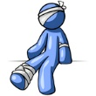
Barriers to running
Lack of Motivation
Lack of Time
Lack of Knowledge
Injury

Slide 4
Getting started
Build your foundation
Strengthen your connective tissue
Increase blood flow to the joints
Develop a more efficient stride
Reduce impact forces
Focus on consistency
Run 3x/week for 6 consecutive weeks
Slow down! Pace and distance are not important
Mix it Up
Alternate running and walking
Strength train 2x/week if possible

Slide 5
Build to 30 minutes
Week | Run 1 | Run 2 | Run 3
1 | (Run 1 min, Walk 1 min) x10 | (Run 1 min, Walk 1 min) x10 | (Run 1 min, Walk 1 min) x10
2 | (Run 2 min, Walk 1 min) x8 | (Run 2 min, Walk 1 min) x8 | (Run 2 min, Walk 1 min) x8
3 | (Run 4 min, Walk 2 min,) x5 | (Run 4 min, Walk 2 min,) x5 | (Run 4 min, Walk 2 min,) x5
4 | (Run 5 min, Walk 1 min) x4 | (Run 5 min, Walk 1 min) x4 | (Run 10 min, Walk 2 min) x2
5 | (Run 10 min, Walk 2 min) x2 | Run 15 min, Walk 2 min, Run 10 min | Run 20 min
6 | Run 25 min | Run 20 min | Run 30 min

Slide 6
Choosing shoes
Base your decision on comfort
Does my foot feel like it can move naturally?
Does the shoe squeeze my toes?
Narrow shoes can contribute to injuries.
Make sure your toes can spread out.
Women with wide feet – consider purchasing men’s shoes.
Do the shoes feel light on my feet?
Does my foot slide around in the shoe?
Shoe Terminology:
Motion control
Heel drop (aka heel to toe offset)
Stack height
Toe box
Outer, midsole, upper
Heel counter
Purchasing shoes online?
Check return policy
Consider multiple pairs
Read reviews
Save money by purchasing last year’s models

Slide 7
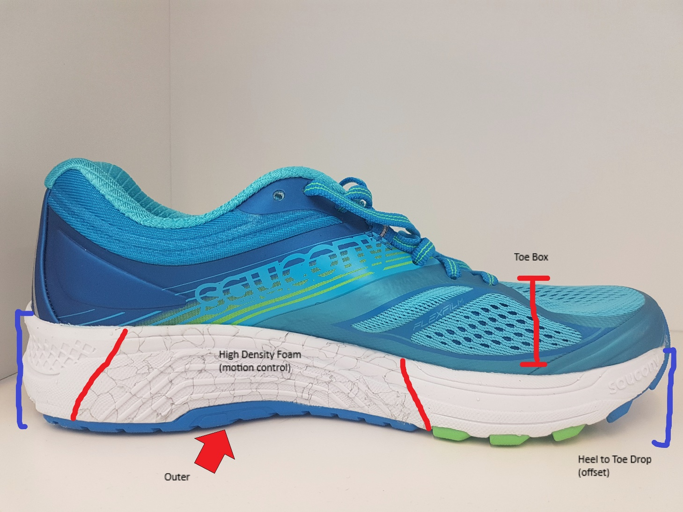
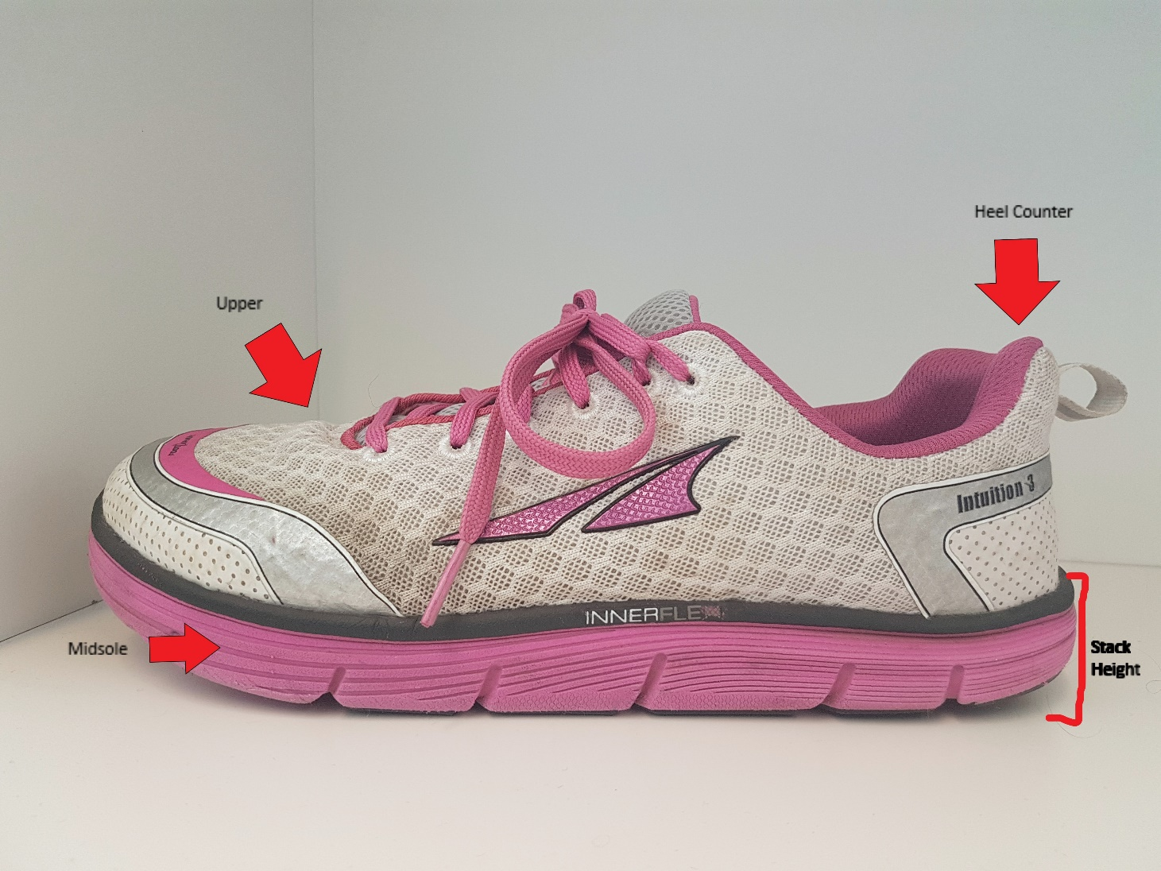
Shoe Anatomy

Slide 8
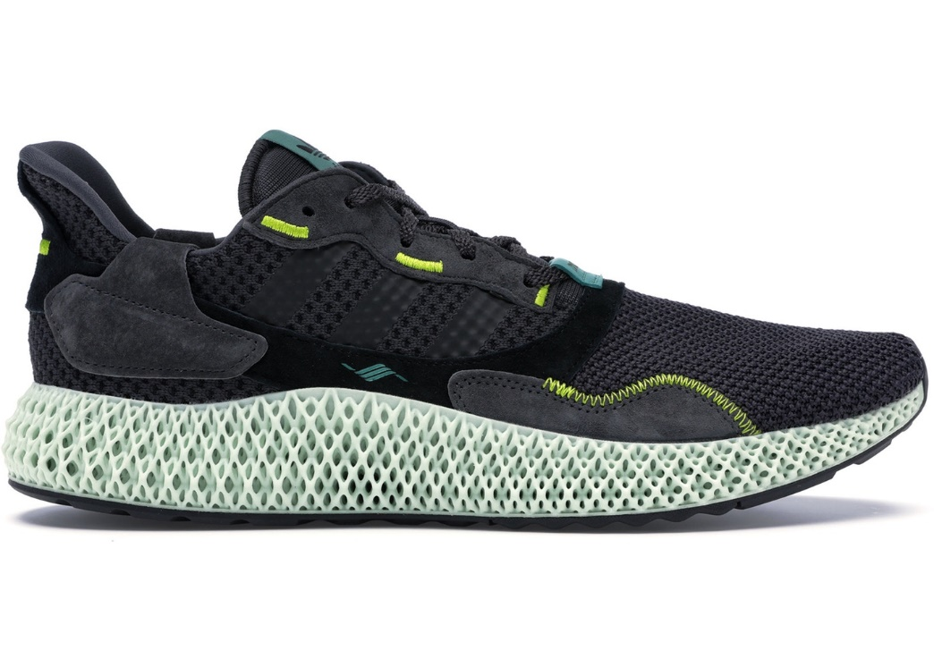
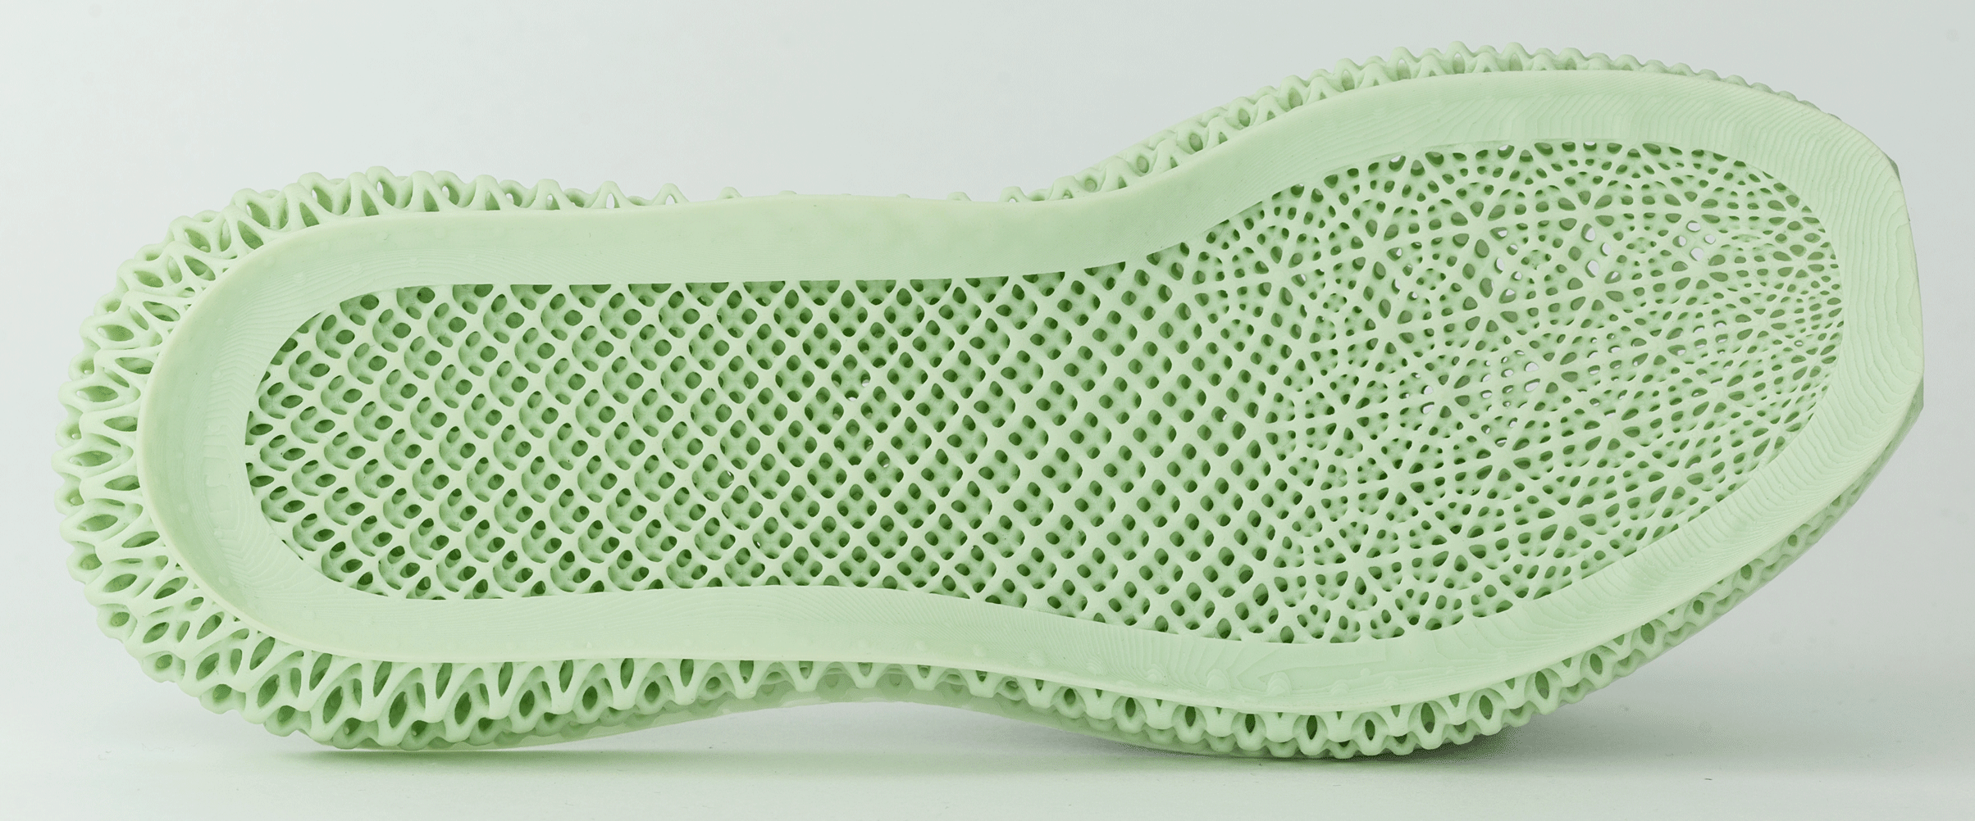

Slide 9
Running Form
Relax. As you run more, you will become more efficient.
Deficiencies in running form are usually the result of muscle imbalances.
The best way to correct these is via strength training exercises.
Key Exercises (start with 1 or 2 sets):
Step Ups – build to 3x8. (super detailed tutorial)
Knee Drives – build to 3x30s.
Calf Raises – build to 3x20 per leg.
Toe Raises – build to 3x20.
Hamstring Ball Rolls – build to 3x15 per leg.
Side Bridges – build to 3x45s. Work through progressions.

Slide 10
Running form (cont.)
Stretching has not been shown to reduce incidence of injury. However, if there is a lack of Functional Mobility you must work to increase your mobility to allow for proper form. Click here for an excellent massage/stretching routine targeting typical problem areas.
Functional mobility – the ability to move through the required range of motion for a specific activity.
Questions? Send me an email and we can set up a consult via webcam

Slide 11
Hurt vs harm
1) Did I experience any difficulty finishing my last training session ? 2) Are any of my aches or pains lasting longer than 2 – 3 days? 3) Am I excessively tired the day after my training session?
Pain during warm-up
If it goes away, continue and monitor.
If it goes away and comes back, stop workout and treat with ice. Refer to 3 questions.
Yes
No
Take the day off training.
Do not increase frequency, intensity or duration.
Contact physio/chiro.
Continue training, you are experiencing benign pain
Pain during workout
Stop if more than 4/10. Consult professional if more than 2 days.
Pain after workout
Onset shortly after, ice and reduce training intensity.
Onset next day, pain is likely DOMS. Continue as normal.
Full Article: http://www.endurance8health.com/2018/02/20/difference-hurt-harm/

Slide 12
Going Further
Want to run further?
Increase the distance of your long run by up to 15% each week.
OR
Add a 4th run/week
Want to run faster?
Add intensity to one run per week
Start with 30-45s accelerations to get used to the feeling of faster running. THEN
Introduce interval training.
Eg. 1min hard, 1min walk x5
Build to 10 intervals.
IMPORTANT: Do not increase intensity and volume at the same time. This is the most common way to get injured.

Slide 13
505 QP Wellness – virtual Race series
How Does it Work?
Track via Strava – 505 QP Wellness
Entry is free
Can be completed on treadmill or outside
Flexible Dates
Accountability
RACE #1
May 4-10
5km or 10km road race
Trail race (preset course)

Slide 14
Questions?
Check out our YouTube Channel and Subscribe
https://www.youtube.com/channel/UC2l9vI0bNPEEvSgJxy9qDEg
Check out our Website
http://www.505qpwellness.ca/
Follow us on Yammer
Calgary Campus Wellness Centre
Strava Club
505 QP Wellness

