Slide 1
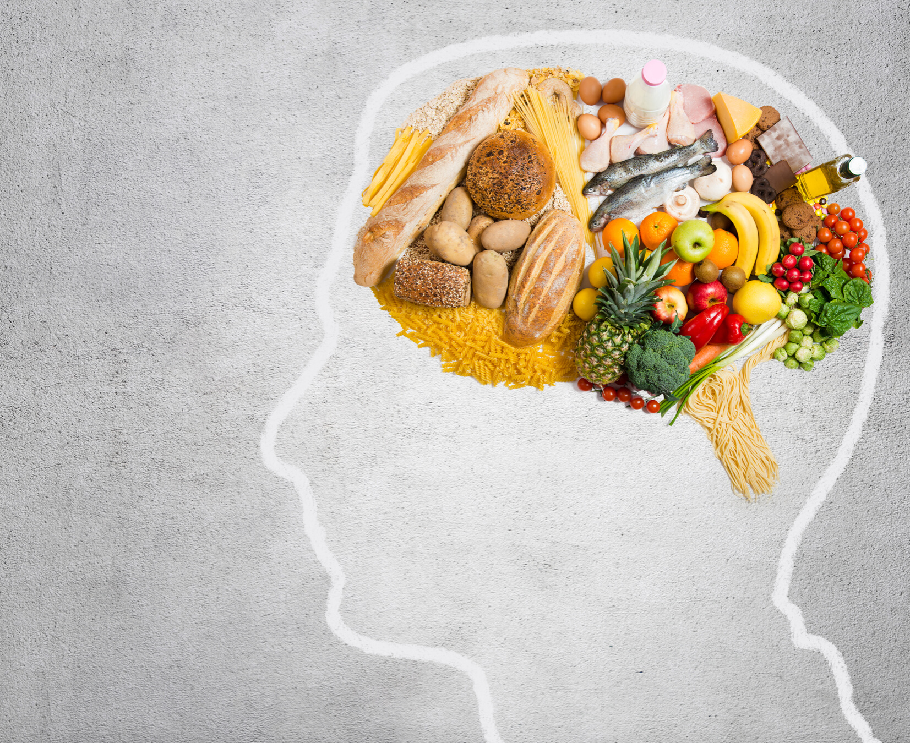
Food & Mood: The Role of Nutrition on Mental Health
Presenter: Andrea Clarke RD, RYT
from Nourished Freedom
Notes:
Welcome!
Spark conversation.
Why this topic?
What are you hoping to learn?
Any experts on this area here?
So I will be providing practical tips and the information on the slides pertaining to specific nutrients in a follow-up email for those who wish to receive them. If you have to leave early, please be sure to grab my business card or you can write down your email on this clipboard.

Slide 2
Disclaimer
The information in this presentation does not constitute, nor substitute for individual medical or mental health advice.
If you are experiencing mental health issues, don't ignore them. Please consult your doctor or other health care practitioner.

Slide 3
Hi! I'm Andrea Clarke.
REGISTERED DIETITIAN
YOGA TEACHER
NUTRITION THERAPIST
BUSINESS OWNER
@NourishedFreedomRD
www.nourishedfreedom.com
Notes:
Hi!
I am a______
Dietitians work in many different areas of practice, but the common theme is that we use evidence based research in advising the public on nutrition choices.
So a question I often get when giving these types of presentations is what is the evidence? In the field of mental health, we don't have many landmark studies but the evidence is rapidly growing. And a quote from a researcher from the 90's said this: " if no randomized trial has been carried out for our patient's predicament, we must follow the trail to the next best external evidence and work from there."

Slide 4
What you'll learn
OVERVIEW
Common Mental Health Issues
Role of Nutrition in Supporting Brain Structure & Function
Nutrients Crucial for Healthy Moods
Impact of Inflammation on Mental Health

Slide 5
Mental Health
THE STATE OF YOUR PSYCHOLOGICAL AND EMOTIONAL WELL-BEING
It is a necessary resource for living a healthy life and a main factor in overall health.
Notes:
What is Mental Health?
Good mental health allows you to feel, think and act in ways that help you enjoy life and cope with its challenges. This can be positively or negatively influenced by:
life experiences, such as:
family situation
the death of a loved one
financial and employment status
relationships with others, such as your:
friends
family members
co-workers
schoolmates
work or school environment
physical health, such as problems caused by:
long-term illness
alcohol or drug abuse
the type of community you live in
is it a supportive and trusting community or one where everyone keeps to themselves?

Slide 6
NATIONAL PERSPECTIVE
1 in 5 Canadians
experience a mental illness or addiction problem
Notes:
In any given year, 1 in 5 Canadians experiences a mental illness or addiction problem.1
By the time Canadians reach 40 years of age, 1 in 2 have—or have had—a mental illness.1

Slide 7
The economic burden of mental illness in Canada is estimated at $51 billion per year.
This includes health care costs, lost productivity, and reductions in health-related quality of life.
COSTS TO SOCIETY
Notes:
Why is mental health such a concern?
The economic burden of mental illness in Canada is estimated at $51 billion per year.
This includes health care costs, lost productivity, and reductions in health-related quality of life.

Slide 8
Anxiety Disorders
Generalized Anxiety Disorder (GAD)
Social Anxiety Disorder
Attention Disorders
ADD
ADHD
Eating Disorders
Mood Disorders
Common Disorders
Bipolar Disorder 1 & 2
Depression
Major depressive disorder
Postpartum & dysthymia
Seasonal Affective Disorder
Notes:
I won't go into too much detail here but there is generalized anxiety disorder, and social anxiety disorder.
Attention Disorders so
-Attention Deficit Disorder
-Attention Deficit Hyperactive Disorder
Eating Disorders:
Anorexia Nervosa
Bulimia Nervosa
Binge Eating Disorder
Mood disorders:
Bipolar 1&2
Major depressive disorder- clinical depression, immobilized, neglect self-care, can't go to work.
Postpartum-
Dysthymic- a general funk, not fully on major depressive disorder. Can go to work.
Seasonal Affective Disorder-change in mood and motivation.

Slide 9
Obsessive Compulsive Disorder
Post Traumatic Stress Disorder
Psychotic Disorders
Schizophrenia
Personality Disorders
OCPD, narcissistic
Boardline
Common Disorders
Substance Use Disorders
Alcohol
Substances (meth, cocaine, etc)
Opioid
Notes:
Obsessive Compulsive Disorder
Post traumatic stress disorder
Psychotic disorders
-Schizophrenia
Personality Disorders
-OCPD, narcissistic
-boarderline
Substance Use Disorder
-alcohol
substances
-opioids

Slide 10
Relationship to Food
Pleasure
Brain Function
Mood Regulation
Food & Mood
Notes:
When we eat something delicious, our brain floods with dopamine and serotonin and all the feel goof neurotransmitters. Social support of eating with others. Know as the Hedonic principles of food and beverages.
Food provides the essential nutrients need for proper brain function, and mood regulation
Food provides the building blocks to nourish the brain, just like our other organs.

Slide 11
The Vicious Cycle
Low Mood
Decreased
Appetite
IMPACTS BRAIN STRUCTURE
Decreased
Intake
Notes:
Low mood/mental illness/substance abuse
As this persists, results in poor intake because of decreased appetite, which leads to worse mood, and continuous cycle of poor intake, leading to changes in brain structure.

Slide 12
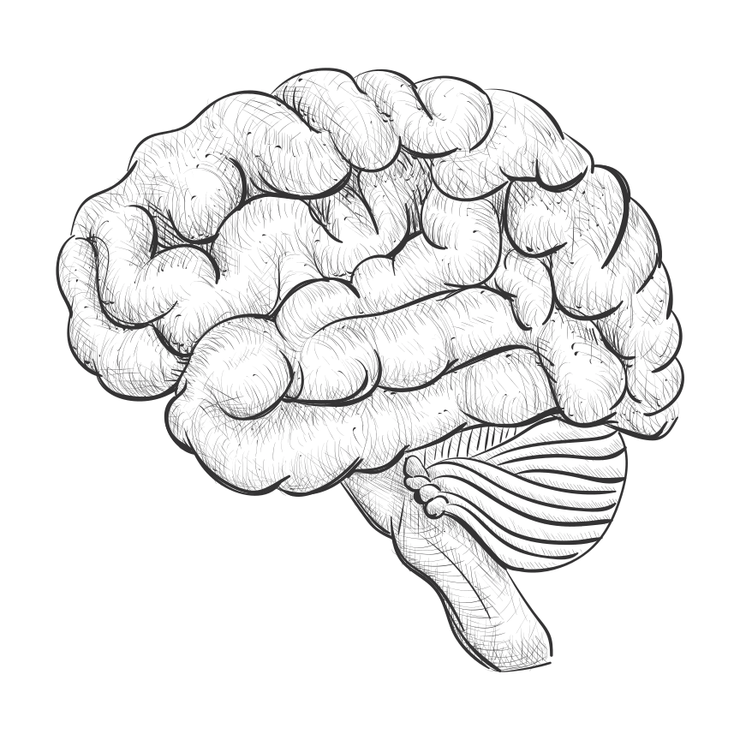
One of the last frontiers of medicine
Stigma of Mental Health
Practical limitations
Nutrition Structure Function
Our brains
Notes:
One of the last frontiers of medicine. Sitgma around mental health. Practical limitations-cant do blood tests, biopsies, imaging-cant find out whats going on at the neuron or synapse.
Nutrition informs/influences the structure of the brain, structure influences function
-diseases like Alzheimers and dementia.
-mood & mental health

Slide 13
BRAIN FUN FACTS:
-2% OF BODY WEIGHT
-25% OF BODY'S ENERGY DEMANDS
Brain Fuel:
Notes:
The brain needs the same nutrients as other organs in the body: protein, carbohydrates, fats, vitamins & minerals, and water.
Some basic physiology about the brain:
It is about 2% of the body's weight and yet takes up 25% of the metabolic energy demands. In terms of the body, it is an energy hog. There are about 84-86 BILLION neutrons (brain cells) and 100 TRILLION synapses (or points of contact)

Slide 14
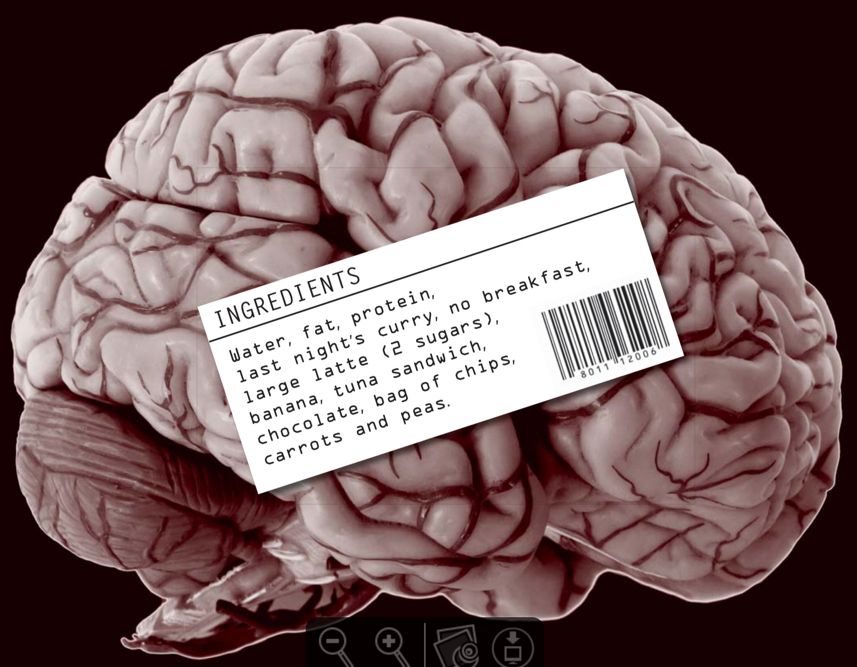
Notes:
Our brain is an organ just like the rest of our body and will be made up of what we feed it.

Slide 15
Notes:
A schematic of a brain cell. Many points of contact. Synapse is where some neurotransmitters are produced. Where the reactions takes place. Nucleus where the metabolism happens. Axon- where it connects the brain cells, a waxy, fatty substance coats the sheath for conduction.

Slide 16
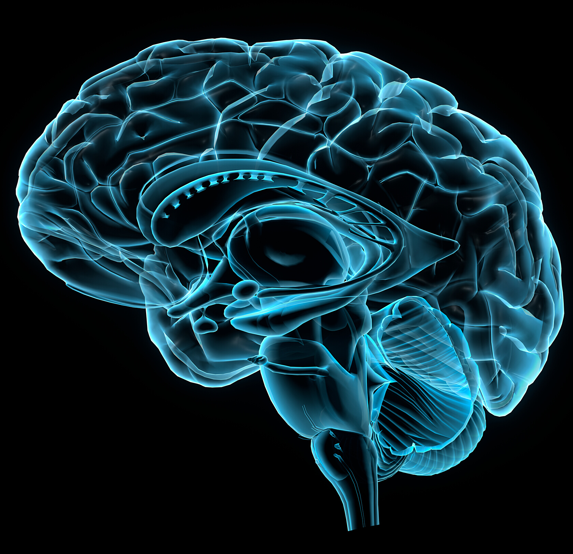
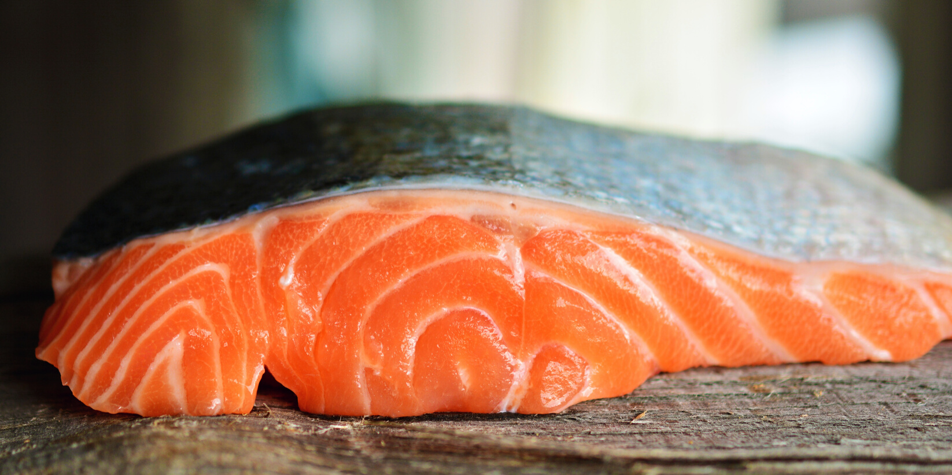
Brain Nutrition
40%
OMEGA-3'S
60% FATS
EPA: mood/behaviour
DPA: metabolize EPA and DHA
DHA: support neuronal structure
60%
Notes:
Brain is made up of 60% fat!
Of all the fats in the brain, 92% will be DHA.
NOT GETTING ENOUGH!

Slide 17
Recommended Intake
Minimum daily NEED:
250-500mg/day
Average intake 125-140mg/day
10% of population gets >250mg/day
Plant vs. Seafood sources
OMEGA-3'S
Notes:
We are not getting enough. Minimum 250-500mg/day, on average most North Americans are getting 125-140g/day and only 10% of the population are getting over 250mg/day.
It is important to note that while you can obtain omega-3's from plant sources like walnuts and flaxseeds, there are structurally different and humans have a very poor conversation rate of ALA to EPA and DHA.
Research has focused mainly on EPA and DHA and has skimmed over DPA. The support is strong for EPA and DHA for supporting mental health. Most supplements contain EPA and DHA (fish, squid, or algae based). New product on the market made from seal blubber, contains all three. Fish & seafood contain all three as well. Take away: all three are important. But EPA and DHA will suffice. lots of evidence to support this.

Slide 18
Brain Nutrition
FUEL
glucose & fatty acids
ketones
Notes:
Your brain can use both glucose (derived from the digestion of dietary carbohydrates AND from the conversion of dietary fats and proteins as needed).
The brain can use ketones as well. They're produced from fat for those who follow a ketogenic or low carb, high fat diet. Lots of way for the brain to get the fuel that it needs, definitely need a lot of fuel.

Slide 19
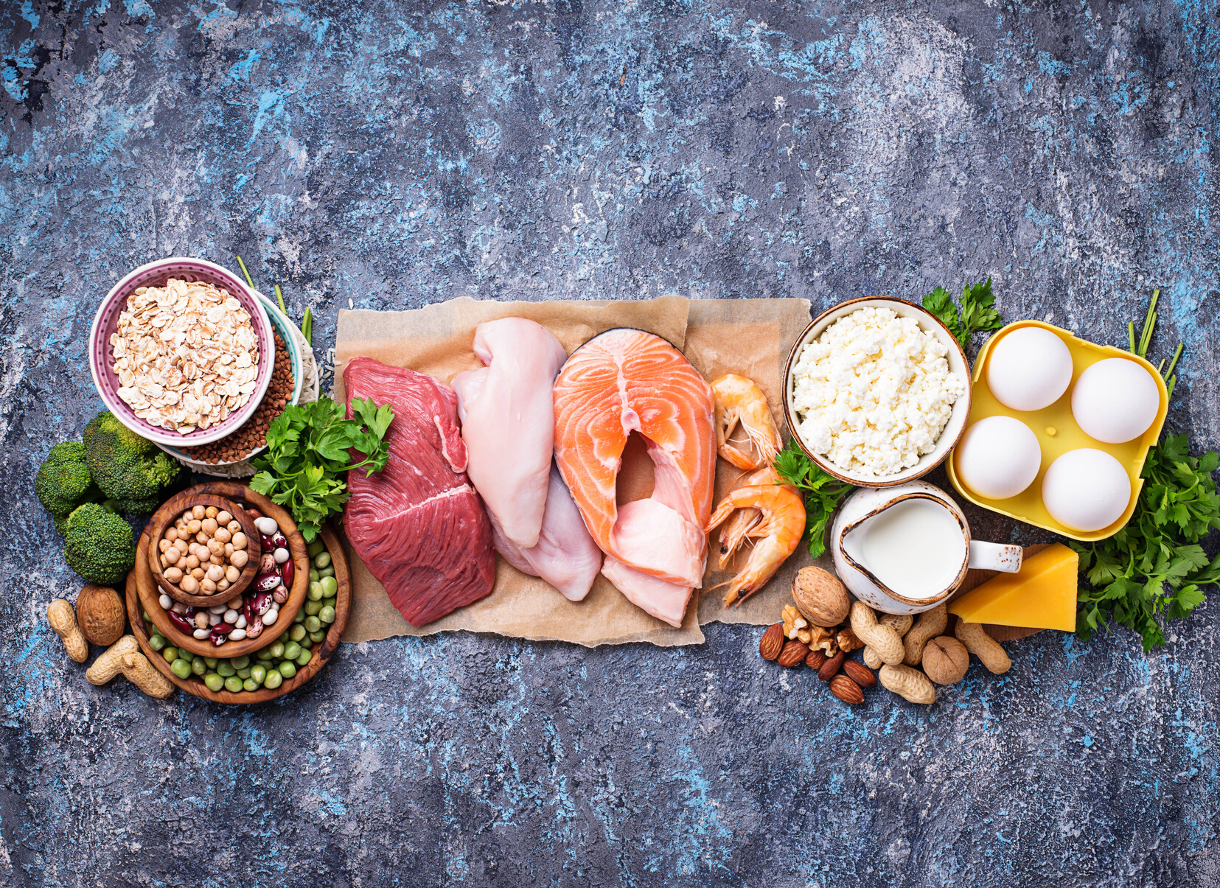
Brain Nutrition
PROTEIN
amino acids
used to make neurotransmitters
Notes:
Protein is digested and broken down into amino acids. Amino acids are the building blocks of neurotransmitters; the chemical compounds that your neutrons use to talk to each other.
Dozens of neurotransmitters:
Serotonin,
Dopamine
Nor-epinephrine
GABA
melatonin
Acetlycholine.

Slide 20
Brain Nutrition
VITAMINS & MINERALS
25 needed for good brain function and mental health.
Most important
B vitamins
vitamin D3
vitamin E
iron
zinc
magnesium
iodine
Notes:
Choline is a vitamin-like compound.
Adequate intake 425mg/day 55omg/day men.
Estimated the average person gets about half that amount.

Slide 21
Brain Nutrition
ANTIOXIDANTS
'Rust-proofing' the brain
Phyto-nutrients
Beta-Carotene
Polyphenols
vitamin C&E
ANTI-INFLAMMATORY
Phyto-nutrients
Vitamins
Minerals
Omega-3's
Notes:
Rust-proofing the brain.
phyto means plant. plant nutrients. Thousands found in the food supply. Help to prevent oxidation or damage to cells.

Slide 22
Brain Nutrition
LUTEIN & ZEAXANTHIN
uniquely concentrated in the brain
anti-inflammatory
appears to preserve brain function and slow cognitive decline
60 FATS
Notes:
Lutein & Zeaxanthin
Concentrated in the brain. Potent anti-inflammatory properties.
Older adults- lutein wish diets. There scores are much lower, ten years younger than biological age.
Healthy diet- lutein makes up 16% of carotenoids . Yellow colour. 66-70% percent of the brains.
Dark green vegetables, corn, egg yolks, avocados, green peas.

Slide 23
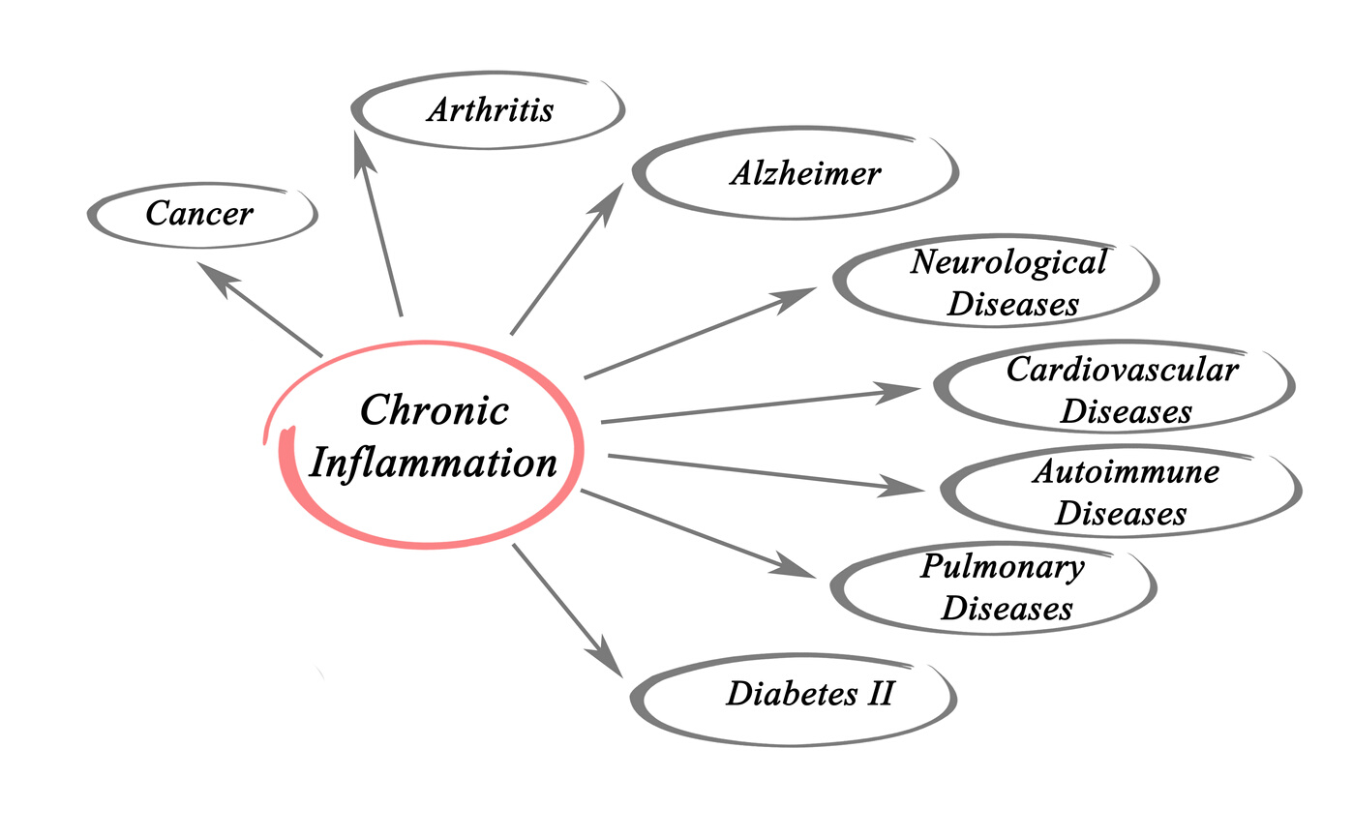
Inflammation
Medical
Autoimmune diseases, infections, malnutrition, chronic diseases, micronutrient deficiencies
Psychological
Stress, cortisol, adrenaline, long term stress.
Lifestyle
Poor diets, smoking, substance use, high volume training
Notes:
Inflammation is not bad, just the bodies attempt at self-producing. Heal process. Immune system. Inflammation because problematic when it becomes chronic and on going, low grade. A source of inflammation that is not being healed.
A cause and an effect of chronic disease.
Impact mood- chronic background inflammation with worsening depression, OCD, and anxiety.

Slide 24
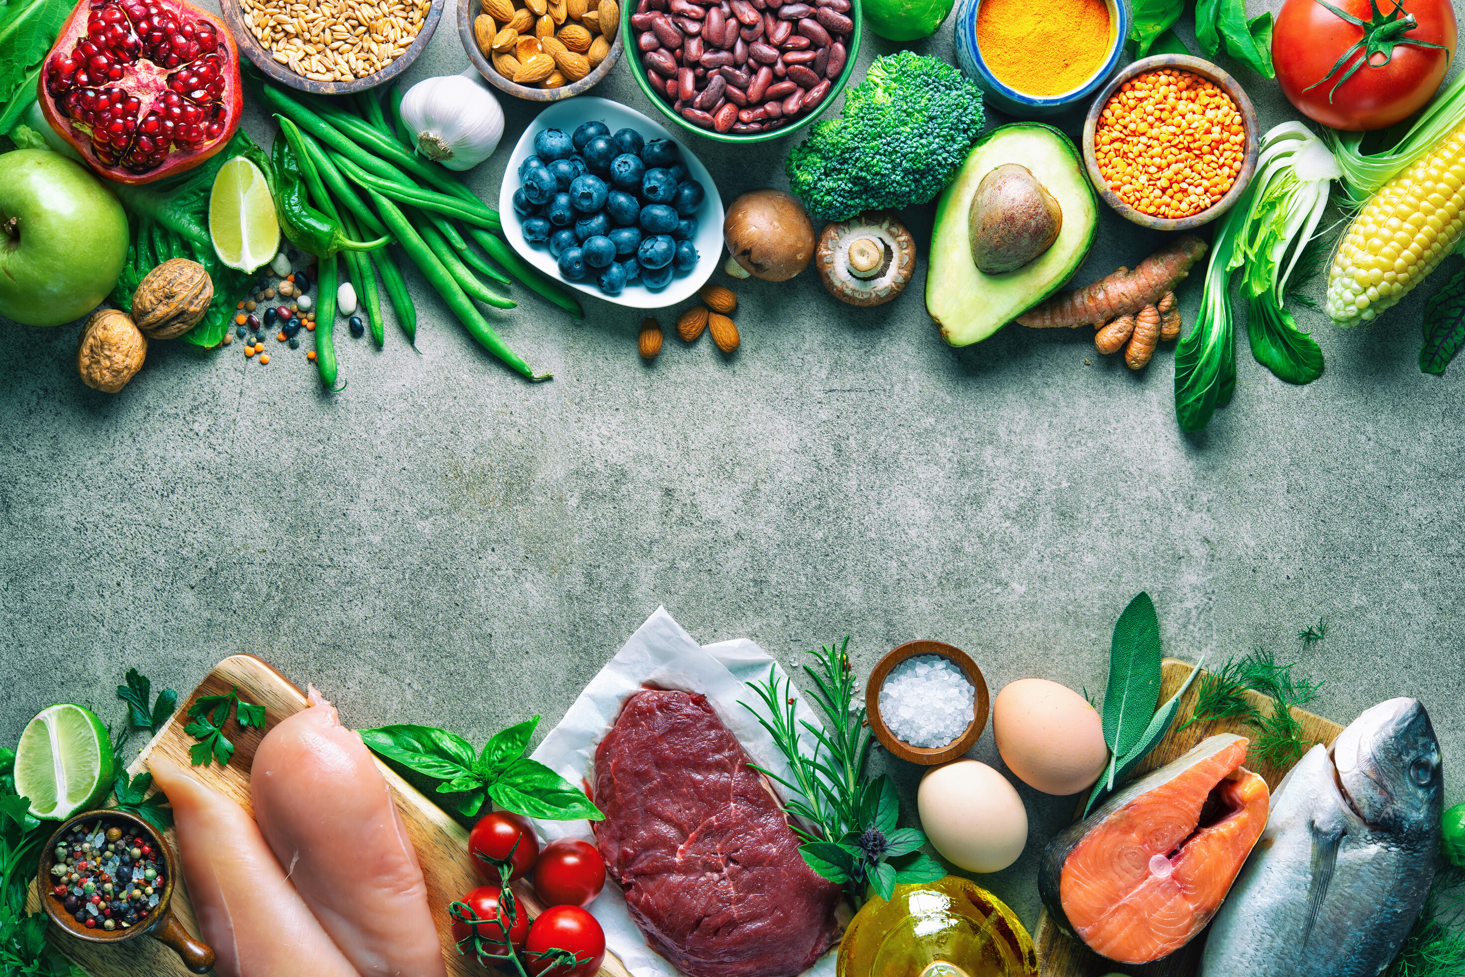
NUTRIENT-RICH
Plant & Animal foods.
MINIMAL ALCOHOL
Anti-Inflammatory
Diet
LIMIT ULTRA-PROCESSED FOODS
MORE OMEGA-3'S
Fish & Seafood Sources
Notes:
Nutrient dense foods. From both animal and plants. Increasing intake of minimally processed foods. Animal foods are nutrient dense, more concentrated in smaller serving size. It includes both.
Low alcohol.
Naturally low in ultra-processed food due to displacement.
More fish & seafood.

Slide 25
Nutrient Triage Theory
Short-term survival vs. long term health
Can impact brain/mental health
Notes:
To illustrate, if magnesium requirements are not ideally met, magnesium will be diverted to essential functions. Maintaining normal nerve and muscle function, and keeping a steady heart beat is more of a priority than ensuring the brain has enough magnesium to support your mood for example.
Given that many studies indicate most of us routinely miss the mark when it comes to meeting nutrient requirements; targeted supplementation of specific nutrients shown to support brain and mental health might be worth considering.
You cannot out medicate a poor diet.
No amount of mood stabilizers can make up for a nutrient deficiency.

Slide 26
Nutrients Crucial for Healthy Moods

Slide 27
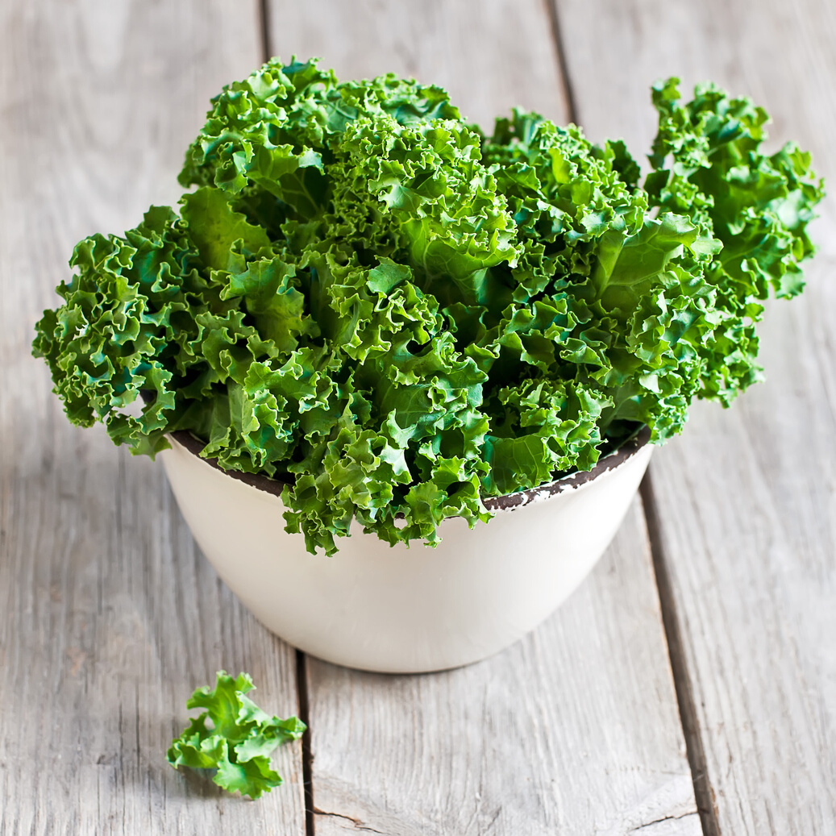
BENEFITS
Cognition
Memory
Learning
Lutein & Zeaxanthin
INTAKE
Average: 2mg/day
Benefit: 6-10mg/day
FOOD SOURCES
Dark green/leafy vegetables
Corn
Egg yolk
Avocado & green peas
Notes:
Lutein & Zeaxanthin: carotenoids benefits cognition, memory, and learning.
Low intakes associated with mood changes and mood disorders, and poor
To give you an idea, a cup of cooked kale has 23mg.
Supplements look for something with both. 2-3mg in a multivitamin unless in an eye specific formula.

Slide 28
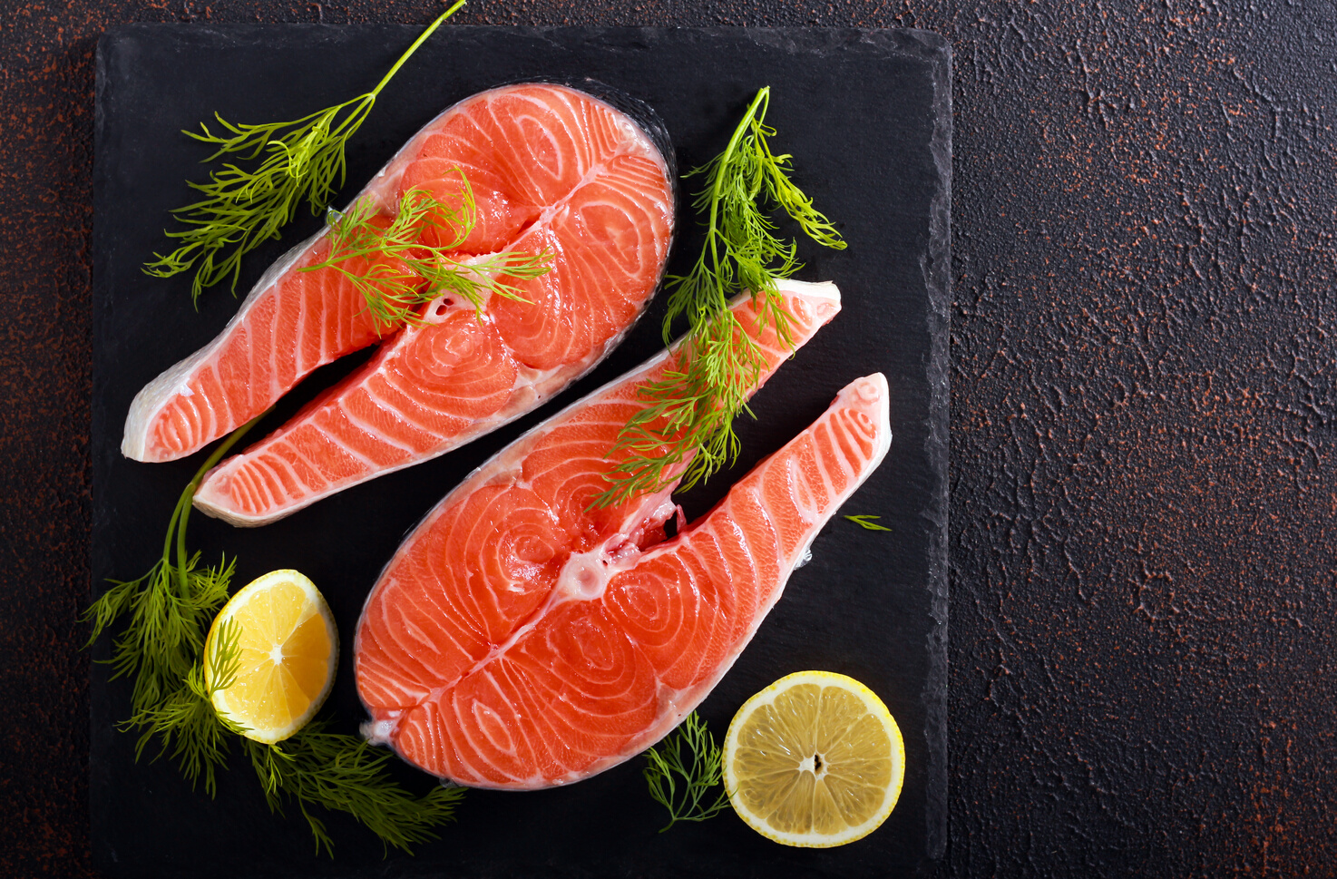
BENEFITS
Depression/Anxiety
Boarderline
ADHD
Alzheimer's risk
Cognition
INTAKE
Omega-3's
1500-2000mg/day
3:1 EPA to DHA
8-10 weeks
FOOD SOURCES
Fish & Seafood
Omega-3 fortified eggs
Supplements (fish, squid, seal, algae)
Notes:
Omega-3's
Best sources:
fish & seafood
fortified eggs
supplements
EPA: mood
DHA: structure
Saturation: 8-10 weeks. The old fats have to turn over in the brain.

Slide 29
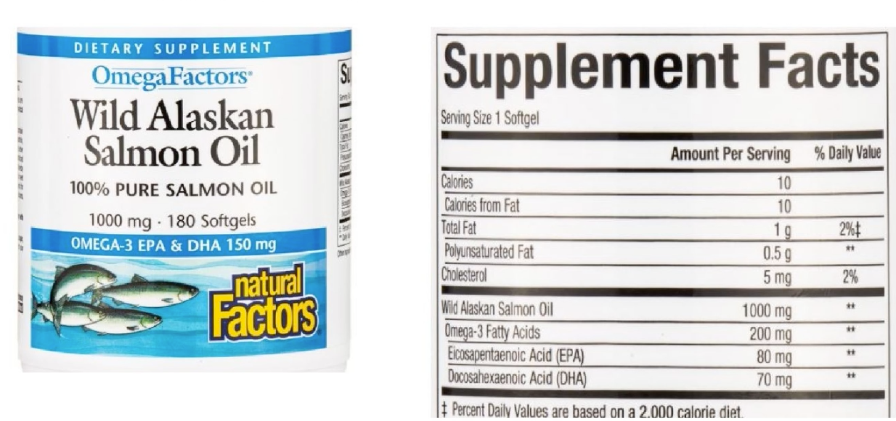
Notes:
States 1000mg of salmon oil but only 80mg of EPA and 70mg DHA. Read carefully.
Vegetarian Brands include NutriSea, Flora DHA Vegetarian Algae, Sisu.

Slide 30
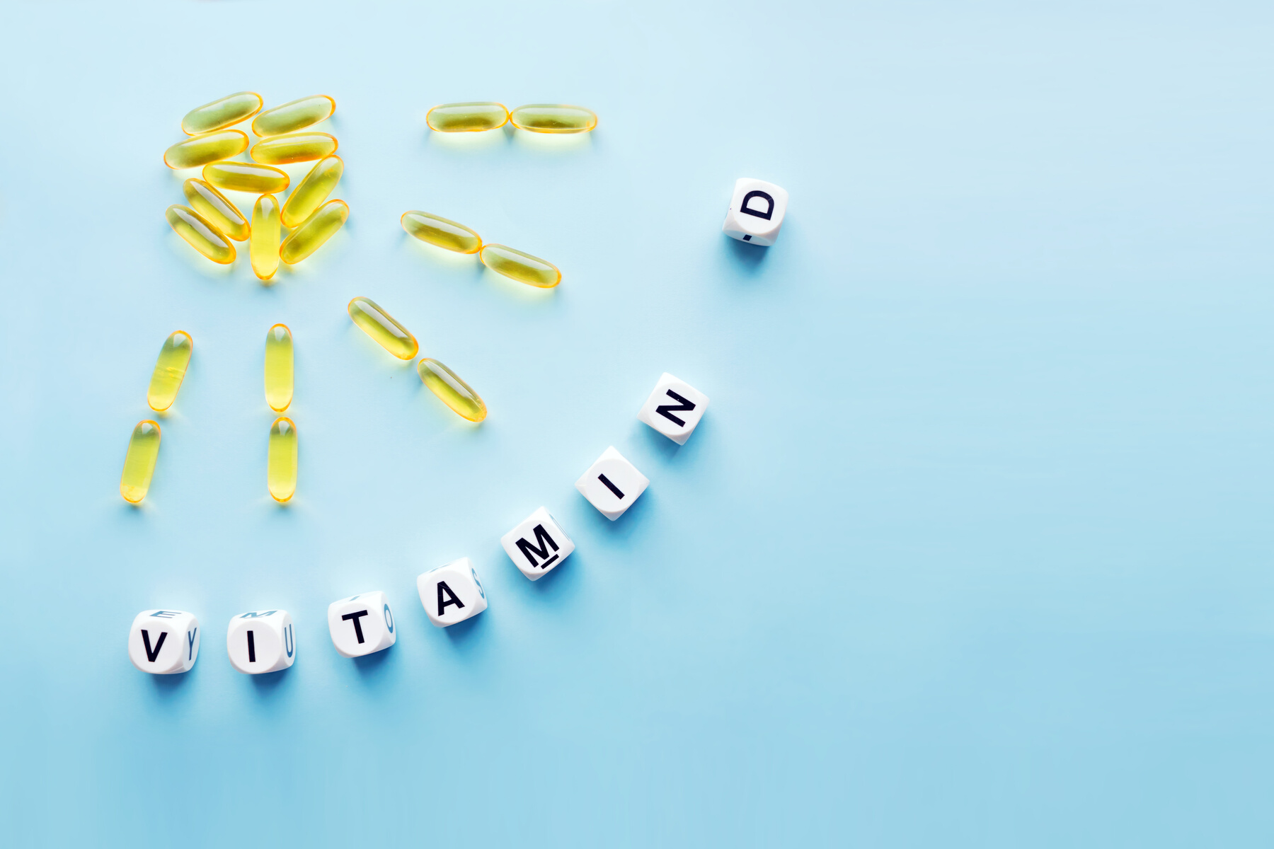
BENEFITS
Depression/Anxiety
Cognition
Promising evidence:
ADHD
Bipolar
Schizophrenia
INTAKE
Vitamin D3
1000-2000 IU/day
Take with largest meal
saturation: 8-10 weeks
FOOD SOURCES
Fish & Seafood
Fortified milk
Egg yolk
Notes:
Be sure its vitamin D3 not D2 which is less potent.
Again, 8-10 weeks to reach benefits, give it time.

Slide 31
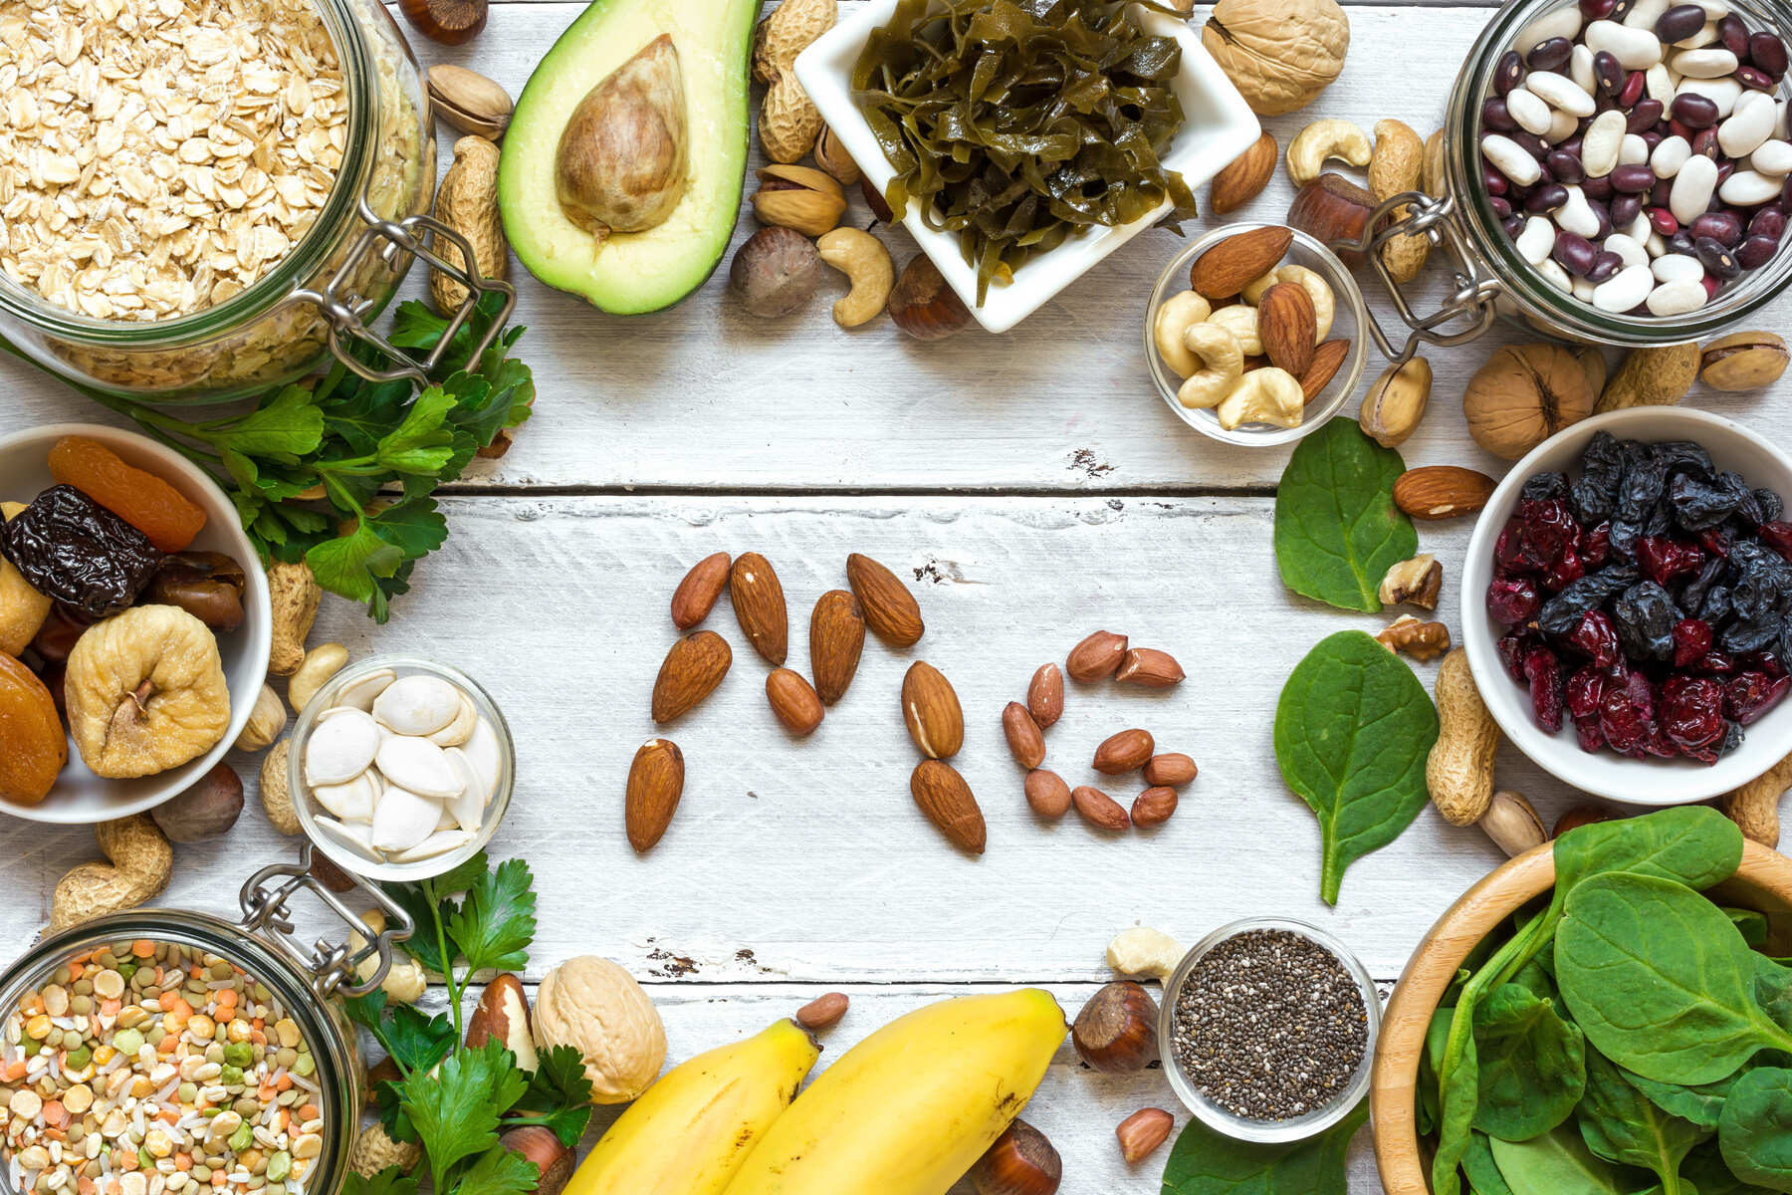
BENEFITS
Depression/Anxiety
Premenstrual cycle
ADHD
May support
Sleep
INTAKE
Magnesium
Anecdotal 200-400 mg before bed
500-1200mg elemental magnesium
125-300mg/meal
125-300mg @bed time
FOOD SOURCES
Dark leafy green vegetables
Nuts & Seeds
Legumes/Tofu
Seafood
Chocolate
Notes:
Magnesium is great, overall brain and mental health nutrient. As a mineral, it's combined with other compounds to form different salts.
This matter because the types of salt influences how well magnesium is absorbed by your body. The least absorbable is magnesium oxide. Go fo supplements that contain magnesium citrate, bisglycinate or glycerinate or malate.
typical effective doses are 200 mg of elemental magnesium, twice a day.

Slide 32
BENEFITS
Depression/Anxiety
Cognition
Dysthymia
May help with
ADHD/ADD
Anxiety
B Vitamins
INTAKE
Few mcg to 100mg, 50 mg standard dose
Synergy with adequate omega-3's l
125-300mg @bed time
Notes:
Bvitamins play a central role in brain health. Because they work together, its best to take them together.
B complex can be bough as a standalone or as part of a multivitamin. It is important to be conscuiouenscious of folate. Keep it to a max of 1mg per day, per dosage.
B vitamins can reduce the risk for cognitive decline when the brain has ample omega-3 fats in its neurons. A great example of synergy.

Slide 33
BENEFITS
Food freedom
Weight stabilization
Reduces risk of eating disorders
Flexible eating
INTAKE
Daily
guided by hunger and cravings
eaten with awareness
contains no traces of guilt, morality, or shame
Vitamin JOY
FOOD SOURCES
All food & no food, depending on the eater
Notes:
Benefits:
Food freedom
Weight stabilization
Reduces risk of eating disorders
Flexible eating
Daily Intake
guided by hunger and cravings
eaten with awareness
contains no traces of guilt, morality, or shame
Food sources:
all foods and no food depending on the eater.

Slide 34
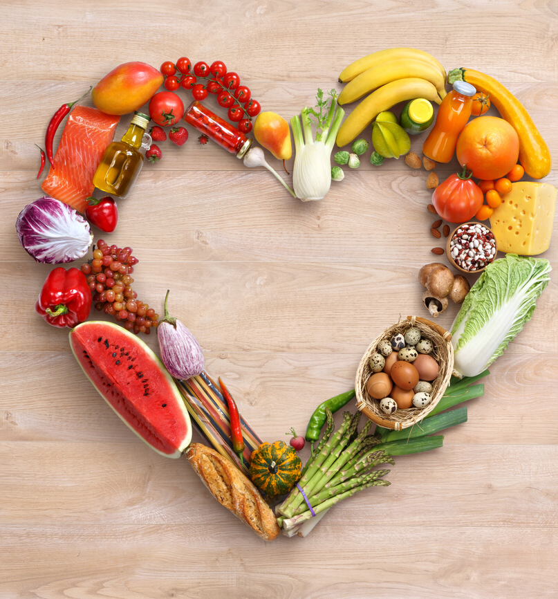
Wrap Up
1. Your brain needs quality nutrition to be at its best.
2. A helthy diet is the foundation to supporting healthy moods.
3. It's never too late to nourish your brain with a healthy diet
What you eat and drink affects your brain structure & function
Supplement as needed
Notes:
1. Your brain needs quality nutrition to be at its best.
A helthy diet is the foundation to supporting healthy moods.
3. It's never too late to nourish your brain with a healthy diet

Slide 35
CONTACT ME TO BOOK A CONSULT!
Andrea Clarke RD, RYT
Nourished Freedom
Phone Number
403-402-5395
E-mail Address
Thank you
andrea@nourishedfreedom.com

