Slide 1
Trigger Point Therapy for the Office Athlete
What is it, and how can you use it to improve your function?

Slide 2
A Patient’s Perspective
Endurance athlete transitions to office job
Experiential knowledge
Trained practitioners
RMT
Chiropractors
Osteopaths

Slide 3
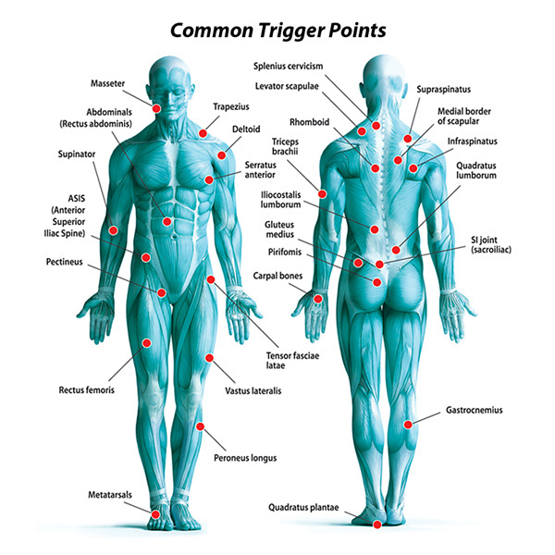
Trigger Point Description
Sore spots on the muscle
Palpable nodules or tight bands of muscle fibres
Often elicit a twitch
Refer pain

Slide 4
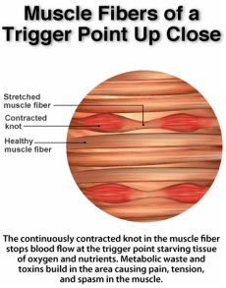
But What Are They?
No consensus in the scientific literature, but there are some clues:
MRI/MRE shows up to 50% higher tension compared to surrounding tissues
Biochemical markers (ACH, Serotonin, Noradrenaline, low pH)
Electrically active

Slide 5
Two Types
Latent
No spontaneous pain
Affects muscle function
Pain on palpation only
Active
Causes pain at rest
Referred pain on palpation, similar to complaint

Slide 6
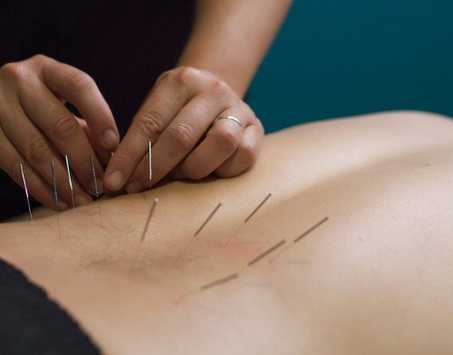
Treatment Modalities
Needling
Local Injections (anesthetic)
Acupunture
Myotherapy – manual pressure using thumb/knuckles/elbow etc.
Stretch and Spray

Slide 7
Effectiveness
High Variation
Dependent on injury/individual
Skill of practitioner
May require a single or multiple treatments
Must be followed up with strengthening exercises
Weak evidence due to small study size
Headaches and migraines – reduce intensity, severity and frequency
Low back pain – best when combined with other therapies

Slide 8
Soft Tissue Release (STR)
“The Soft Tissue Release Handbook”. Sanderson and Odell. 2013.
AKA – Active Release Therapy
Lock – Lengthen – Release
Lock – Surface area (start broader), Pressure (start lighter), Direction (angled vs direct)
Lengthen – Active (patient moves), Passive (therapist moves), Weight bearing, Resisted.

Slide 9
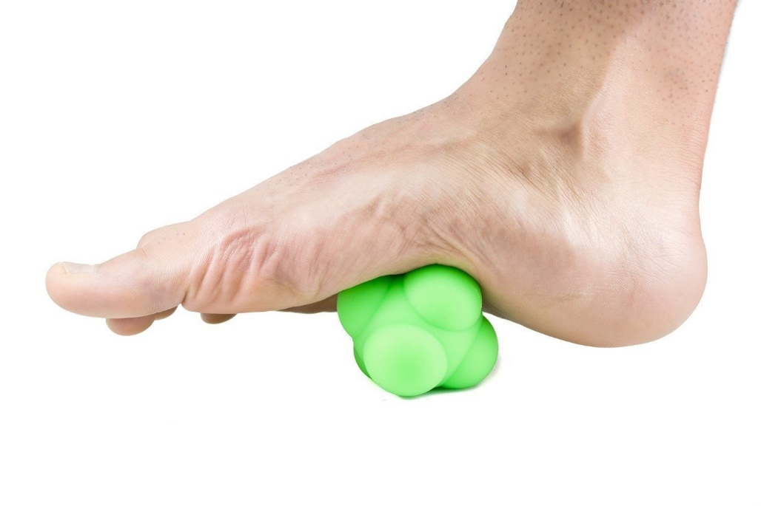
Calf/Shin/Foot
Toe muscle activation
Big toe extension
Ankle dorsiflexion
Larger-smaller implement (tennis ball, lacrosse ball, golf ball, smooth rock, Sharpie lid, knuckles)

Slide 10
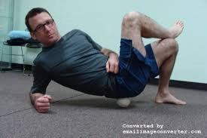
Piriformis - PITA
Medium size implement (roller, medicine ball, lacrosse ball)
Active, passive or resisted
Warm up the muscle – quite uncomfortable

Slide 11
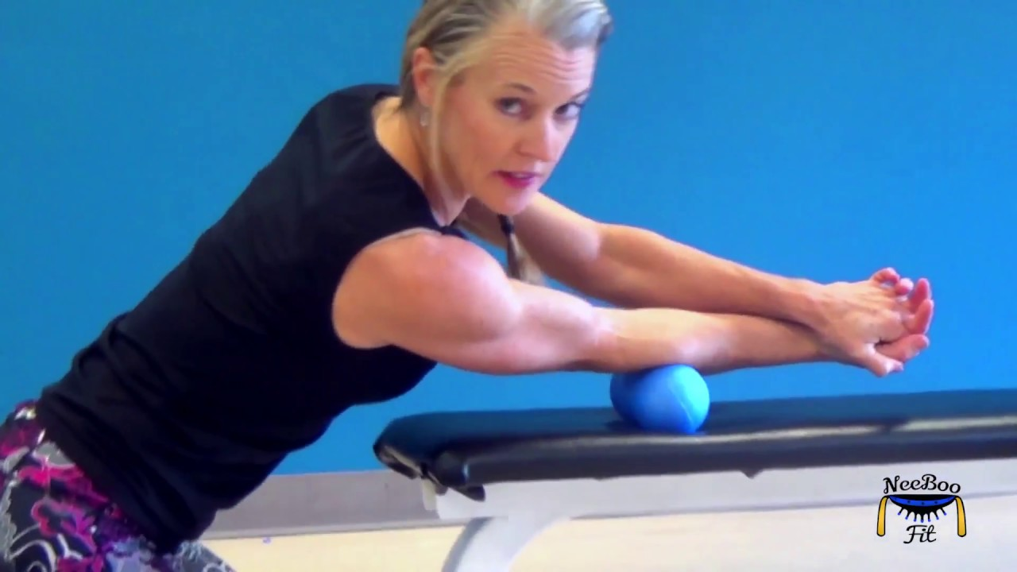
Elbow
Foam roller, dumbbell, dowel to warm up muscle
Fingers/knuckles, golf ball for trigger point
Active or passive

Slide 12
Choosing a Therapist
Should gain noticeable relief within a couple of visits
Most of the time should treat away from the painful area
Should give you at home myofascial release exercises and strengthening/stretching exercises
Beware of rest
Should not cause excessive bruising.

Slide 13
Resources
“The Soft Tissue Release Handbook”. Sanderson and Odell. 2013.
Intended for use by therapists
Gives a very good overview of the injury process, and the rational behind TPT
Medline – free with Calgary Public Library membership
For those who want to know the current scientific research
“Anatomy Trains”. Thomas Myers, 3rd Ed.
All about fascia

