Slide 1
SLEEP
practical tips to improve our sleep quality

Slide 2
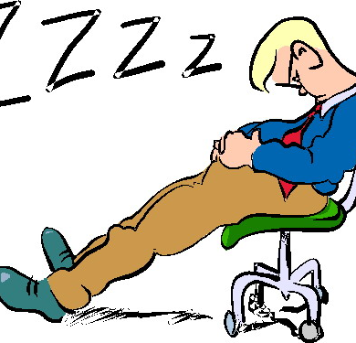
Why do we need sleep?
Memory consolidation
Muscle growth
Tissue regeneration
Hormone production

Slide 3
Sleep and your health
Heart disease
Increased risk of heart attack
Increased blood pressure
Congestive heart failure

Slide 4
Sleep and your health
Diabetes
Reduced glucose tolerance
Hormone disruption (insulin)
Weight gain

Slide 5
Sleep and your health
Mental health
Energy level
Depression
Anxiety
Negative feedback loop

Slide 6
Sleep and your health
Obesity
Ghrelin and Leptin
Cortisol
Reduced Metabolism (TSH)
Increased carb intake
More time to eat

Slide 7
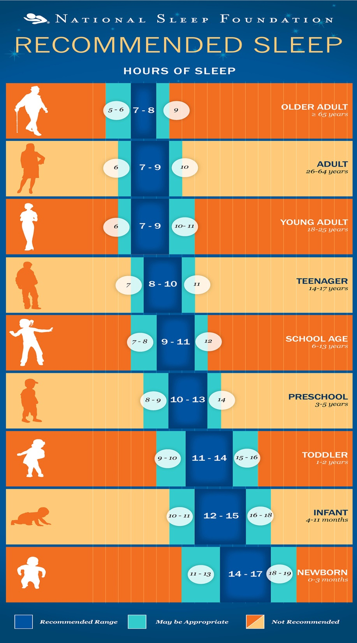
How much sleep is enough?
Individual
Basal Sleep Needs
Sleep Debt

Slide 8
Individual factors
Are you productive, healthy and happy?
Overweight?
Chronic Disease?
Require Caffeine?
Sleepy while driving?

Slide 9
How do I get more sleep?
Consistency
Routine
Environment
Exercise
Add 30min

Slide 10
Sleep stealers
Caffeine
Alcohol
Heavy or spicy meals
Naps
Screens
Cigarettes
Too much water

Slide 11
Sleep Enhancers
White noise
Blackout blinds
Light snack
Mattress/pillows
Progressive relaxation
Journaling

Slide 12
Useful Links
www.precisionnutrition.com
Search “sleep”
www.sleepfoundation.org

