Slide 1
Get Your Head in the Game
How to turn wants into action

Slide 2
Sound Familiar?
I’m going to try to…
I wish I could …
I want to start …
I am planning on …

Slide 3
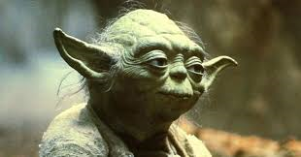
DO OR DO NOT, THERE IS NO TRY

Slide 4
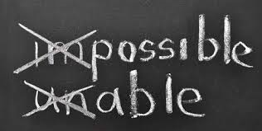
Change your language
I’ll try to …→ I WILL do
Commitment
I think I might → I KNOW I will
Self-belief
I have to → I GET to
Embracing the process

Slide 5
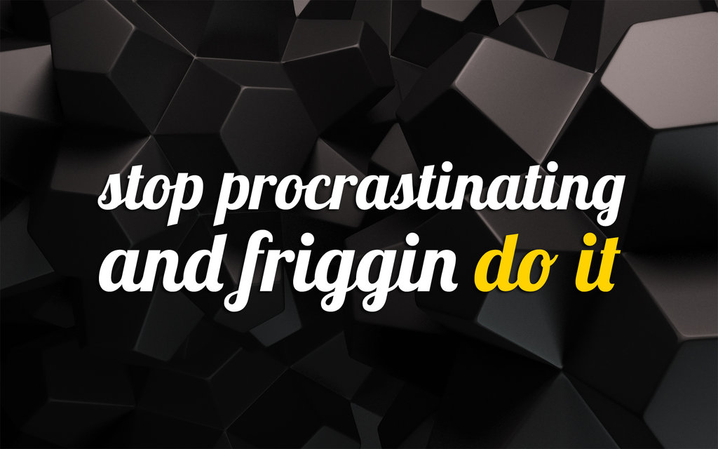

Slide 6
I’m going to make some basic assumptions; you have the desire to change and you have a reasonable amount of will power.
Stop berating yourself. You just need the right tools, knowledge and enough time.

Slide 7
Setting smart goals
Specific
Measurable
Action-oriented (vs Outcome-oriented)
Outcome – factors beyond our control
Action – factors that are within our control. AKA process goals
Realistic
Timely
Eg. I will lose 20 lbs in 10 weeks.

Slide 8
The process
The process (your action steps) are within your control
Eg. I WILL exercise for one hour each day, 5x/week. I WILL follow this schedule for 2 months.
Document the process
Watch your language
Process goals are easier to set if you truly understand your WHY?

Slide 9
Notes:
Why is it that some leaders and organizations are able to inspire greater loyalty and engagement among their
customers and employees alike? How are they are able to achieve and sustain inordinate amounts of success for years on end?
Whether they realize it or not, all great and inspiring leaders and organizations think, act and communicate in the same way... and it is the complete opposite from everyone else.
Every single organization on the planet, even our own
careers, function on three levels:
1. What we do
2. How we do it, and
3. Why we do it.
When those three pieces are aligned, it gives us a filter through which to make decisions. It provides a
foundation for innovation and for building trust. When all three pieces are in balance, others will say, with
absolute clarity and certainty, “We know who you are,” “We know what you stand for.”
This simple idea is The Golden Circle. It is a concept discovered by optimist and author Simon Sinek.

Slide 10
Finding your why
“What” is the outcome, “How” is the process, and “Why” is your motivation.
The “why” comes from our limbic system, and it influences all of our decisions.
Ask yourself: What do I stand to gain? What will I lose?
Write your answers down, this is “Your List”
Not an easy process

Slide 11
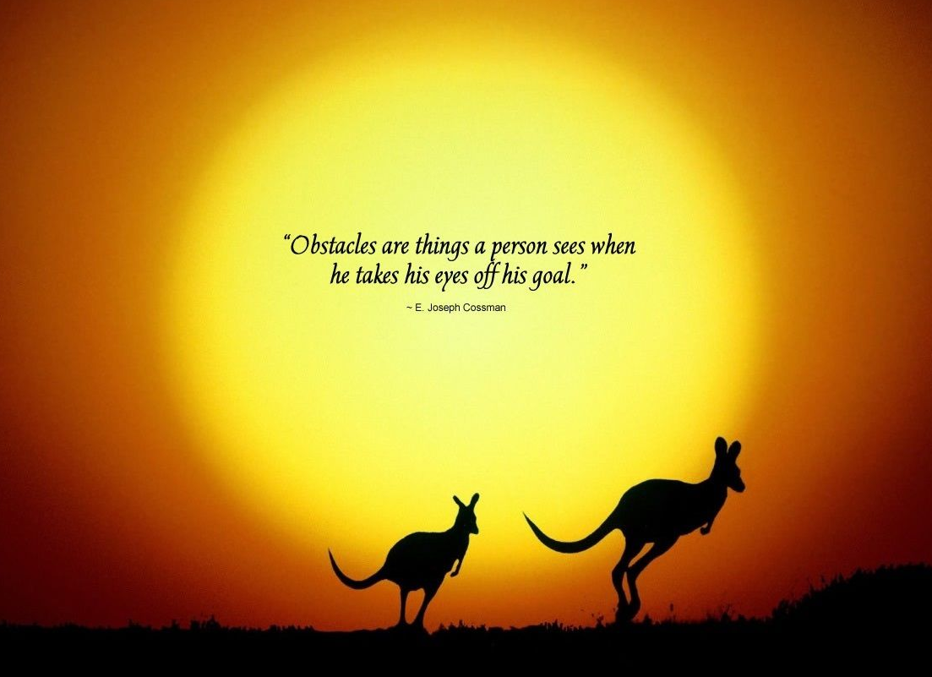
roADBLOCKS TO CHANGE
Procrastination
Lack of education
Perceived lack of time
Self-belief
SMART goals that aren’t so smart

Slide 12
Procrastination
No Sense of Urgency
Timeline
“I can do it tomorrow”
You don’t really care, you haven’t found your “why”
Refer to Your List

Slide 13
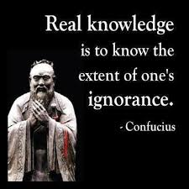
Lack of education
Don’t know where to start
Injury
Ineffective strategies
Unreasonable expectations

Slide 14
Example
I wish I could … run 10km.
Unreasonable expectations
I think I could build up to 10km in a month.
Ineffective strategies
I’m just going to go out and see how far I can run.
Don’t know where to start
Am I running fast enough? Slow enough? Far enough? Often enough?
Injury
I read that heel-striking is bad, so I’m going to try to land on my forefoot.

Slide 15
Perceived Lack of time
Occasionally this is true … but more often than not you just need to get creative.
Commute
Down time
How you spend your time is a reflection of your priorities
Take 3 days to track your time (include a day on the weekend)

Slide 16
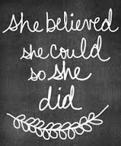
Self-belief
Set small, manageable goals which you can build from
Keep a record
Test yourself (the “M” in SMART)
Find help
partner with a similar goal, personal trainer, dietician, financial advisor etc.

